Slide 1


Welcome

Slide 2

National Dignity Council Aims to promote the importance of ‘Dignity’ for all through:-
To lead in raising awareness of Dignity and its importance in delivering excellent services.
Developing clear guidelines to raise citizen’s awareness on their right to access respectful dignified and compassionate services
To lead and inspire people to take action to promote Dignity
To lead and stimulate a National Dignity Campaign.
To support and maintain growing networks of Dignity Champions
Inspire champions to be true to their role and uphold the ten Dignity Dos
To lead in designing, planning and promoting an annual National Dignity Action Day.
To ensure the sustainability of the National Dignity Council.
Notes:
NDC council members – respond to requests to present.
Council and its immediate stakeholder group works in partnership with the NHS Confederation – Human Rights Commission – local employers – contributed to the PEAT assessments – members on the DANi inspections – Members on Nursing Care and Quality Forum,
Its about promoting it every day –council members have worked with LA.s for example Walsall - designed audits to inspect on dignity for anyone to use – we work with poor quality providers to help them improve their services–
The Council communicates with Champions through the Facebook page and the Discussion Forum.–
Other sources of support are for example Kissing it Better – Books and films by Amanda Waring -

Slide 3
Where do we start to learn about dignity?
Notes:
Its important we start as soon as possible if we can teach children to understand what is meant by respect, we can provide a really good start but it has to be about modelling good practice. You cannot expect someone to treat you with respect if you do not reciprocate.
The Children's dignity cards take the Dignity Do’s and put them into a language that has meaning for young children.

Slide 4
How do you define dignity?
Notes:
Think about what dignity means to you and the words that you use when you feel you have been treated with respect and dignity.
Can be done as a small group or individual exercise.
It isn’t easy to describe dignity in a few words, often we can more easily define what it isn’t that what it is.

Slide 5
Definition of dignity
Dignity consists of many overlapping aspects, involving respect, privacy, autonomy and self-worth
a standard dictionary definition: a state, quality or manner worthy of esteem or respect; and (by extension) self-respect.
Dignity in care, therefore, means the kind of care, in any setting, which supports and promotes, and does not undermine, a person’s self- respect regardless of any perceived difference.
While ‘dignity’ may be difficult to define, what is clear is that people know when they have not been treated with dignity and respect
SCIE- Dignity in care guide
Notes:
Some definitions that others have come up.

Slide 6
Dignity is:
Kindness
Respect
Compassion
Notes:
But perhaps we can sum it up by saying that dignity is one or all of the above.

Slide 7
When was the last time you were
not
treated with dignity
and respect?
What happened?
How did you feel?
How did you behave?
Notes:
Exercise to get people to start thinking about what its like to no be treated with dignity and respect and how that impacted on their behaviour.

Slide 8

Defining Dignity – the NMC Code
The Prioritise People Standard:
Treat people as individuals and uphold their dignity To achieve this, you must:
1.1 Treat people with kindness, respect and compassion
1.2 Make sure you deliver the fundamentals of care effectively
1.3 Avoid making assumptions and recognise diversity and individual choice
1.4 Make sure that any treatment, assistance or care for which you are responsible is delivered without undue delay and
1.5 Respect and uphold people’s human rights
Notes:
One element in the PP standard is to uphold peoples dignity – but how might we do that?

Slide 9
Delivering Services with Dignity
.
Notes:
The NDC promotes active delivery of DIGNITY through the 10 DD’s and the work of its dignity Champions. Will look at these first and then consider application to Incontinence.

Slide 10
Notes:
These are some of the words that we might use when looking at the tools and resources we have to ensure that we work in a way that respects dignity and the individual. Many organisations have policies and guidelines that govern the way they expect people to act and services to be delivered. The regulators too have similar rules and standards, that are enshrined in law and are designed to ensure a quality service that treats people with dignity. Often the concept of dignity is not overt in the standards it is almost there as a given and that can make it difficult to help people understand what they need to do and how they need to act. NICE, SCIE, SFC amongst others are continually developing new resources that help people work in ways that are more overt about dignity and respect.

Slide 11
CQC operating model
Notes:
Regulatory context = The Care Quality Commission (Registration) Regulations 2009
Health and Social Care Act 2008 (Regulated Activities) 2014.
The Health and Social Care Act 2008 (Regulated Activities) (Amendment) Regulations 2015
2 key context docs = “Raising standards, putting people first “ and consultation doc “ A new start” which proposed radical changes to the way CQC should regulate health and adult social care services. Changes were developed with extensive engagement with the public, our staff, providers and key organisations. And also reflected the then forthcoming Care Act and criticisms of its bureaucratic focus linked to high profile scandals in the H &SC sector – Staffs Hosp and Winterbourne View. As with Care Act, this was intended as a revolution - turning away from systems and paper to focus on people.
Stakeholders and the public across the care sectors welcomed the proposals, which contained a number of key themes = include a more robust approach to registration; the introduction of chief inspectors; expert inspection teams; ratings to help people choose care; a focus on highlighting good practice; and a commitment to listen better to the views and experiences of people who use services.
July 2017 Reveiwe: “CQC will keep its relentless focus on quality by sharing successes, identifying failings, taking action to ensure areas in need of improvement are tackled, and at all times, by being transparent and acting in the public’s best interests. To achieve this, our regulation of adult social care will become even more targeted, risk-based and intelligence-driven over the next few years. “

Slide 12
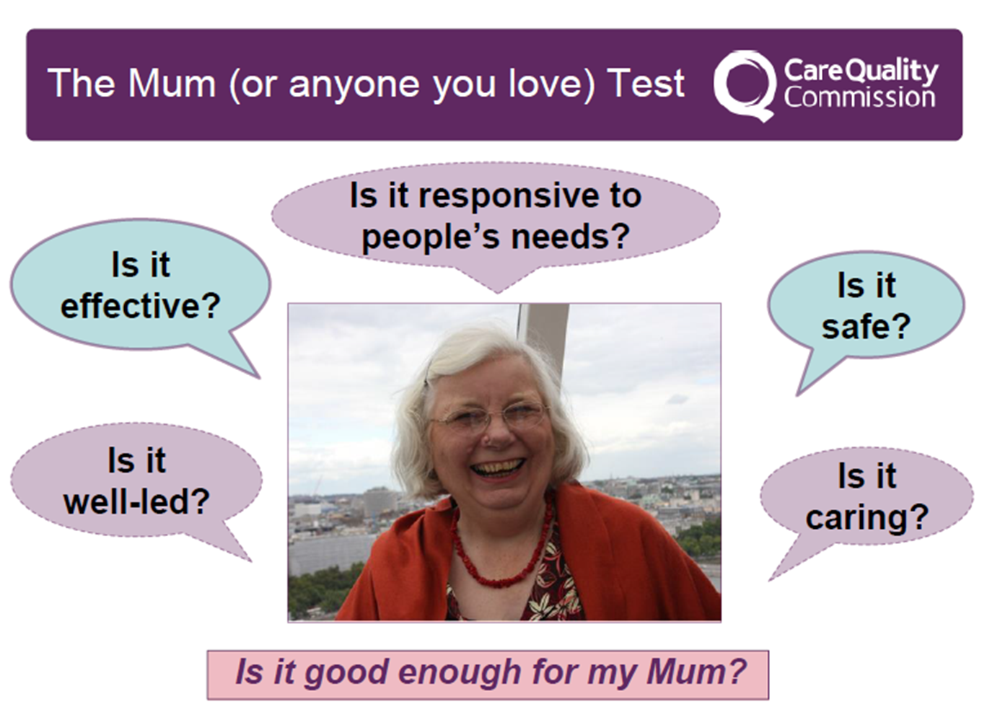
DIGNITY AND REGULATION
Notes:
Dignity is not just a nice to do when you have time - embedded in the CQC inspection frameworks for all H&SC services. It lies at the heart of the Mum’s test [or the test for someone who is important in your life], and is incorporated into the Fundamental Standards for responsive person centred services.

Slide 13
We ask the same five questions of all the services we inspect
:Are they safe?
you are protected from abuse and avoidable
harm.
Are they effective?
your care, treatment and support achieves
good outcomes, helps you to maintain quality of life and is based on the best available evidence.

Slide 14
Are they Caring?
staff involve and treat you with
compassion, kindness, dignity and respect
Are they responsive to people's needs?
services are organised so that they meet your needs.
Are they well-led?
the leadership, management and governance of the organisation make sure it's providing high-quality care that's based around your individual needs, that it encourages learning and innovation, and that it promotes an open and fair culture.

Slide 15





DOING IT WITH DIGNITY?
WHERE IS THE DIGNITY
IS THE SERVICE:
SAFE? EFFECTIVE? CARING? RESPONSIVE WELL LED?

Slide 16
Definition of Wellbeing
Wellbeing is a broad concept, and the statutory guidance defines it as relating to the following nine areas in particular:
personal dignity (including treatment of the individual with respect)
physical and mental health and emotional wellbeing
protection from abuse and neglect
control by the individual over day-to-day life (including over care and support provided and the way it is provided)
participation in work, education, training or recreation
social and economic wellbeing
domestic, family and personal relationships
suitability of living accommodation
the individual’s contribution to society
Notes:
In its broadest sense, the principle of wellbeing requires assessments to be holistic; less about deficit models of care, and more about enabling people to build on their strengths.
The Act and most of the statutory guidance makes it clear that it is talking about individual rather than a collective sense of wellbeing. There is no hierarchy in the areas of wellbeing listed above – all are equally important. There is also no single definition of wellbeing, as how this is interpreted will depend on the individual, their circumstances and their priorities.
Wellbeing is a broad concept applying to several areas of life, not only to one or two. Therefore, using a holistic approach to ensure a clear understanding of the individual’s views is vital to identifying and defining wellbeing in each case. NOTE: FOR CARERS ONE OF THE PRINCIPLES FOR IMPLEMENTATION OF WELBEING IS the importance of achieving a balance between the individual’s wellbeing and that of any friends or relatives who are involved in caring for the individual

Slide 17
Caring for our Future: Reforming care and support
5 statements:
Maintaining independence: I am supported to maintain my independence for as long as possible
Quality: I am happy with the quality of my care and support
Dignity and respect: I know that the person giving me care and support will treat me with dignity and respect.
Taking control: I am in control of my care and support
How care and support works: I understand how care and support works, and what my entitlements and responsibilities are.

Slide 18
What is a Champion?

Slide 19
Ten Dignity Do’s
.

Slide 20
Key Aims for Dignity Champions
Stand up and challenge disrespectful behaviour rather than just tolerate it.
Act as a good role model by treating other people with respect particularly those who are less able to stand up for themselves
Speak up about Dignity to improve the way that services are organised and delivered
Influence and inform colleagues
Listen to and understand the views and experiences of citizens
Making sure dignity, compassion and respect is at the heart of everyday practice and isn’t an addition to it.
Treating everyone as a unique individual
Promoting independence, well-being and quality of care /life
Uphold and promote the Ten Dignity Do’s
Notes:
There are more documents and resources on the website that enable champions to put their commitment into positive action.

Slide 21
DIGNITY CHAMPIONS
SIGN UP TO UPHOLD
THE TEN DIGNITY DO'S

Slide 22
Have zero tolerance of all forms of abuse
Support people with the same respect and compassion that you would want for yourself or A member of your family!
Treat each person as an individual by offering a personalised service
Listen and support people to express their needs and wants
Respect people’s right to privacy
Enable people to maintain the maximum possible level of independence, choice and control
Ensure people are able to complain without fear of retribution
Engage with family members and carers
Assist people to maintain confidence and a positive self-esteem
Act to alleviate people’s loneliness and isolation
Notes:
The dignity do cards are available to download as well as being supplied with every badge / wristband purchased.

Slide 23
Notes:
This poster is available on the website

Slide 24

Notes:
What does this say to you.

Slide 25

Notes:
What do you think this is and why might we use it in the context of Dignity.
This is a mirror it symbolises the fact that we are what we project to the world. A mirror enables us to see ourselves as the world sees us. Dignity is not just about how we expect to be treated it is about how we treat others and the messages that we send through our actions and our words.
Dignity is not just a concept it fundamentally affects all our interactions and everything we say and do in whatever context. Dignity is everyone’s responsibility.

Slide 26

SAFE JOURNEY!

