Slide 1
NICE: what does dignity mean to us?
Holly Irwin – Manager, Social Care & Leadership

Slide 2
Respect
Personalised care
Independence, Choice & control
Safe
Hope, positivity
Connected

Slide 3
NICE
NICE aims to improve quality in health & social care through development of guidance based on the best available evidence
Comprehensive set of recommendations for a particular areas
Prioritised set of measurable statements designed to support quality improvement

Slide 4
Quality & dignity
Quality & improved outcomes for people

Slide 5
People as experts
“NICE is committed to patients, people who use health and care services, carers and the public having an active role in the development of its guidance and other products.
The lay members of NICE’s committees have equal status to the professional and practitioner members and their perspectives have equal value when considering evidence.”

Slide 6
Dignity in guidance
GUIDELINES
Improving people’s experience in adult social care services (NG86)
Improving service user experience in adult mental health services (CG136)
Improving patient experience in NHS services (CG138)
QUALITY STANDARDS
Due to publish
Dec 2018
QS14
QS15
Social care
Health

Slide 7
Improving patient experience (CG138)
Guideline recommendations around:
Knowing the patient as an individual
Essential requirements of care
Tailoring healthcare services for each patient
Continuity of care and relationships
Enabling patients to actively participate in their care
Quality statements including:
Statement 1 – patients are treated with dignity, kindness, compassion, courtesy, respect, understanding and honesty.
Statement 4 – patients have opportunities to discuss their health beliefs, concerns and preferences to inform individualised care.

Slide 8
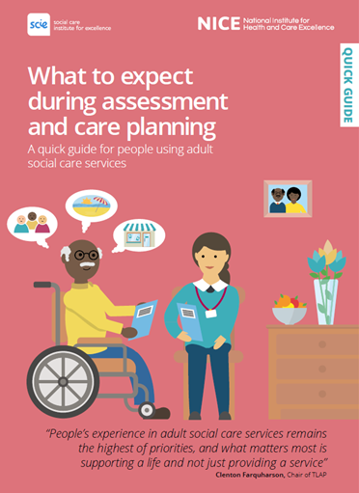
Improving people’s experience of adult social care services (NG86)
Guideline recommendations including:
Rec 1.1.2 Support people to maintain their independence. This means finding out what people want from their life, and providing the support and assistance they need to do this.
Rec 1.4.11 All practitioners providing personal care should ensure that personal care needs are responded to in a timely, appropriate and dignified manner in line with the person’s wishes and their support plan
Social care quick guide – for people using adult social care services

Slide 9
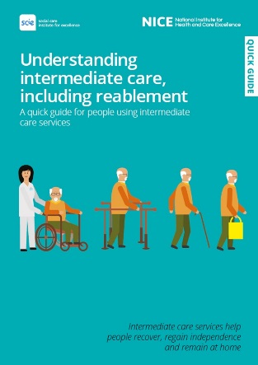
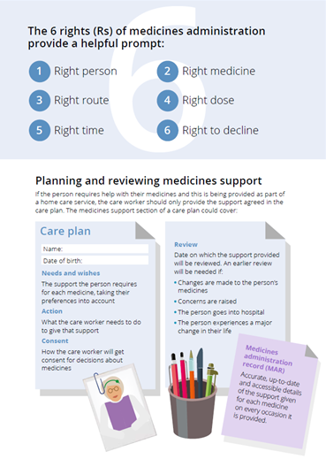
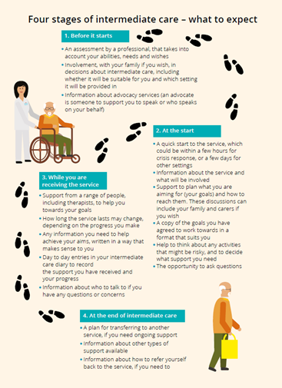
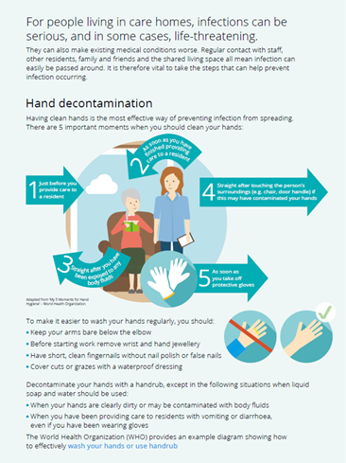
NICE social care quick guides
Practical & easy to understand
Ideal for use in staff training
www.nice.org.uk/quick-guides

Slide 10
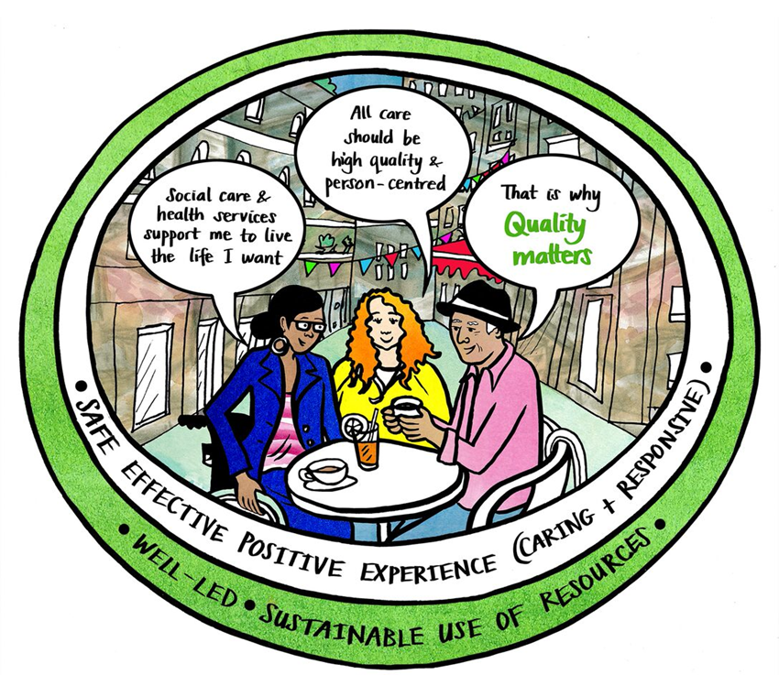
NICE and partnerships
We are a Quality Matters partner, signed up to the shared commitment to improve the quality of adult social care
We are supporting delivery of 4 of the 6 Quality Matters priorities

Slide 11
Unlocking capacity: smarter together
A new digital resource promoting good quality, person-centred care through collaborative working across health and adult social care
Produced by: NICE, Skills for Care, NDC, NHSE, CQC, CPA, LGA, ADASS, TLAP & SCIE

Slide 12
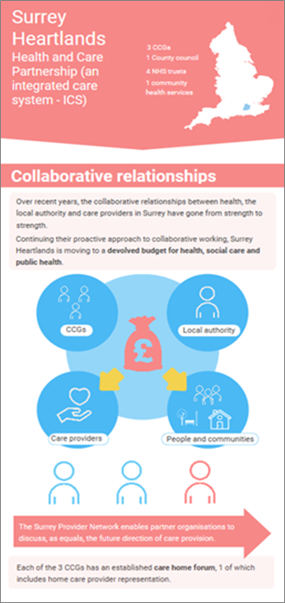
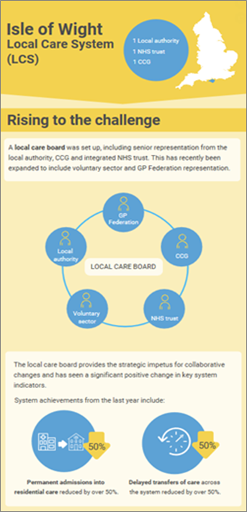
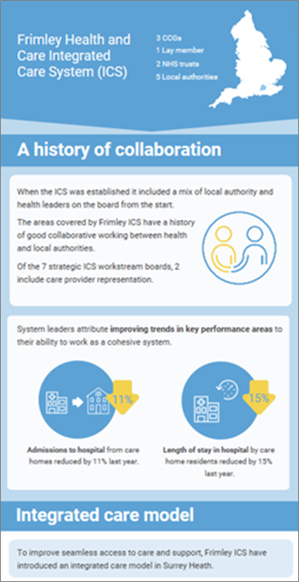
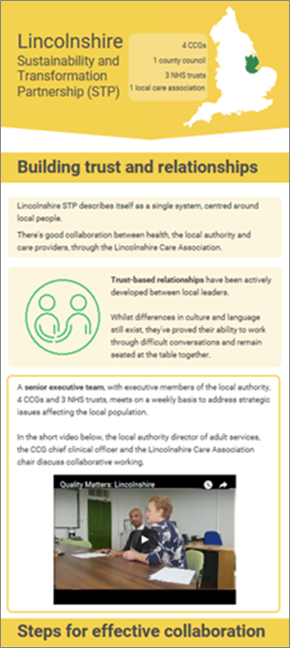
Unlocking capacity: smarter together

Slide 13
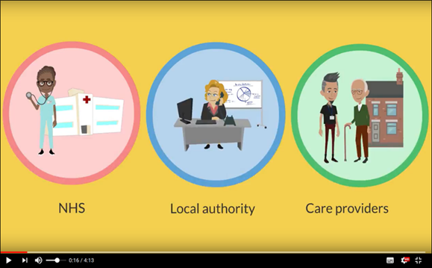
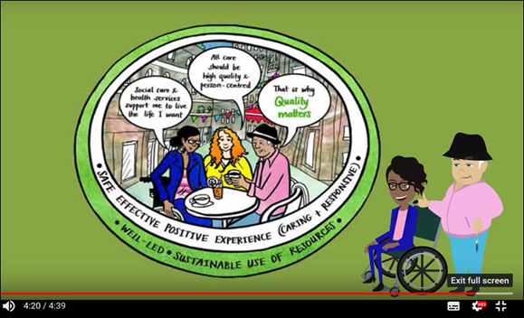
Unlocking capacity: smarter together
Use this resource in your local area
http://qualitymatters.nice.org.uk/unlocking-capacity-smarter-together/index.html

Slide 14
Get involved & keep up to date
Get involved in guideline development or by commenting on draft guidance – register here as a stakeholder organisation
To keep up to date with NICE’s work in health and social care please sign up to receive our free monthly ebulletins:
NICE News – click here to register
NICE in Social Care – click here to register

