Slide 1
National Dignity Council
Overview section

Slide 2
The aims of the Dignity Campaign:

Slide 3
National Dignity Council Aim promote the importance of ‘Dignity’ for all through:-
Raising awareness of Dignity and its importance in delivering excellent services.
Developing clear guidelines to raise citizen’s awareness on their right to access respectful dignified and compassionate services
Leading and inspiring people to take action to promote Dignity
Leading and stimulating a National Dignity Campaign.
Supporting and maintaining growing networks of Dignity Champions
Inspiring champions to be true to their role and uphold the ten Dignity Dos
Leading in designing, planning and promoting an annual National Dignity Action Day.
Ensure the sustainability of the National Dignity Council.

Slide 4
the issues
There is a lot of positive action taking place in health and social care settings. The Dignity in Care Campaign has highlighted some of this positive work through:
its annual Dignity in Action Day.
Dignity Audits have been developed to enable staff and service users to understand what Dignity looks like.
Service Users are being involved as experts in developing alternative ways of providing support that respects Human Rights and Dignity
Toolkits have been developed by SCIE, DoH, Skills for Care and Skills for Health amongst many organisations to enable staff to work in ways that respect the Dignity of those they are supporting.
BUT WE NEED MORE OF THIS AND FOR THE TECHNIQUES TO BE MORE WIDELY ADOPTED AND DISSEMINATED

Slide 5
The range of campaign activities and resources to help inspire and equip our social movement
The
Dignity
Challenge
The Dignity
Tour
Dignity
Champions
Spreading best practice &
equipping people to take action
Raising awareness &
inspiring people to take action
Interactive
Website
High Profile
Ministerial
Leadership
Training
Resources
Dignity
Ambassador
Dignity in Care
Campaign
Dignity in Care
Practice Guide
Conferences &
events
£100M Privacy
& Dignity Fund
Sustained
media coverage
£117M
Capital
Investment
Health &
Social Care
Award
Beacon Council
Scheme
Rewarding & recognising those that make a difference

Slide 6
DEFINITIONS

Slide 7
  DIGNITY IS?……………………..
  in your own words define Dignity

Slide 8
Defining ‘Dignity’
Dignity consists of many overlapping aspects, involving respect, privacy, autonomy and self-worth [Oxford Dictionary]
a standard dictionary definition: a state, quality or manner worthy of esteem or respect; and (by extension) self-respect.
To treat someone with dignity is to treat them as being of worth, in a way that is respectful of them as valued individuals .[RCN – Defending Dignity survey 2008]
Dignity in care means the kind of care/ support, in any setting, which supports and promotes, and does not undermine, a person’s self-respect, regardless of difference
  (SCIE Guide 15)
While ‘dignity’ may be difficult to define, what is clear is that people know when they have not been treated with dignity and respect
SCIE- Dignity in care guide

Slide 9
Definitions of dignity
Treating people with respect
Listening to people
Responding to the person as soon as requested
Maintaining confidentiality at all times
Dignity is about being treated as an individual with respect and compassion.
Putting the person receiving care at the centre of things
Asking what their specific wants and needs are
Giving information

Slide 10
Definitions of dignity
Helping people see they are in a safe environment
Making sure people are not left in pain
Ensuring people do not feel isolated or alone
Giving people privacy
Encouraging people to help themselves as much as possible
Taking into account people’s cultural and religious needs, not discriminating against them
Being addressed in an appropriate manner
Being patient
Not patronising the person receiving care

Slide 11
Dignity in Care – what does it mean?
Lack of respect for an individual’s dignity in care can take many forms and may differ from person to person. The following are some examples we have heard from older people of where they felt their dignity was not respected:
feeling neglected or ignored whilst receiving care
being treated more as an object than a person
feeling their privacy was not being respected during intimate care eg. being forced to use a commode in hospital rather than being provided with a wheelchair and supported to use the bathroom

Slide 12
Dignity in Care – what does it mean?
a disrespectful attitude of staff or being addressed in ways they find disrespectful eg. by first names
being provided with bibs intended for babies rather than a napkin whilst being helped to eat
needing to eat with own fingers rather than being helped to eat
generally being rushed and not listened to

Slide 13
What is Dignity
Dignity of the Human Being
Dignity of Personal Identity
Dignity of Merit
Dignity of Moral Status

Slide 14
Dignity Definition
Dignity Is
  Kindness
  Respect
  Compassion

Slide 15
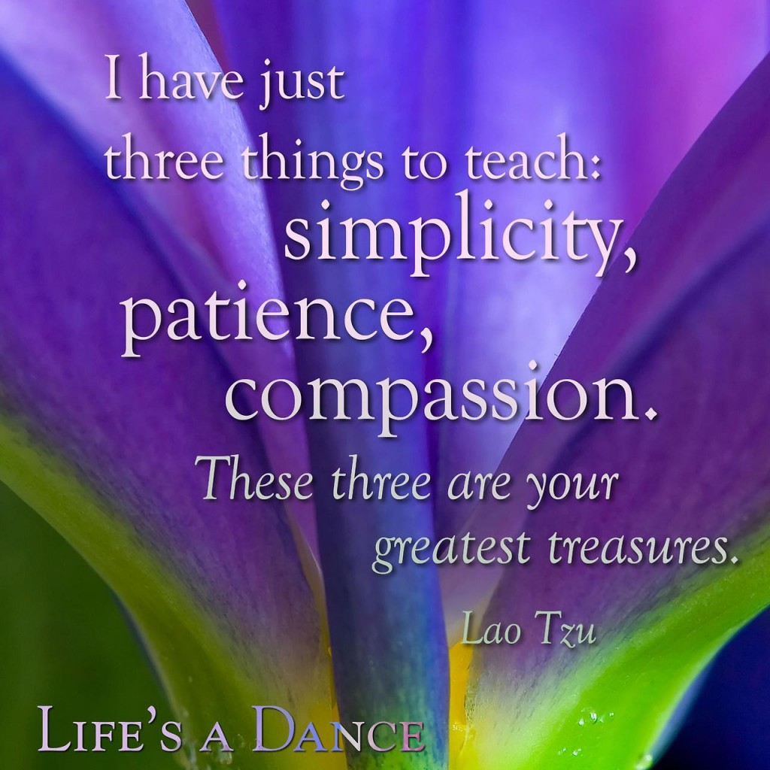
COMPASSION -A deep awareness of the suffering of another coupled with the wish to relieve it. - Dictionary

Slide 16
Empathy
If you were receiving domiciliary care, what would the care worker do or say to make you feel you were receiving a dignified service.
Use words, phrases or sentences to describe that service.

Slide 17
Why we need the campaign?

Slide 18
The Winterbourne View scandal 2011
Failings at the Mid Staffs NHS Foundation Trust – “…the story it tells is first and foremost of appalling suffering of many patients…” Francis Report 2013
CQC's 2013 - first dedicated review of privacy, dignity and nutrition in hospitals found that in nearly a fifth of hospitals older people are not being treated with dignity or afforded respect and privacy
CQC “Cracks in the pathway” 2014– report reviewing care of those with dementia moving between hospitals and care homes. Found more good care than poor care BUT 90 per cent had some aspect of poor or inconsistent care.
CQC – Sep 2015 - Adult Social Care Inspections so far under new framework:
  0.5% Outstanding
  60% Good
  34% Requires improvement
  5.4% Inadequate

Slide 19
Why change?
People in hospital and care settings are not being helped to eat
Human rights
People’s human rights are not being respected
Empowering
Staff do not listen and enable people to make their own decisions.
Malnutrition
Valued
People feel invisible and abused because they are not in control of their own lives
Prejudice
There is a culture of negative attitudes towards older people

Slide 20
Dignity is about people – their stories
“In the next room you could hear the buzzers sounding. After about 20 minutes you could hear the men shouting for the nurse, “Nurse, nurse”, and it just went on and on. And then very often it would be two people calling at the same time and then you would hear them crying, like shouting “Nurse” louder, and then you would hear them just crying, just sobbing, they would just sob and you just presumed that they had had to wet the bed. And then after they would sob, they seemed to then shout again for the nurse and then it would go quiet”
Independent Inquiry into care provided by
Mid-Staffordshire NHS Foundation Trust

Slide 21

Why Change?
Poor monitoring results
Lack of awareness during training
Dignity challenge
Changes to the contract
Raised service user expectation
Service user complaints
Raised profile in media
Bad publicity

Slide 22
Why Change?
Human Rights and other discriminatory legislation
National minimum standards and regulation
Regulatory inspections
Contract terms
Others waiting to whistle blow on you
It could cost you your job

Slide 23
Changes required
Changes to the service provided
Organisational change
Improvements in staff attitudes
Changes in commissioning practices

Slide 24
Implementing change
Understand the reasons for change
Be responsive
Bring ideas to the table
Give assistance to the process
Be proactive
Examine your own values

Slide 25
Making Change Sustainable
Policies and procedures are only part of the solution
Change can not be driven by a centrally led campaign – local responsibility & accountability are needed
People need to be connecting with this agenda on a an emotional level – making dignity matter personally!

Slide 26
Barriers to providing dignified care
1. Environment
2. Staff attitudes and behaviours
3. Culture of care
4. Specific care activities

Slide 27
Specific care needs
Older people
Physically disabled people
People with specific health needs e.g. cancer
People with mental health problems e.g. dementia
People with learning difficulties
Younger physically disabled people
People from minority ethnic groups
People from the LGBT communities

Slide 28
Human Rights and Dignity

Slide 29


Slide 30
Dignity, Human Rights & our Responsibility
Human rights belong to everyone.
They are the basic rights we all have simply because we are human, regardless of who we are, where we live or what we do.
Human rights represent all the things that are important to us as human beings, such as being able to choose how to live our life and being treated with dignity and respect. Human rights are based on a number of core values, including:
  Fairness, Respect, Equality, Dignity, & Autonomy
Human rights should be at the centre of everything we do.
Need to focus on quality of life and individual outcomes rather than needs and processes
Care Quality Commission will support this drive through their work as regulator

Slide 31
“Quite simply, we cannot hope to improve people’s health and well-being if we are not ensuring their human rights are respected.”
Rosie Winterton MP, 2007, Joint Committee on Human Rights: Eighteenth Report)

Slide 32
Regulatory Landscape
Standards/Principles/Practice

Slide 33
Care Act: Principles into Practice
What is key to delivering the vision of the Care Act in practice:
A system that promotes people's independence and wellbeing
Based on the principle that people should have control of their care and support and be able to make the choices that are right for them
Good care should mean care that is built around the whole person, their skills, aspirations and preferences as well as their needs
Good care should also extend the opportunity for independence and help to build stronger community links, not just for the few, but for everybody

Slide 34
Definition of Wellbeing
Wellbeing is a broad concept, and the statutory guidance defines it as relating to the following nine areas in particular:
personal dignity (including treatment of the individual with respect)
physical and mental health and emotional wellbeing
protection from abuse and neglect
control by the individual over day-to-day life (including over care and support provided and the way it is provided)
participation in work, education, training or recreation
social and economic wellbeing
domestic, family and personal relationships
suitability of living accommodation
the individual’s contribution to society

Slide 35
http://www.health.org.uk/sites/default/files/PersonCentredCareMadeSimple.pdf

Slide 36
KEY PRINCIPLES IN PERSON CENTRED CARE
To afford people dignity, compassion and respect
To offer co-ordinated care, support or treatment
To offer personalised care, support or treatment
To support people to recognise and develop their own strengths and abilities to enable them to live an independent and fulfilling life

Slide 37
Caring for our Future: Reforming care and support
5 statements:
Maintaining independence: I am supported to maintain my independence for as long as possible
Quality: I am happy with the quality of my care and support
Dignity and respect: I know that the person giving me care and support will treat me with dignity and respect.
Taking control: I am in control of my care and support
How care and support works: I understand how care and support works, and what my entitlements and responsibilities are.

Slide 38

SPICES
Social Cultural
Physical Emotional
Intellectual Spiritual

Slide 39
Standards
Care Quality Commission
Codes of Practice
Workforce
Housing Standards
NICE
Professional standards
Human Rights
Legislation – Care Act 2014

Slide 40
CQC operating model

Slide 41
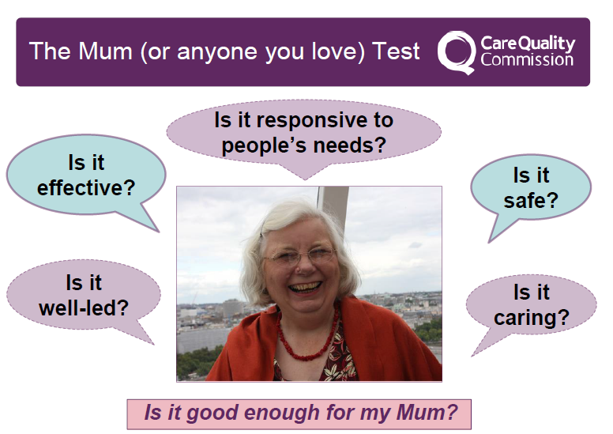

Slide 42





The 5 KLOES
SAFE EFFECTIVE CARING RESPONSIVE WELL LED
http://www.careimprovementworks.org.uk

Slide 43
“What are our expectations / standards and what are some of the consequences –when and where we cross the line?”

Slide 44

THE 6 C'S

Slide 45
Policies
Confidentiality
Whistle blowing
Communication
Equality and Diversity

Slide 46
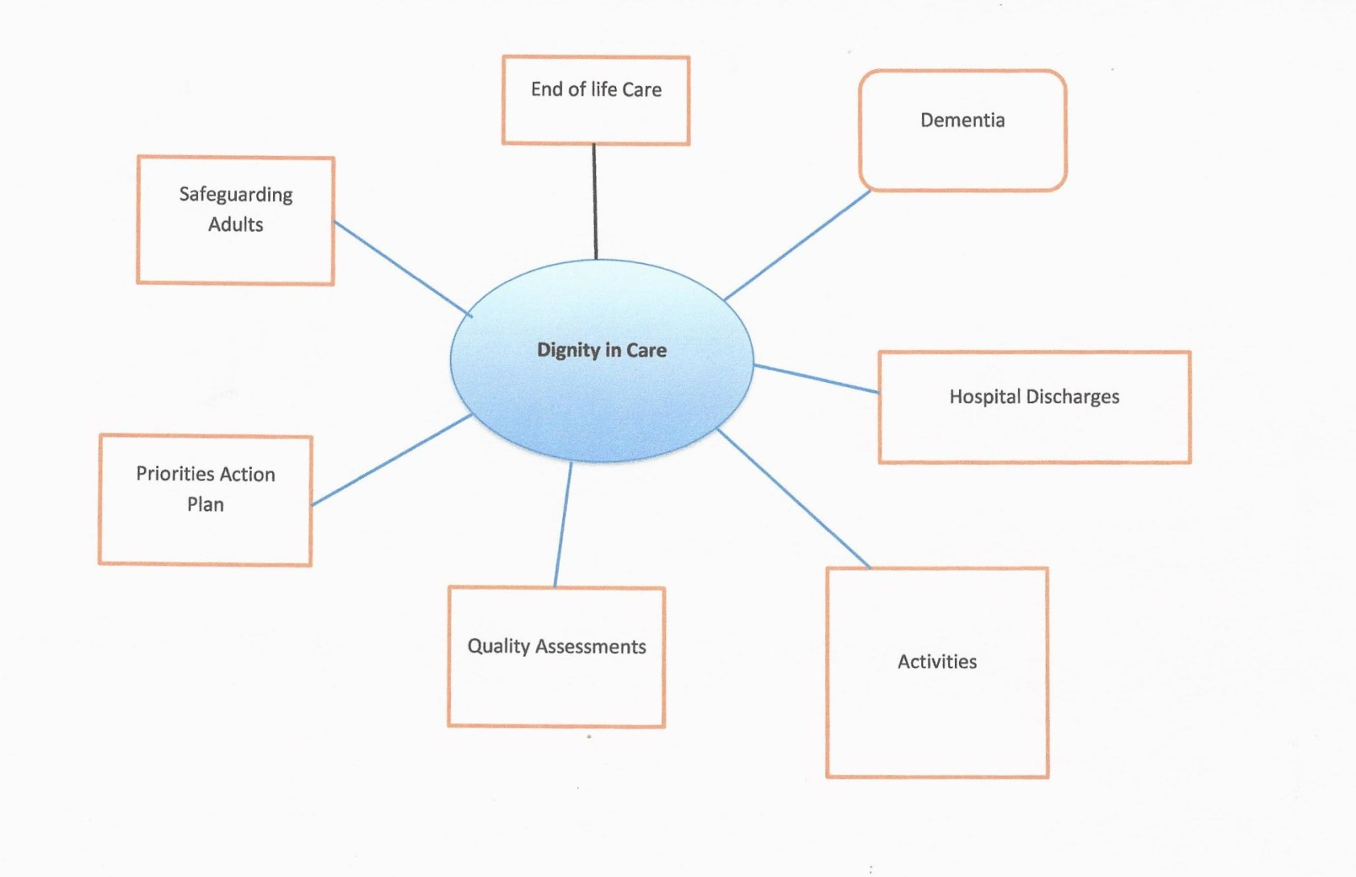

Slide 47
Ten Dignity Do’s
.

Slide 48
The Dignity Do’s
Have zero tolerance of all forms of abuse
Support people with the same respect you would want for yourself or a member of your family
Treat each person as an individual by offering a personalised service
Enable people to maintain the maximum possible level of independence, choice and control
Listen and support people to express their needs and wants
Respect people’s right to privacy
Ensure people feel able to complain without fear of retribution
Engage with family members and carers as care partners.
Assist people to maintain confidence and positive self esteem
Act to alleviate people’s loneliness and isolation.

Slide 49
Learning outcomes
Staff are aware of how service users feel when they are not treated with respect and dignity
Staff know what constitutes best practice when providing services with dignity and respect and ensure they employ these practices
Staff understand why unacceptable staff attitudes and practices must be replaced where they exist

Slide 50
Have a Zero
Tolerance of all forms of abuse
  Support be it in respect of health or social care is provided in a safe and secure environment.
  There are a range of options for individuals to share concerns in confidence.
  The environment enables the challenging of abuse and abusive situations.

Slide 51
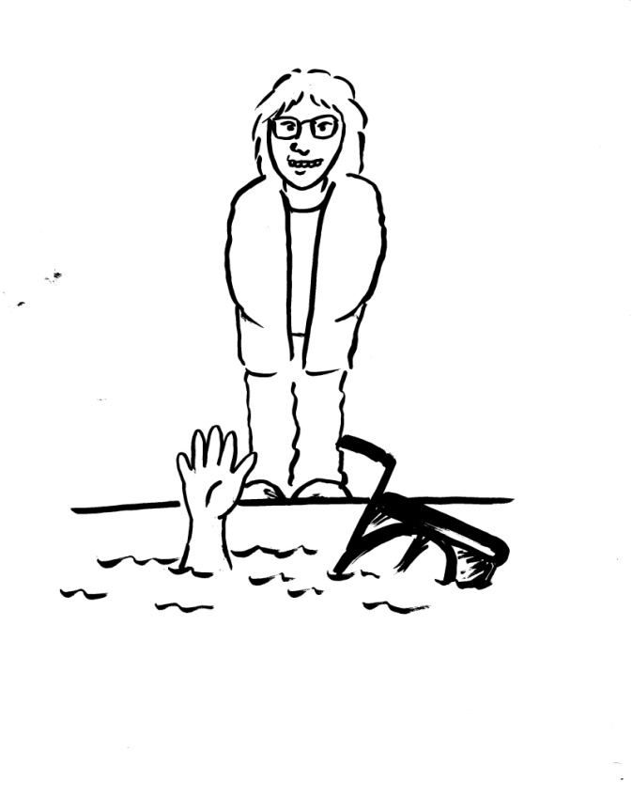
Have a Zero
Tolerance of all forms of abuse
Care and support is
provided in a safe
environment, free
from abuse.
Abuse can take many
forms physical,
psychological,
emotional,
financial,
sexual, neglect and ageism

Slide 52
Support people with the same respect you would want for yourself or a member of your family
  People are treated as equals and remain in control.
  Individual decisions are respected.

Slide 53
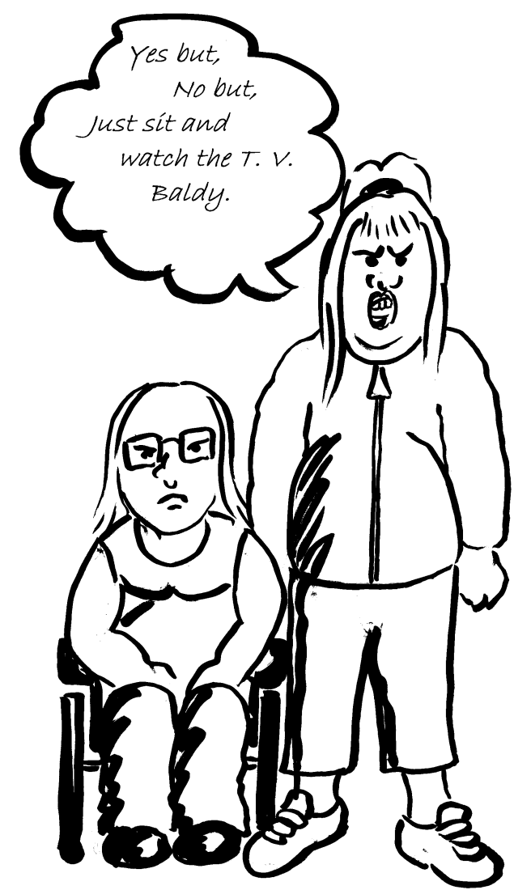
Support people with the same respect you would want for yourself or a member of your family
People should be cared for in a polite
and courteous manner, ensuring time
is taken to get to know the person
We are all patients at some point
e.g. Doctor’s, Dentist, a stay in hospital.

Slide 54
Treat each person as an individual by offering a personalised service
Emphasis on needs led support services.
Individual defines the level, frequency, type and duration of contact with support staff.
The role of others [families, friends, fellow residents/patients, volunteers] in providing support is recognised.
The concept of community and the role of the individual within that is recognised.

Slide 55
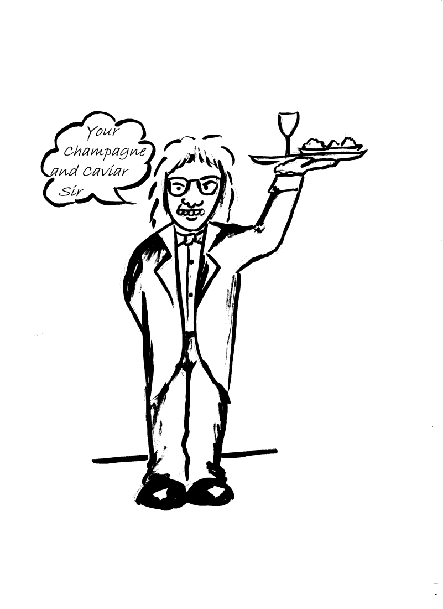
Treat each person as an individual by offering a personalised service.
Services are not
standardised but are
personalised to each
individual.
Support physical, cultural,
spiritual, psychological and
social needs

Slide 56
Enable people to maintain the maximum level of independence choice and control
Involve people in the improvement of services
Invite people who use services to contribute ideas
Opportunities to participate and contribute are integral to autonomy and therefore dignity
Menu approach to services.
Security and safety

Slide 57
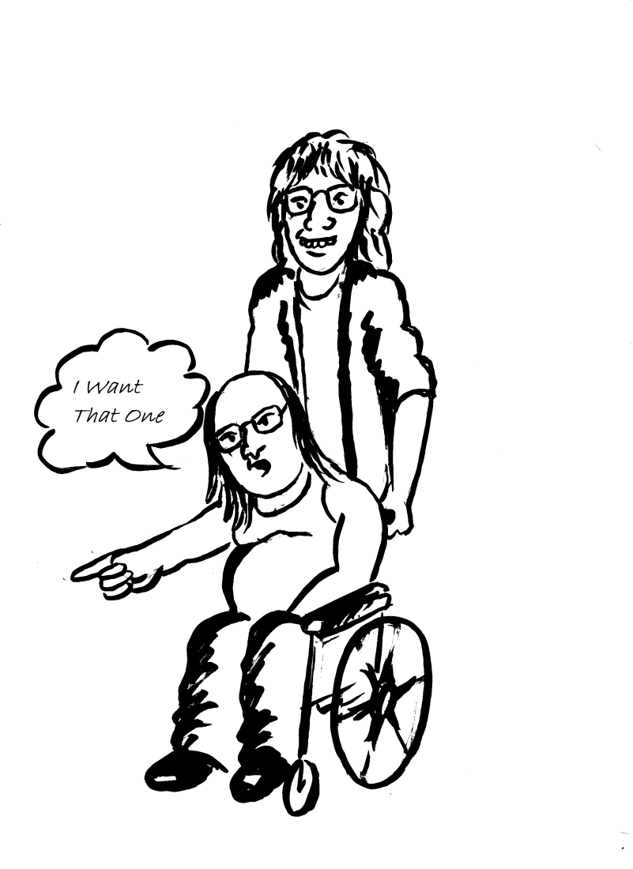
Enable people to maintain the maximum level of independence choice and control
People are involved in
decisions about their
personal care.
Avoid making assumptions
about what people want
or what is good for them.

Slide 58
Listen and support people to express their needs and wants
The individual defines the type of support they want from specific services, on the basis of a wide range of information, provided in suitable formats.
Any package is agreed as part of a wider range of options and a team approach.

Slide 59
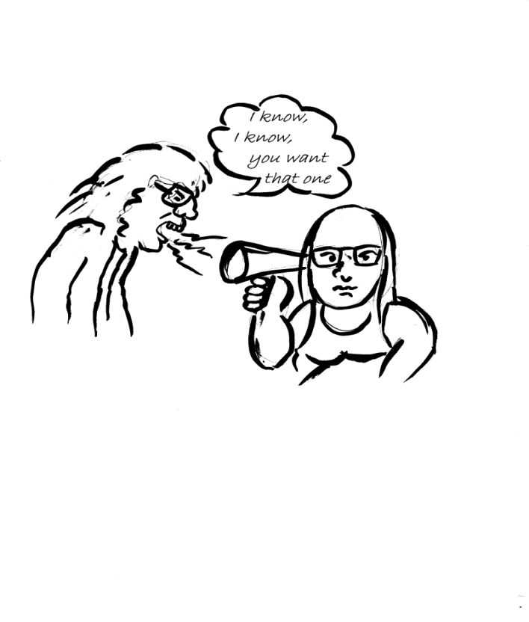
Listen and support people to express their needs and wants
Provide information in a way
that enables a patient to
reach agreement in care
planning and exercise their
rights to care and treatment.
Adequate support provided
for those with communication
difficulties or cognitive impairment

Slide 60
Respect people’s right to privacy
The ‘My Own Front Door’ concept in sheltered and extra care housing gives individuals the control over access and contact.
Organisations and settings provide a mechanism for accessing a range of options without intruding on personal space.
Where it is necessary to provide support in a less private environment, e.g. hospital or community this is done sensitively and with respect.

Slide 61
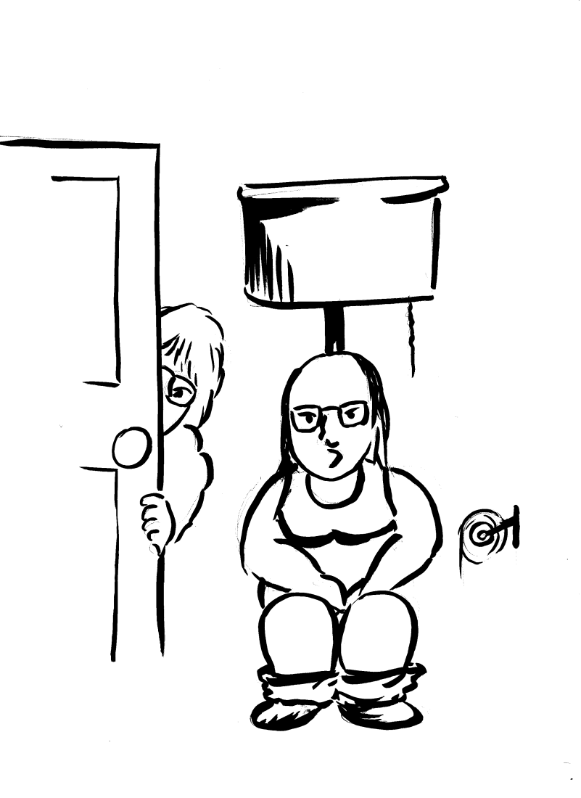
Respect people’s right to privacy
Areas of sensitivity which
relate to modesty, gender
culture or religion .
Patients are not made to
feel embarrassed when
receiving care and
support.

Slide 62
Ensure people feel able to complain without fear of retribution
Users of services are provided with support in making complaints.
Users of services committees and community action groups provide additional support
Individuals are made aware of the existence of complaints systems and supports.

Slide 63
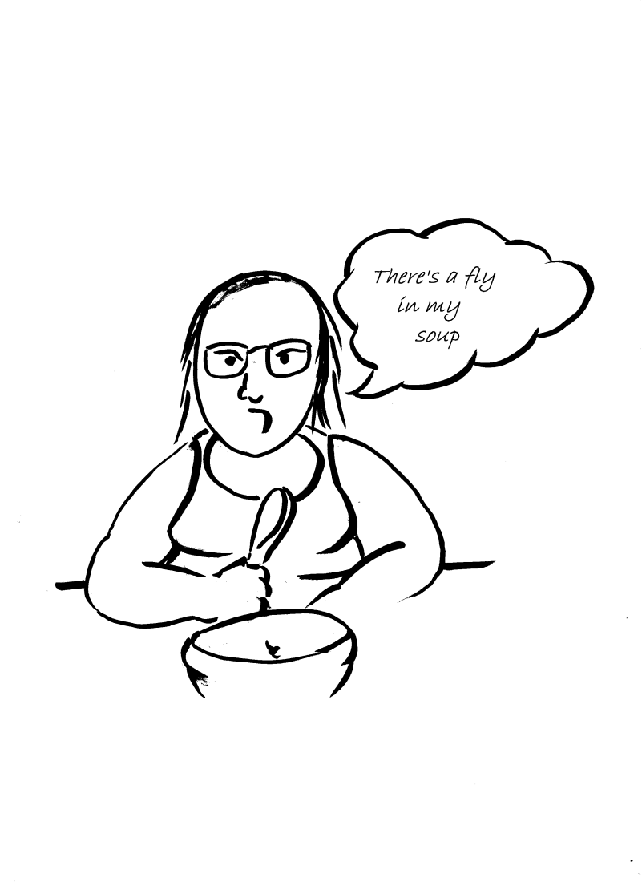
Ensure people feel able to complain without fear of retribution
People have access to
information and advice
they need.
Concerns and complaints
are respected and
answered in a timely
manner.

Slide 64
Engage with family members and carers as care partners
Families, friends and communities [including the organisation itself], are seen as integral parts of the total approach.
Individuals feel valued and in control.

Slide 65
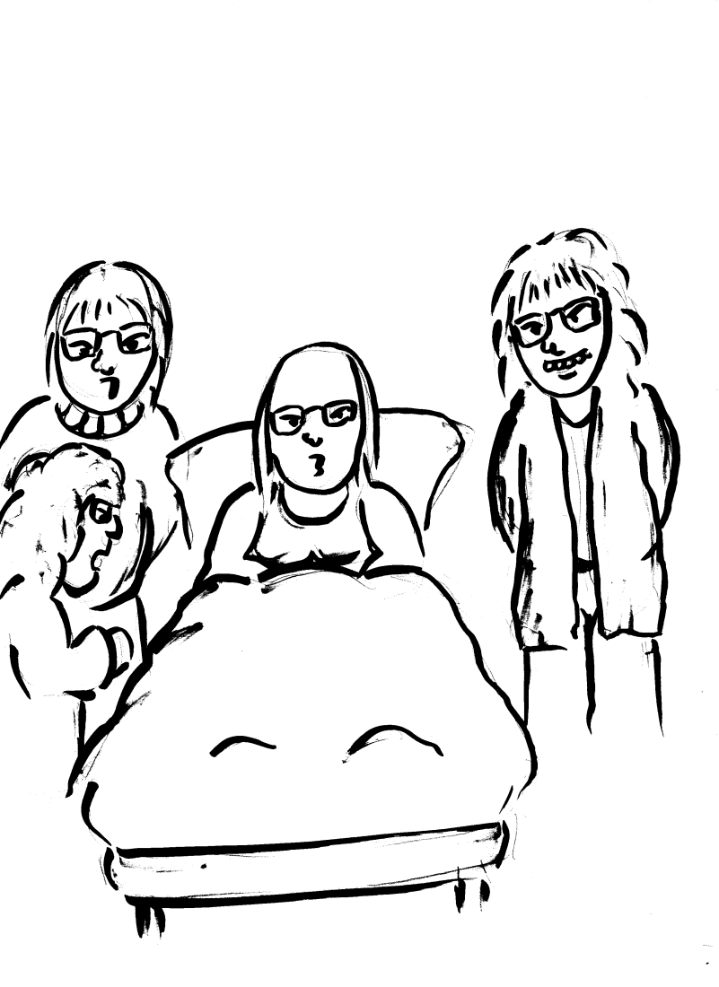
Engage with family members and carers as care partners
Relatives and carers are
kept fully informed and
receive timely information.
Relatives and carers are
listened to and encouraged
to contribute to the benefit
of the person receiving the
service.

Slide 66
Assist people to maintain confidence and a positive self esteem
Although support is available individuals retain the responsibility for managing their lives and as such do not loss confidence in their abilities.
This enhances self esteem, and should be strived for even where individuals do not have full capacity to exercise that control.

Slide 67
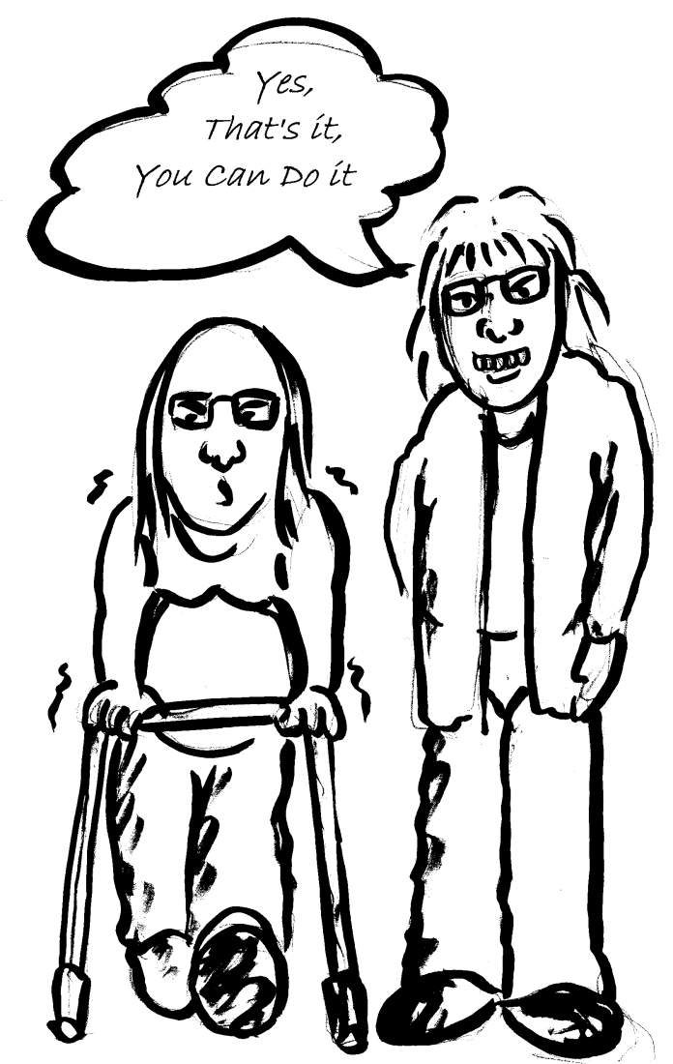
Assist people to maintain confidence and a positive self esteem
The care and support
provided encourages the
person to participate as far
as they feel able.
Care aims to develop the
self-confidence of the person
receiving the service.

Slide 68
Act to alleviate people’s loneliness and isolation
Organisations provide mechanisms for the relief of isolation and loneliness, whilst still providing ‘personal space’ wherever possible.
Company is available when it is wanted from a range of sources.

Slide 69
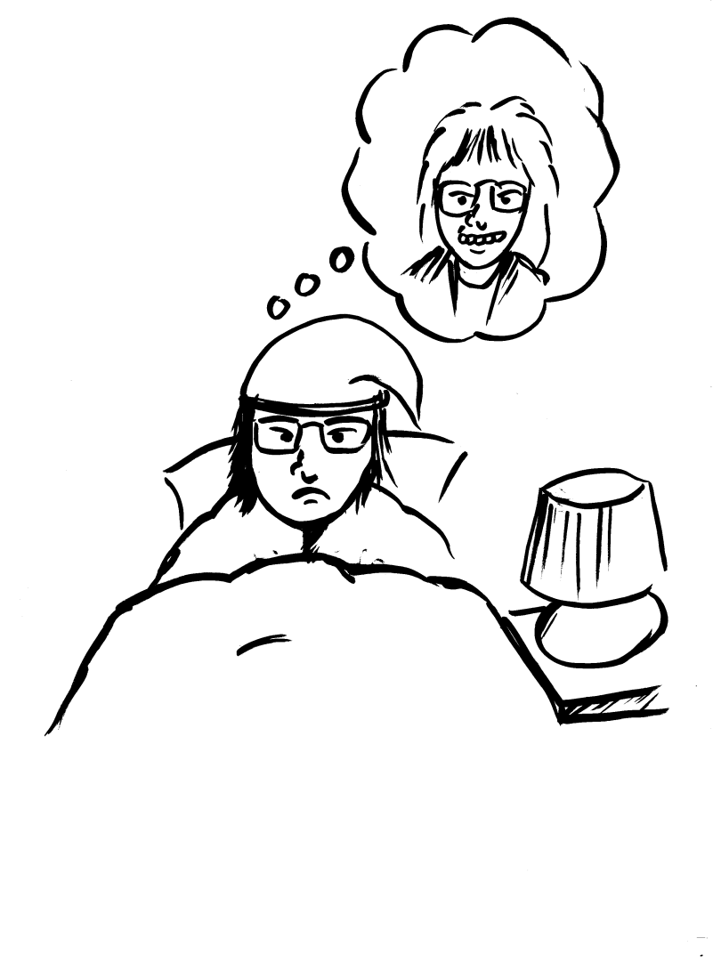
Act to alleviate people’s loneliness and isolation
Offer enjoyable activities
that are compatible with
individual interests, needs,
and abilities.
Offer your time.

Slide 70

What is a Champion

Slide 71
Key Aims for Dignity Champions
Stand up and challenge disrespectful behaviour rather than just tolerate it.
Act as a good role model by treating other people with respect particularly those who are less able to stand up for themselves
Speak up about Dignity to improve the way that services are organised and delivered
Influence and inform colleagues
Listen to and understand the views and experiences of citizens
Making sure dignity, compassion and respect is at the heart of everyday practice and isn’t an addition to it.
Treating everyone as a unique individual
Promoting independence, well-being and quality of care /life
Uphold and promote the Ten Dignity Do’s

Slide 72
Reward and recognise those who make a difference and go that extra mile.

Slide 73
Stimulate a country-wide debate about the importance of care services respecting the dignity of those who use them.

Slide 74
Encourage people to stand up and tackle services that don’t respect dignity, rather than just tolerating them

Slide 75
Raise awareness of dignity in care and inspire local people to take action

Slide 76
Spread best practice and support people and organisations to drive up standards

Slide 77
DIGNITY CHAMPIONS
SIGN UP TO UPHOLD
THE TEN DIGNITY DO'S

Slide 78
THERE ARE OVER 77,000 CHAMPIONS SIGNED UP ON THE DIGNITY IN CARE WEBSITE

Slide 79
Taking Action – ideas – pictures

Slide 80
S What do you See?………
A What is the Atmosphere like?…………
F What do you Feel?………
E Where is your Evidence ……
T Who can you Tell
Y Your responsibility to report.

Slide 81
Promoting Dignity
There is no wrong way to promote dignity at local levels, we have seen:
Verse
Prose
Posters & beer mats
Award schemes & ceremonies
Dignity Charters & pledges
DVDs
Post card and local media campaigns
Arts schemes
Protected meal times
Life Story work
Volunteer visitor/ Befriender schemes

Slide 82
What action can we all take to shape dignity in the future both at work and personally
Lead by example
Encourage and develop local champions
Develop a dignity networks
Develop ways to sustain your dignity initiatives
Have your own dignity action day
Have a local award scheme
Work with partners to deliver dignity
Refer to dignity in policy and practice
Include dignity on your web sites
Include dignity in your team meetings
Use the 10 point challenges as a way of self assessing and appraisal of staff
Involve carers and family
Offer choice to those in care
Set up intergenerational initiatives
Use the action packs to develop care and involve the public
Invite Health Watch to be involved

Slide 83
Working Together
How can you and your organisation work both internally and externally (with local partners) to deliver on this agenda?
Have you:
  Identified a baseline?
  What you need to do?
  What stage you need to engage with others (local Dignity Co-ordinators)
  What (if any) are the givens?
  Who are your critical partners in this
  Got an action plan
  Got a risk log?

Slide 84
Starting position

Slide 85
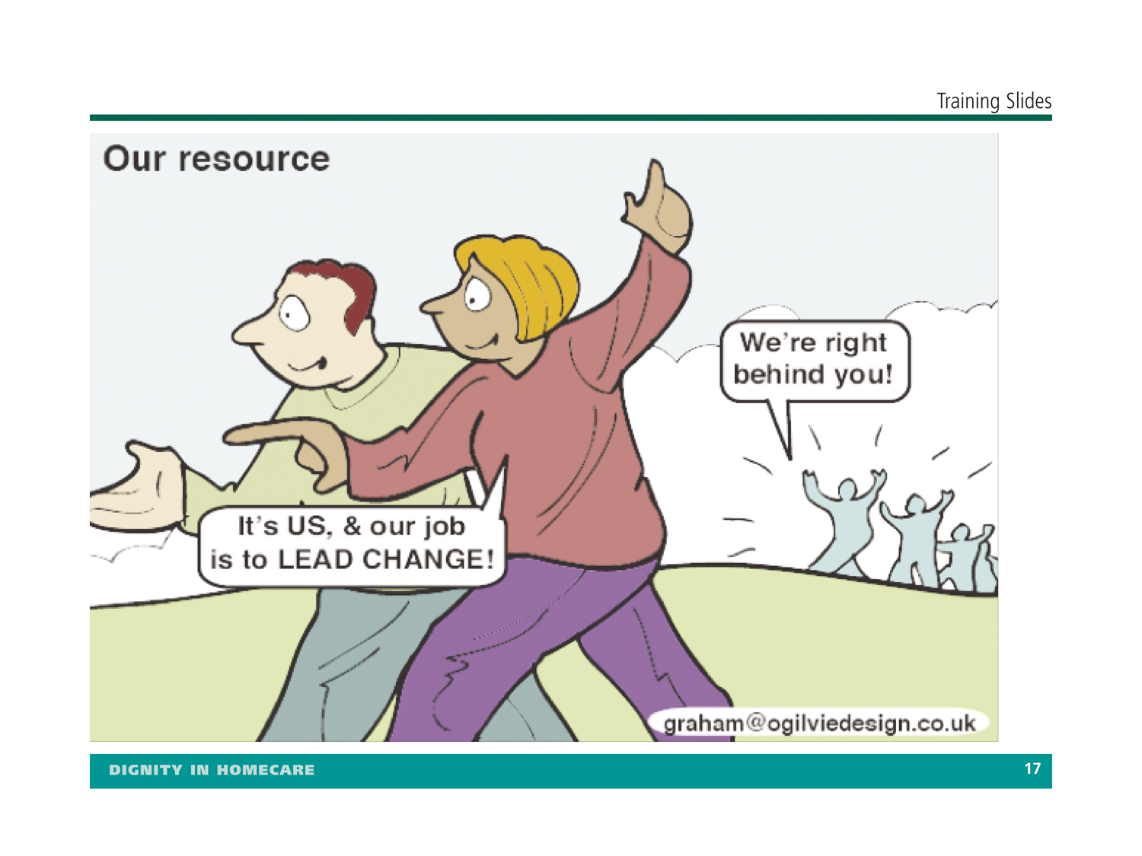

Slide 86

Sometimes personal choices are quite risky!

Slide 88
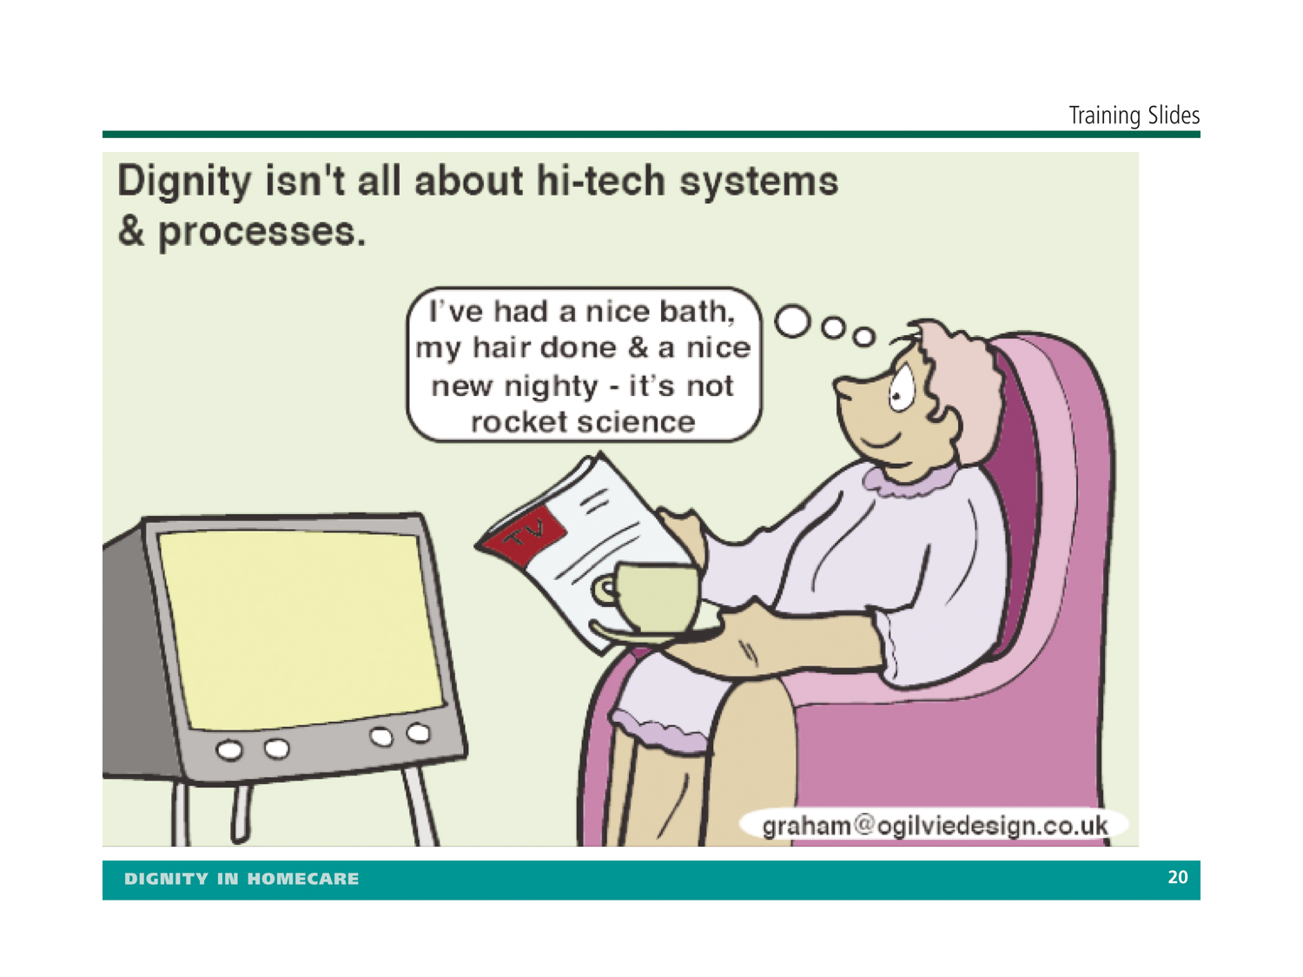

Slide 89
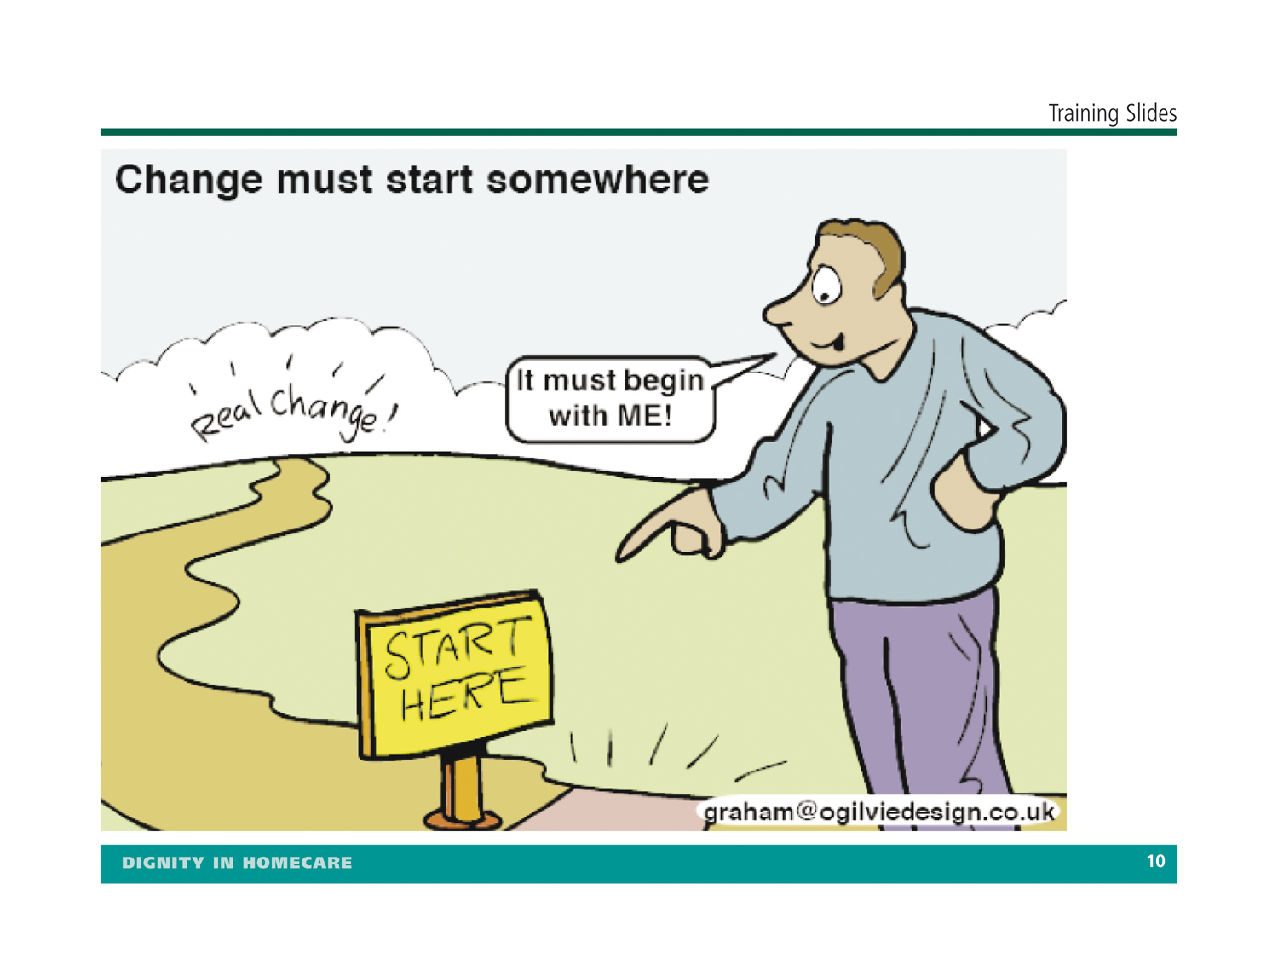

Slide 90
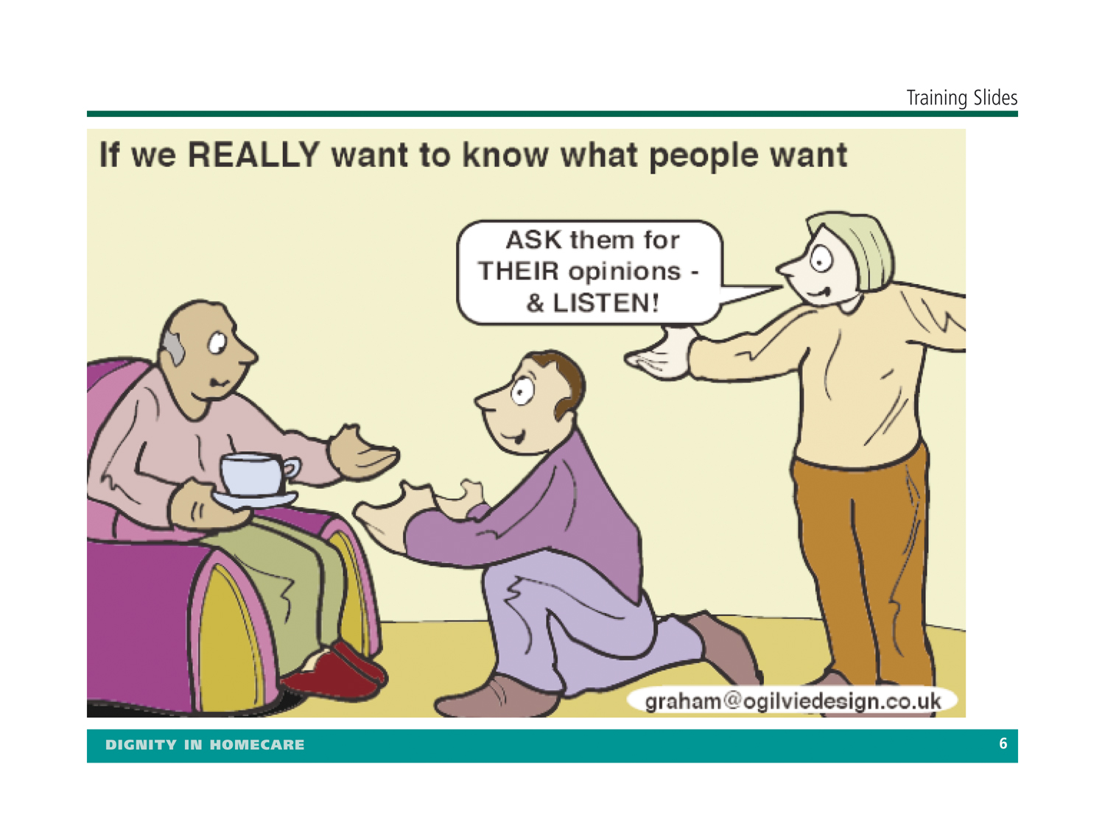

Slide 92
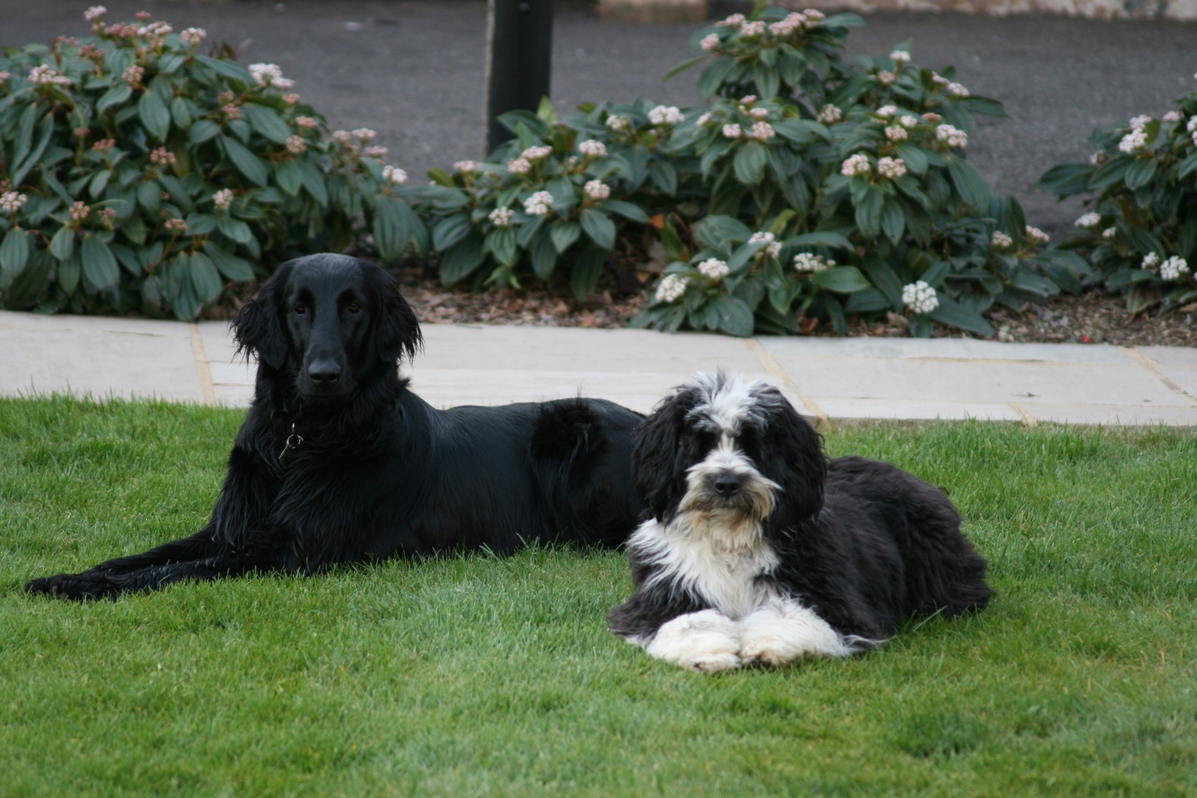
We balance risks in our own lives.

Slide 93


Slide 94
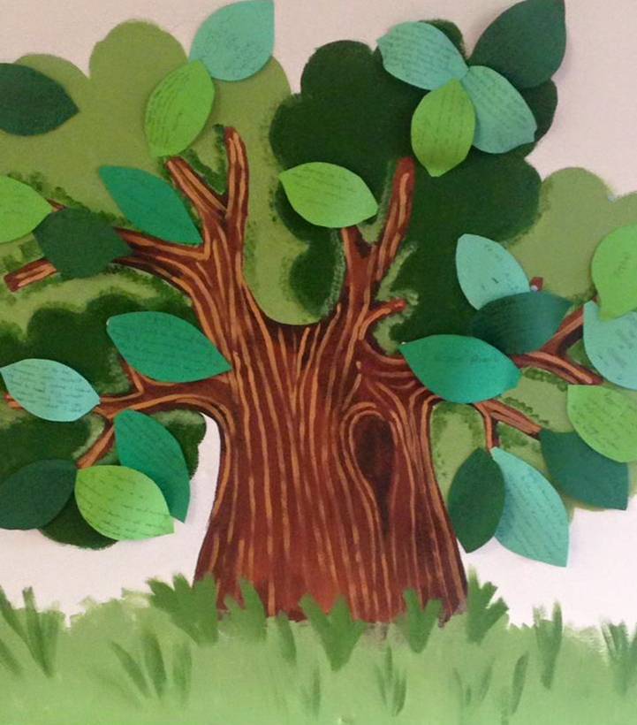
Digni-Tree Exercise

Slide 95
Legal Duty of Candour –
Ensure that the NHS is the most open and transparent system in the world – for patient safety and patient experience. When something goes wrong patients and relatives should be told about it promptly.

Slide 96


INDIVIDUAL ACTION PLAN
3 KEY THINGS I HAVE LEARNED FROM THIS EVENT:
WHAT SHOULD I TAKE BACK TO MY WORKPLACE THAT NEEDS TO BE ACTIONED?
WHO DO I NEED TO SHARE THIS WITH TO MAKE THINGS HAPPEN? WHAT RESOURCES DO I NEED TO DO THIS?

Slide 97


Slide 98


Can you be like the dandelion?

Slide 99


Slide 100


Slide 101

If you think that you are too small to make a difference.
Ask a mosquito.

Slide 102


Slide 103
‘It is more productive to convert an opportunity into results than to solve a problem – which only restores the equilibrium of yesterday.’
Peter F Drucker

Slide 104
Sign up now go to: www.dignityincare.org.uk
Facebook group– Dignity in Action

Slide 105

Safe Journey

