Slide 1

National Dignity Conference
CQC new approach
Sue Howard
14 October 2014
1
Notes:
1

Slide 2

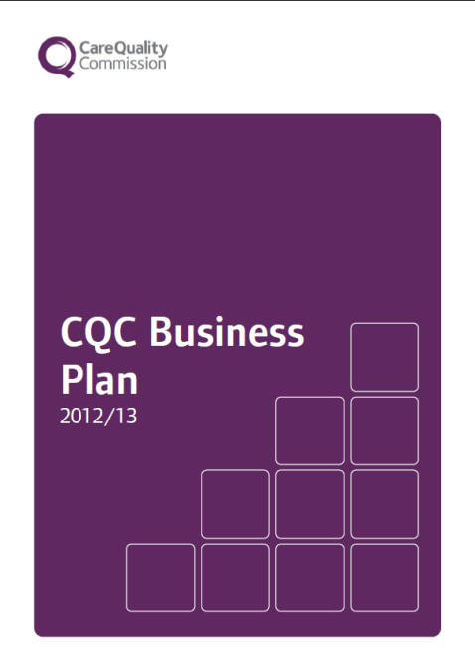
Our purpose and role
Our purpose
We make sure health and social care services provide people with safe, effective, compassionate, high-quality care and we encourage care services to improve
Our role
We monitor, inspect and regulate services to make sure they meet fundamental standards of quality and safety and we publish what we find, including performance ratings to help people choose care
2

Slide 3
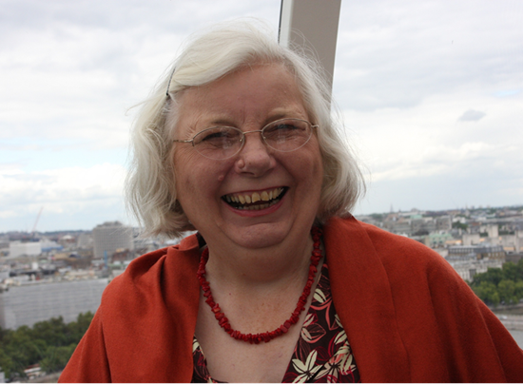
The Mum Test
Is it responsive to people’s needs?
Is it good enough for my Mum?
Is it
effective?
Is it safe?
Is it
well-led?
Is it caring?
My Dad? My Nan? My brother? My friend? Me?
Andrea’s Mum!

Slide 4
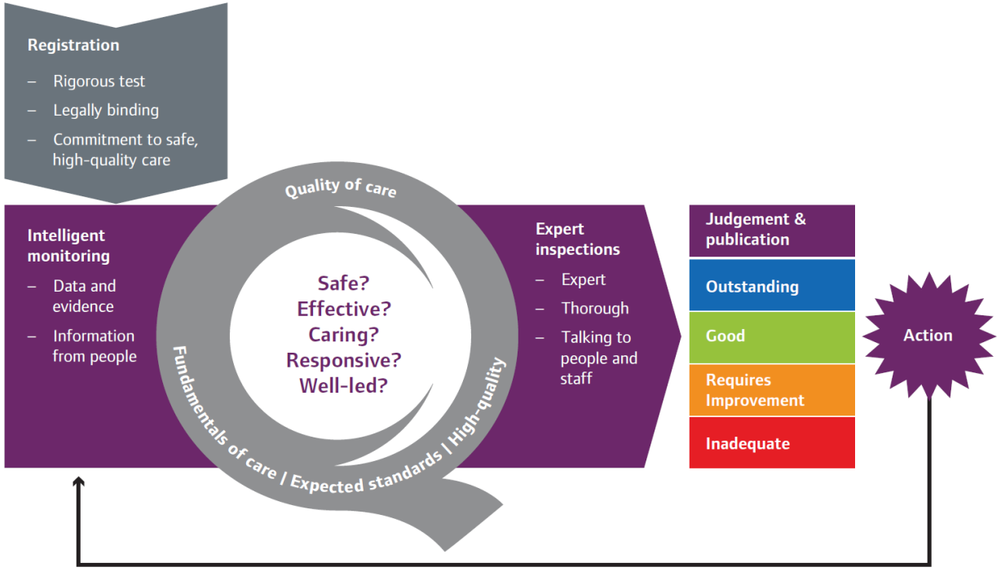
CQC operating model

Slide 5
What will be different
Now | Future
Outcomes | 5 key questions – Safe, Effective, Well led, Responsive & Caring?
Guidance about compliance | KLOEs (21 in total, 16 mandatory) and characteristics of ratings
Focus on compliance | What good looks like – quality, improvement and ratings
Reporting non-compliance | Report answers 5 questions and mum’s test
Annual inspection | Frequency determined by ratings 6 months to 2 years
Ongoing monitoring | Improved by better information

Slide 6
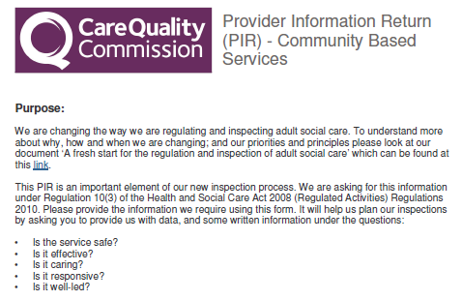
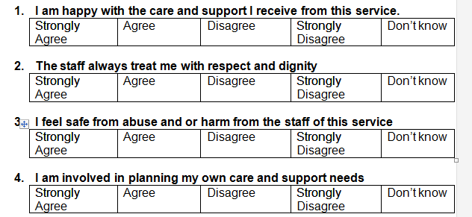

What will be different:
The PIR and questionnaires
Provider information return:
  Provider
Questionnaires:
  People who use the service
  Family and friends
  Staff
  Community professionals
Aligned to the 5 key questions

Slide 7
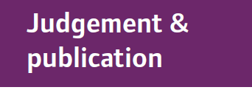
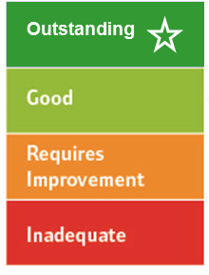
Four point scale
High level characteristics of each rating level
Innovative, creative, constantly striving to improve, open and transparent
Consistent level of service people have a right to expect, robust arrangements in place for when things do go wrong
May have elements of good practice but inconsistent, potential or actual risk, inconsistent responses when things go wrong
Severe harm has or is likely to occur, shortfalls in practice, ineffective or no action taken to put things right or improve
7
Notes:
Following each inspection, we will judge whether services are outstanding, good, requires improvement or are inadequate.
We have developed characteristics to describe what each of these ratings looks like (

Slide 8
Caring KLOE - How is people’s privacy and dignity respected and promoted?
Caring KLOE – Residential Services (C3)
How are people assured that information about them is treated confidentially and respected by staff?
Do people have the privacy they need?
Are people treated with dignity and respect at all times?
Can people can be as independent as they want to be?
What arrangements are there for making sure that the body of a person who has died is cared for in a culturally sensitive and dignified way?

Slide 9
Caring KLOE – Residential Services (C3)
Do staff understand and promote respectful and compassionate behaviour within the staff team?
Are people’s relatives and friends able to visit without being unnecessarily restricted?
How does the service make sure that staff understand how to respect people’s privacy, dignity and human rights?

Slide 10
Timetable
Oct 2013 – March 2014
Co-production and development to shape consultation proposals
April 2014
Consultation on regulatory approach, ratings and guidance
April –
May 2014
Wave 1 pilot inspections
June 2014
Evaluation; guidance and standards refined.
July – Sept 2014
Provider guidance consultation. Wave 2 pilot inspections, initial ratings of services
Oct 2014
New approach fully implemented and indicative ratings confirmed
March 2016
Every adult social care service rated

Slide 11

  Why does this matter?
People are at the heart of it
11

Slide 12


Get involved
enquiries@cqc.org.uk
@CareQualityComm
www.cqc.org.uk

Slide 13
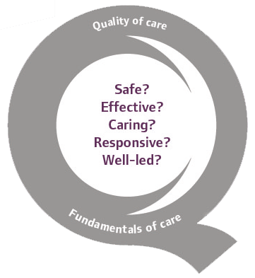
  Thank you
www.cqc.org.uk
Sue Howard
Interim Deputy Chief Inspector of Adult Social Care
13

