Slide 1
Workforce resilience and crisis preparedness

Slide 2
Where are we now?
What have we learnt?
What has worked well?

Slide 3
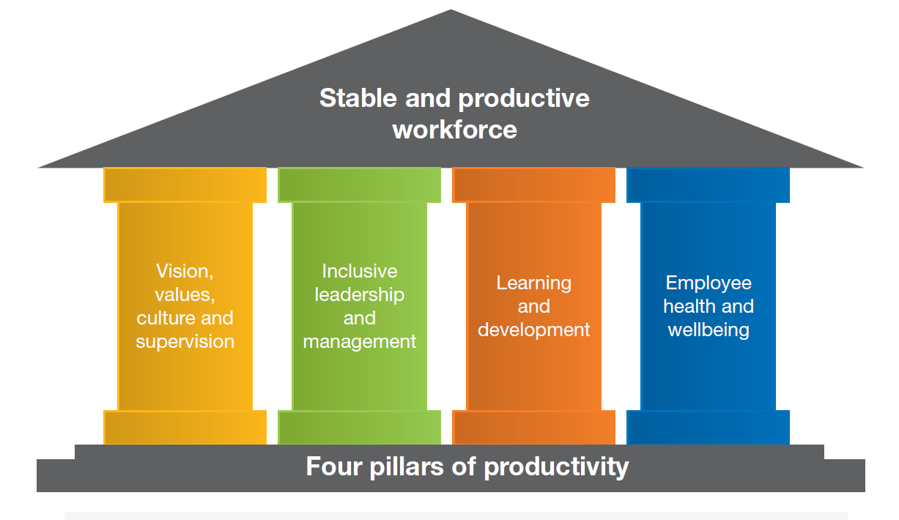

Slide 4
Reflections and moving forward
Pause
Reflect
Recharge
Act
What have we…
Learnt
Loved
Lacked
Longed for…

Slide 5
Please visit the Skills for Care website www.skillsforcare.org.uk
Contact :
Jim.Thomas@skillsforcare.org.uk

