Slide 1
DIGNITY
DIGNITY TRAINING
Notes:
OVER THE YEARS THE COUNCIL HAS RECEIVED MANY REQUESTS FOR DIGNITY TRAINING. WHILST WE DO NOT HAVE THE RESOURCES TO DELIVER SUCH TRAINING ON A REGULAR BASIS, WE DO BELIEVE THAT WE CAN PROVIDE GUIDANCE AND SUPPORT TO OTHERS IN DELIVERING SUCH TRAINING. THE PACK WE HAVE DEVELOPED IS INTENDED TO OPERATE ON TWO LEVELS.
TO PROVIDE ORGANISATIONS AND INDIVIDUALS WITH
A METHOD OF EXPLORING THEIR OWN APPROACH TO DIGNITY AND
ENSURING THAT THE TRAINING THEY DELIVER MEETS SOME KEY OBJECTIVES.
THE POWERPOINT PRESENTATION PROVIDES THE BASIS OF THE KNOWLEDGE DELIVERY AND THE WORKBOOK PROVIDES THE OPPORTUNITY FOR PARTICIPANTS TO RECORD THEIR KNOWLEDGE BASE AND ATTITUDES AND DEVELOP THE COMMITMENT TO DELIVERING SERVICES WITH DIGNITY, RESPECT AND COMPASSION. It is intended that the two be used together and that they provide a structured approach to this learning. The council is happy to validate training delivered using a sampling method of workbooks and in house observation reports.
We are conscious that many organisations have developed their own packs over the years and we would hope that this pack will provide a benchmark against which to ensure that there are consistent messages around Dignity, Compassion and Respect.
Trials of the pack have shown that it can be delivered in about four hours, although this will vary according to how much discussion is enabled and the number of examples that are used to explore the concepts of dignity in all its guises.

Slide 2
COURSE OBJECTIVES
By the end of the training participants will be able:-
To define what dignity means to them
To describe what delivering services with dignity might mean
Challenge behaviours and practices that do not ensure dignity.
To demonstrate in their own practice an understanding of dignity.
Notes:
We are keen to ensure that any training should be based on the observation of practice and not just a tick box exercise, so although this course enables the underpinning knowledge and context to be explored, we do believe very strongly that in order to be qualified there should be at least one observation of practice undertaken. We also would recommend that refresher training is offered at regular intervals, ideally annually. Whilst the aim is to instil a dignified approach in all that we do we are aware that familiarity can result in ‘shortcuts’ and less than ideal approaches.

Slide 3
DIGNITY TRAINING
Notes:
This pack is intended to be used as a baseline training tool around the concept of Dignity and how it might be encouraged in the setting in which people are working or living. The pack provides core messages that are consistent and the underpinning knowledge to enable individuals to deliver services and support in a manner which respects the dignity of those with whom they are working, supporting and / or living, and evidences the core values of compassion, respect and dignity.
The pack should be seen as more than delivering information and it is fundamental that any person who is seen as successfully completing the course should undergo actual observation of their practice to ensure that evidences the implementation of what they have learned.
There are a number of questions at the end of the course which provide an opportunity to test an individual’s understanding of the knowledge element and begin to test the application of that knowledge. However, it must be emphasised that working in a manner that evidences a commitment to dignity and all that means is more than a philosophical exercise and must be evidenced in actual physical behaviour.
Experience has led us to believe that whilst this course can be completed on an individual basis, participants do benefit from the opportunity to discuss and bounce ideas off one another. It is therefore recommended that the work should be undertaken in pairs or small groups.
The accompanying workbook provides space to record discussions at various points in the training, as well as the answers to the questions, and a record of observed practice. It is expected that participants should achieve 80% correct answers alongside a piece of observed practice in order to be achieved a pass.
Practical trialling of the pack has indicated that it should take in the region of four to five hours to complete, dependent on the amount of discussion that takes place.

Slide 4
DEFINING DIGNITY
Notes:
THE STARTING POINT IS TO LOOK AT DIGNITY AS DEFINED BY A VARIETY OF SOURCES AND THEN EXPLORE WHAT DIGNITY MIGHT LOOK LIKE IN PRACTICE. EXPERIENCE HAS TAUGHT US THAT DIGNITY IS NOT EASY TO DEFINE BUT THAT EVERYONE KNOWS WHEN THEY FEEL THEY ARE BEING TREATED WITHOUT DIGNITY. EXAMPLES OF POOR PRACTICE ARE SUPPLIED BUT THE EXPECTATION IS THAT PARTICIPANTS WILL USE THEIR OWN EXPERIENCE AND KNOWLEDGE TO EXPLORE THE TOPIC.

Slide 5
CONTEXT
LEGISLATION
PERSONAL BELIEFS
REGULATIONS
SOCIETAL EXPECTATIONS
ORGANISATIONAL POLICIES AND PROCDEURES.
LIFE EXPERIENCE
Notes:
THE COURSE THEN GOES ON TO LOOK AT THE CONTEXT IN WHICH SERVICES ARE DELIVERED AND HOW DIGNITY MIGHT BE JUDGED. THIS INCLUDES LOOKING AT THE LEGISLATION AND REGULATORY BASE. AT THIS STAGE PARTICIPANTS ARE ASKED TO EXPLORE HOW THEIR OWN LIFE EXPERIENCE AFFECTS THE WAYS IN WHICH WE VIEW DIGNITY. THERE IS THE OPPORTUNITY FOR DISCUSSING HOW DIGNITY IN OUR INTERACTIONS IS NOT “BLACK OR WHITE”, AND HOW DIGNITY FOR ONE PERSON MIGHT IMPACT ON THE DIGNITY OF OTHERS. A RANGE OF SCENARIOS ARE PROVIDED TO START THIS THINKING, BUT WE ARE ALSO VERY AWARE OF THE FACT THAT ACTUAL CASE STUDIES HAVE A GREATER IMPACT, AND THAT ORGANISATIONS MAY ALREADY USE ‘YOU TUBE’ AND OTHER SOURCES OF SUCH CASE STUDY MATERIAL. THE IMPORTANT THING IS ABOUT HAVING THE DISCUSSION AND STARTING TO LOOK AT HOW ORGANISATIONAL, SOCIETAL AND PERSONAL CONTEXT HAS AN IMPACT.

Slide 6
NATIONAL DIGNITY COUNCIL
Notes:
THE COURSE THEN LOOKS AT THE AIMS AND TARGETS OF THE NATIONAL DIGNITY COUNCIL, and the Dignity Campaign INCLUDING ITS HISTORY AND DEVELOPMENT This is to enable participants to understand that whilst there has been much discussion about the importance of delivering services with dignity, compassion and respect, unfortunately there is still much to do to ensure that everyone who needs or accesses support experiences those core values in the way that support is delivered.

Slide 7
DIGNITY CHAMPIONS
Notes:
DIGNITY CHAMPIONS ARE FUNDAMENTAL TO THE NATIONAL DIGNITY CAMPAIGN AND THE SPREADING OF KEY MESSAGES. TIME IS TAKEN TO EXPLORE THE ROLES THAT CHAMPIONS MIGHT TAKE AND THE ACTIONS THEY MIGHT TAKE TO CHANGE THE NATURE OF THE EXPERIENCE OF THOSE THEY SUPPORT OR WITH WHOM THEY WORK.

Slide 8
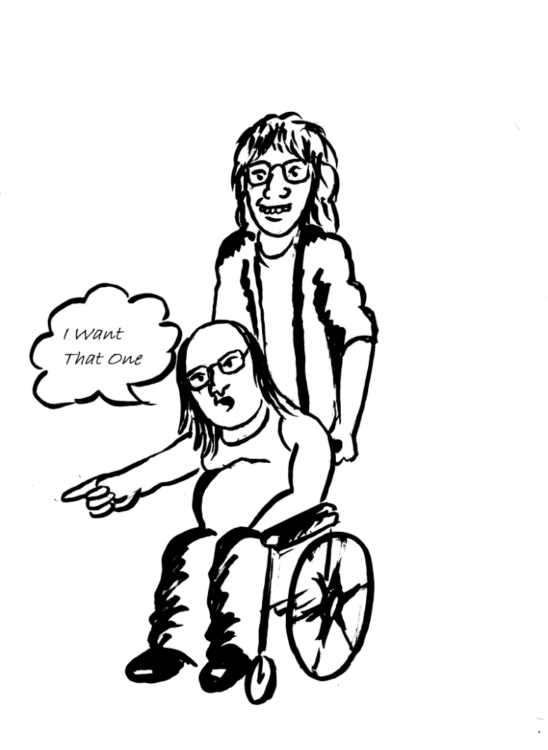
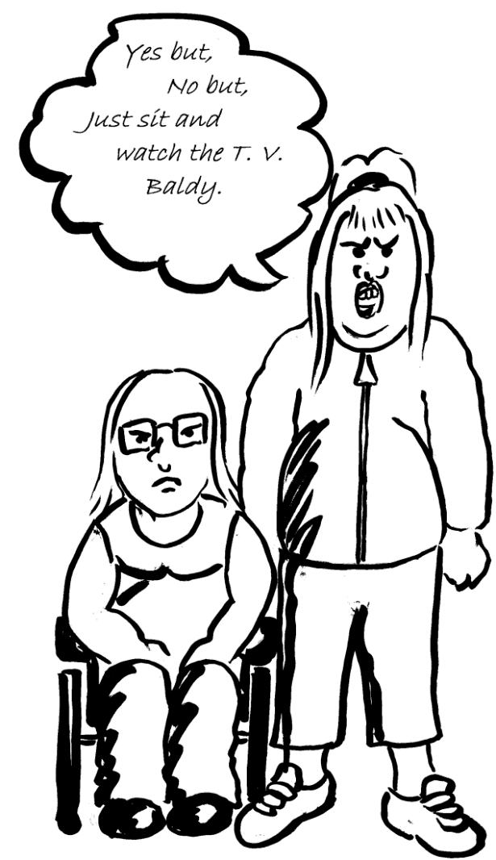
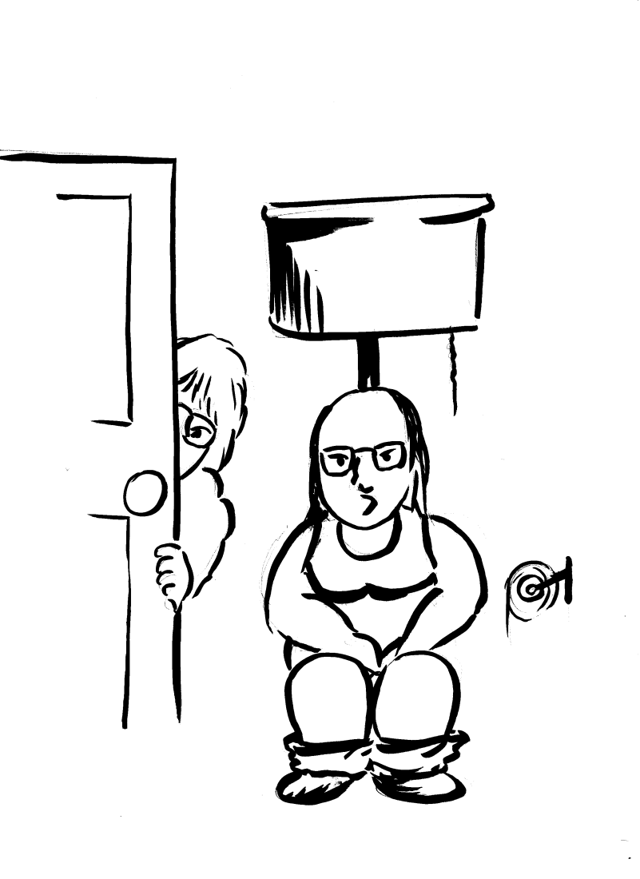
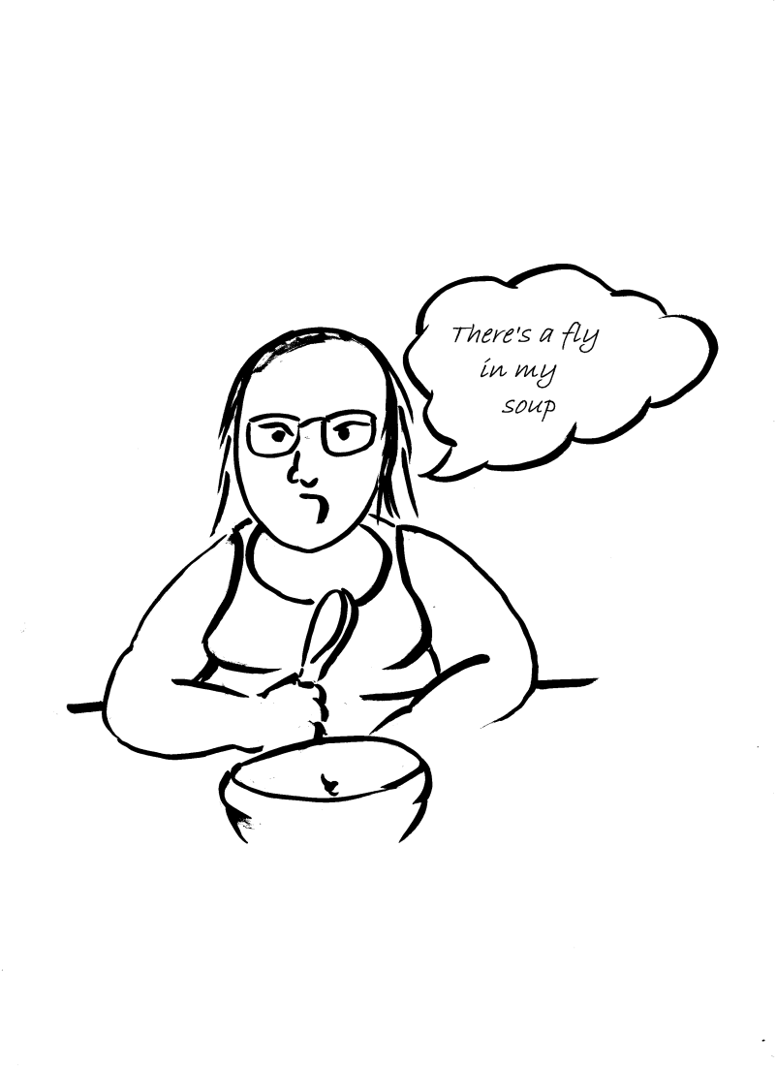
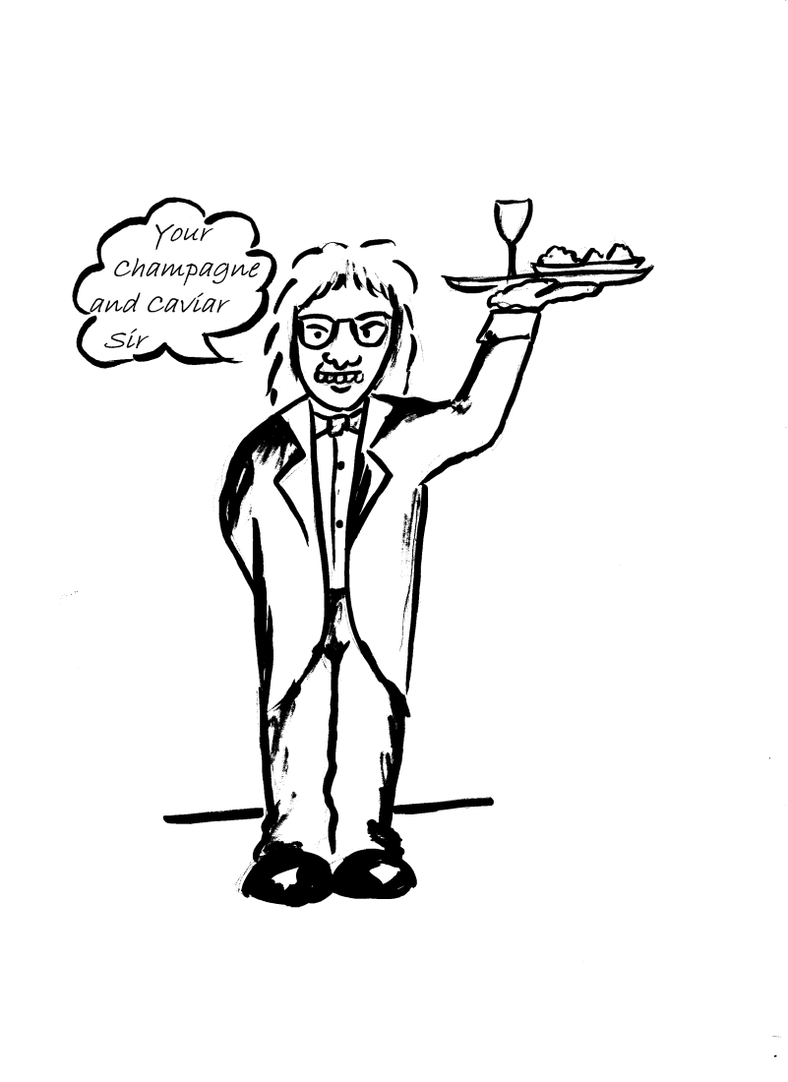
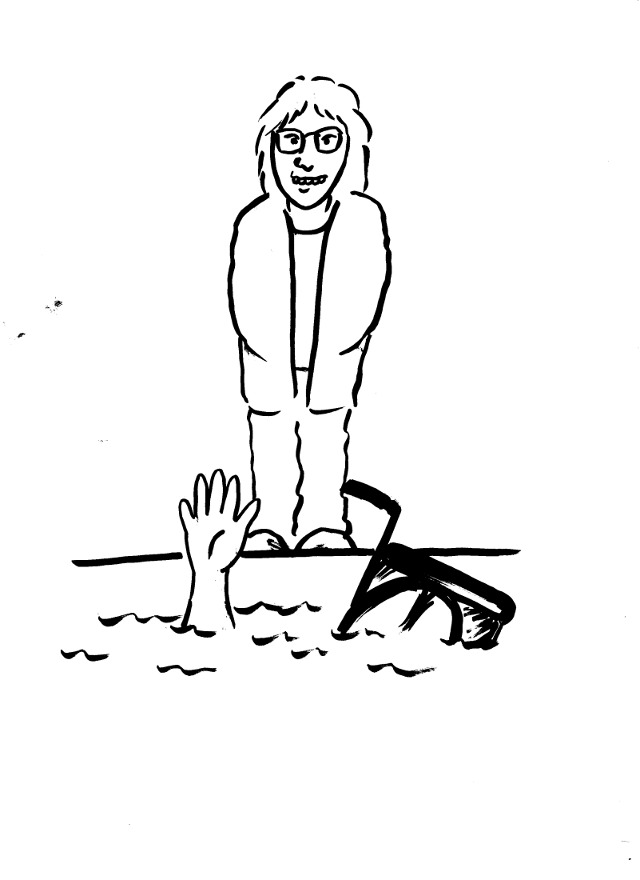
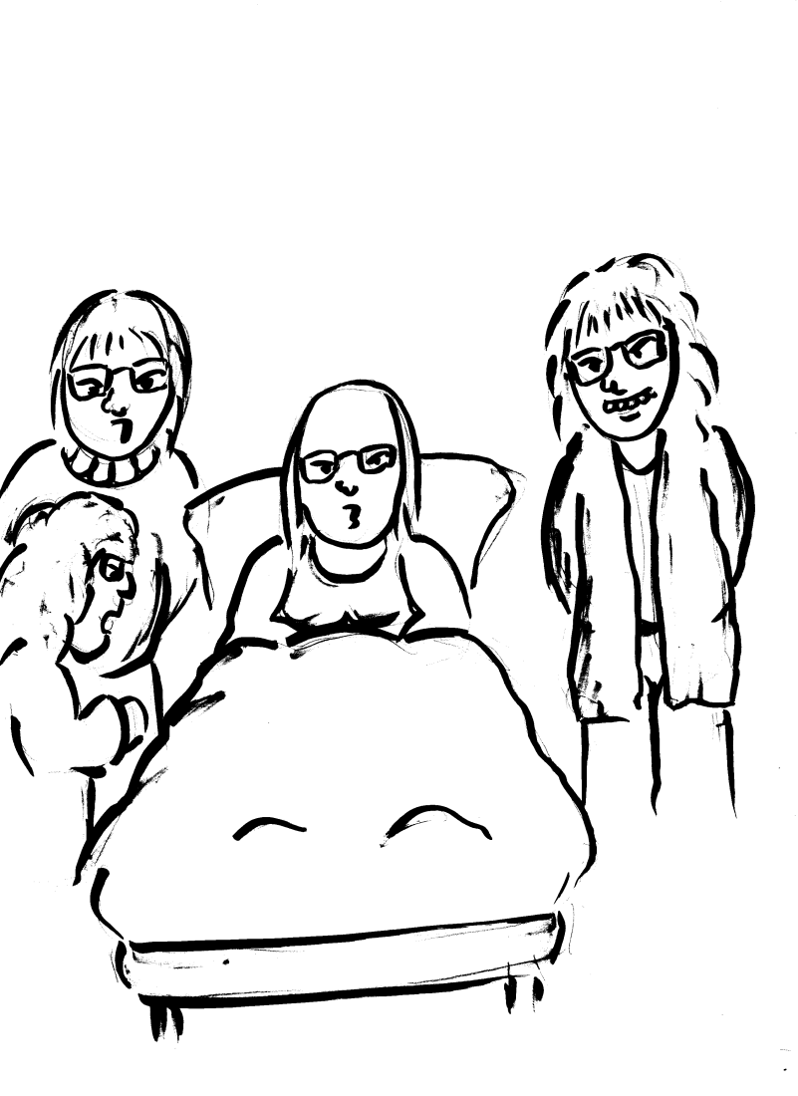
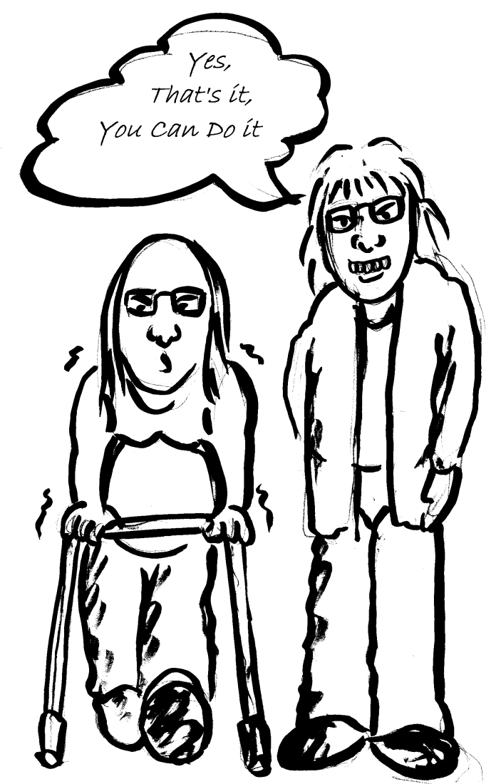
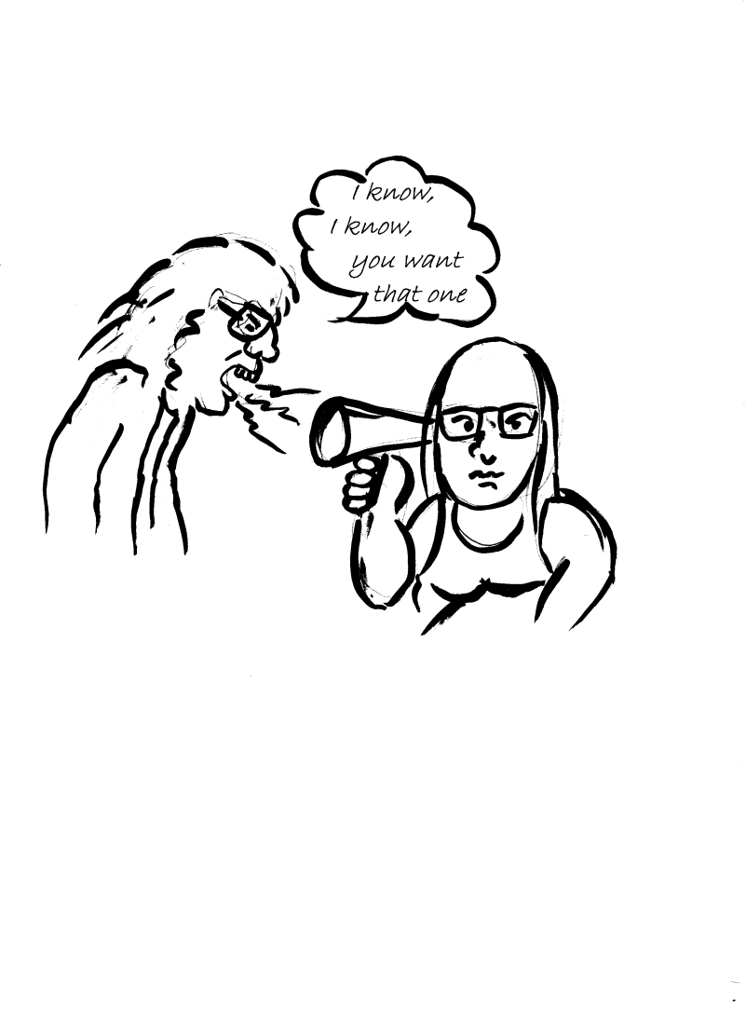
DIGNITY DOS
Notes:
THE TEN DIGNITY DO’S UNDERPIN ALL THAT CHAMPIONS AND THE CAMPAIGN STAND FOR AND THE COURSE CONCLUDES BY LOOKING AT EACH IN SOME DETAIL AND ENABLING PARTICIPANTS TO THINK ABOUT HOW THEY MIGHT PUT EACH INTO PRACTICE IN THEIR ORGANISATIONS AND DAILY INTERACTIONS WITH OTHERS.

Slide 9
NEXT STEPS
Develop a companion training pack for managers
Develop validation and certification schemes for in house training
Work with our partners to ensure consistency across the sector,

