Slide 1



Vanda Carter
RGN, Dip HE. MA , PhD Candidate
Practice Education Facilitator for Research
Setting up a dignity teaching module for pre-registrants

Slide 2


Question
How can we measure Dignity?

Slide 3
How can we measure Dignity? Here are my thoughts…….
Quantitative and qualitative research or evaluation
Feedback formal/informal
Complaints/ Litigation
Family and friends test
Patient experience ie CQC, PALS
CQC ratings
Audits
Statistics
Staff survey
Observation
Gut feelings
Gauging the atmosphere. How comfortable do you feel
Your moral compass guide

Slide 4

RWT Project Team
Vanda Carter - Practice Education Facilitator for Research
Karen Meridith - Practice Education Facilitator Pre- Registration
Nurse Education
Karen Bowley - Senior Matron
Tony Wheate - Practice Education Facilitator -
Jan Burns MBE - Chair of the UK Dignity Council
Judith Davis - PALS

Slide 5
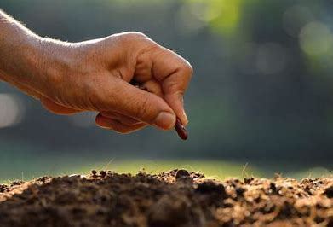

Slide 6

Learning Aim and Objectives:
By successfully completing this workshop you can earn the right to be called a “Dignity Champion”. Your will receive a certificate and a badge.
The blended learning module is assembled to offer you a unique learning opportunity of exploration and self-discovery around the subject of dignity. What does dignity mean to you? This is prepared for to you work through systematically via a suite of 10 different dignity, related activities.

Slide 7
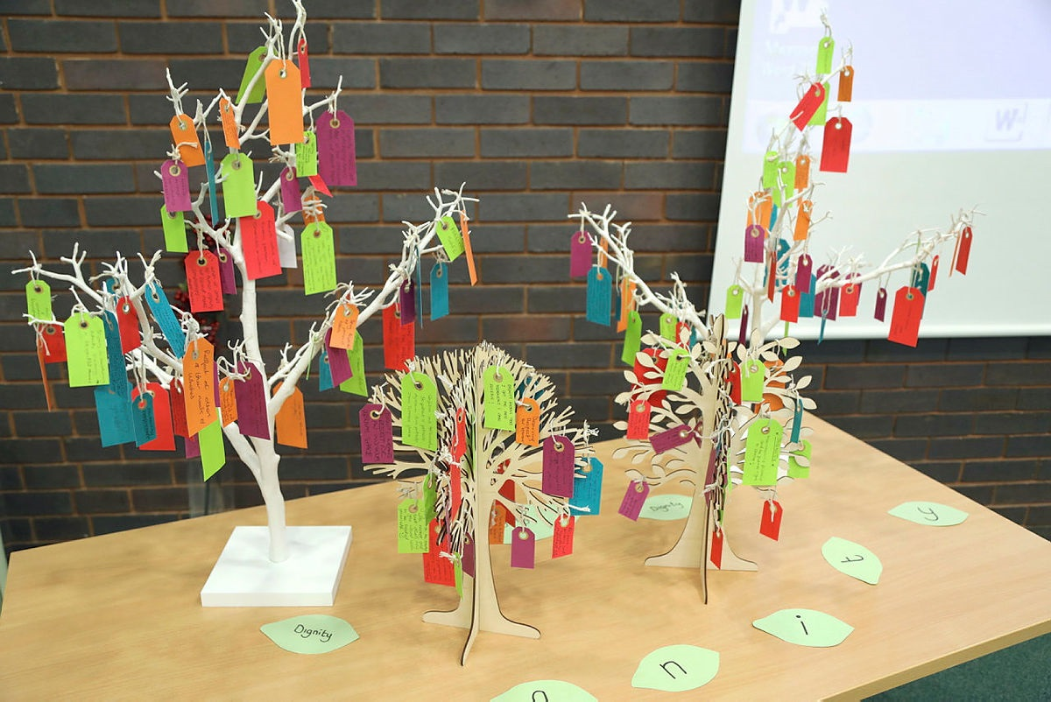
Contents:
Project Team
Forward by Jan Burns, MBE – National Dignity Council Chair
Introduction:
Learning Objectives:
Equipment and materials
Activities 1-10
Final comments
Further reading and Tools
Dignity Commitment
Evaluation form

Slide 8
The Dignity Commitment
The 10 Dignity Do's
Have a zero tolerance of all forms of abuse
Support people with the same respect you would want for yourself or a member of your family
Treat each person as an individual by offering a personalised service
Enable people to maintain the maximum possible level of independence, choice and control
Listen and support people to express their needs and wants
Respect people's right to privacy
Ensure people feel able to complain without fear of retribution
Engage with family members and carers as care partners
Assist people to maintain confidence and positive self-esteem
Act to alleviate people's loneliness and isolation

Slide 9

Next steps and piloting the project at RWT

Slide 10

PRESS PLAY - How Wolves Change Rivers?
Notes:
https://www.youtube.com/embed/ysa5OBhXz-Q?start=6

Slide 11

“Tell me and I forget. Teach me and I remember. Involve me and I learn.” – Benjamin Franklin
It is now over to you………
Thank you

