Slide 1
ENJOYING LIFE WITH DIGNITY AT THE HEART OF EVERYTHING WE DO

Slide 2
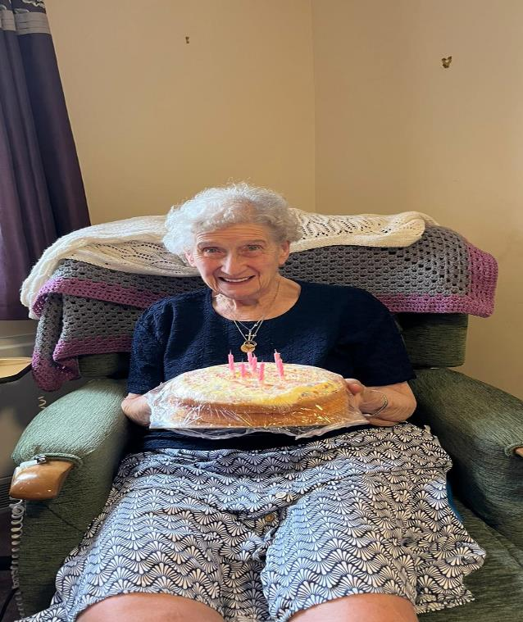
LIVING WELL
JOAN - LIVED AT HOME WITH SUPPORT FROM FRIENDS WHO ARE LIKE FAMILY
AFTER AN ILLNESS DECIDED SHE NEED MORE SUPPORT
INTERESTS SOCIALISING, SINGING AND CHURCH
JOINED THE CHOIR
TOOK PART AND HELPED AT CHURCH FAYRE SELLING SWEETS SHE HELPED TO MAKE UP
FREQUENT VISITORS AS AUNTY TO MANY
FEELS WORTHWHILE AND SAFE

Slide 3
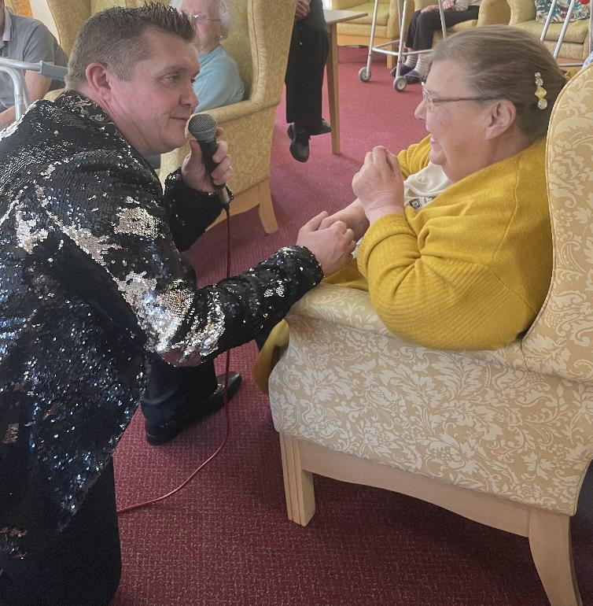
LIVING WITH DIGNITY
GLENYS - PARTIAL SIGHTED LIVED INDEPENDENTLY IN THE COMMUNITY FOR MANY YEARS CARING FOR HER BROTHER
HAD MANY ADVENTURES AND LIVED AN ACTIVE LIFE WITH SUPPORT OF PA’S
AS SHE BECAME MORE DEPENDENT TRIED RESPITE CARE IN 2015 AND STAYED
STILL ENJOYED HOLIDAYS AWAY INDEPENDENTLY WITH SUPPORT
JOINED THE CHOIR
ENJOYS BEING PART OF THE CHURCH FAMILY
PARTICIPATES IN ALL ACTIVITIES - LIKES TO GIVE BACK TO OTHERS

Slide 4
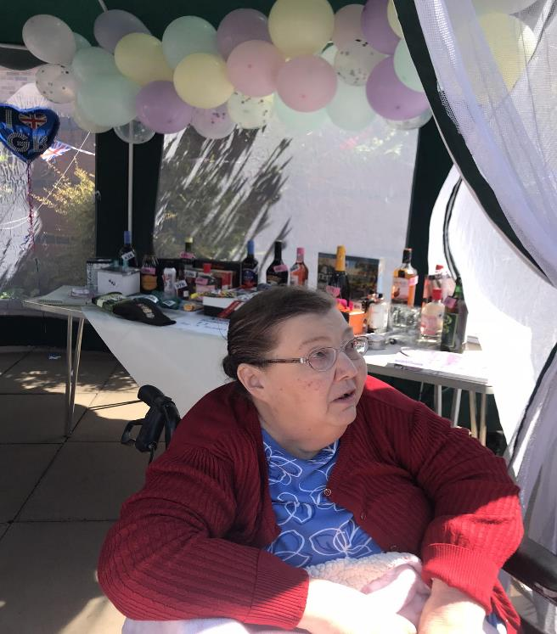
LIVING WITH DIGNITY
COMPLETED CARE CERTIFICATE
WORKING ON THE OLIVER MCGOWAN TRAINING AT PRESENT
ACTIVE DIGNITY CHAMPION
HELPS TO INTERVIEW NEW STAFF - ASKING THEM WHAT DIGNITY MEANS TO THEM
GLENYS LOVES HELPING AT EVENTS

Slide 5
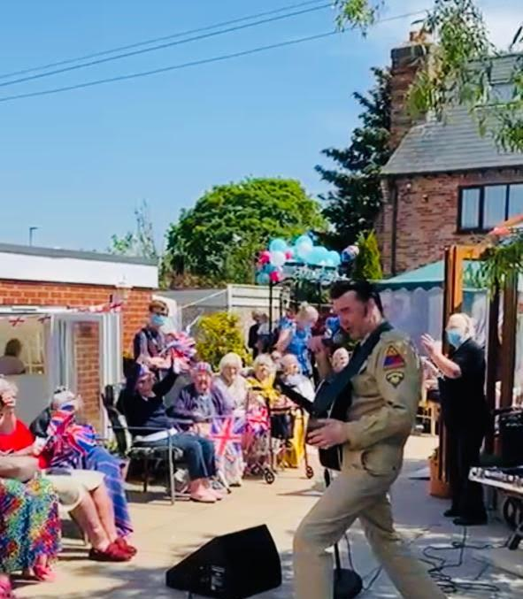
DIGNITY AT THE HEART OF EVERYTHING
ACTIVITES WITH A PURPOSE
OUR RESIDENTS HAVE DECORATED THE VILLAGE WITH POSTERS
RAINBOW POSTERS DURING THE PANDEMIC
POSTERS TO CELEBRATE VE DAY
POSTERS TO CELEBRATE THE QUEENS JUBILEE
INVITED THE COMMUNITY INTO OUR HOME TO CELEBRATE EVENTS

Slide 6
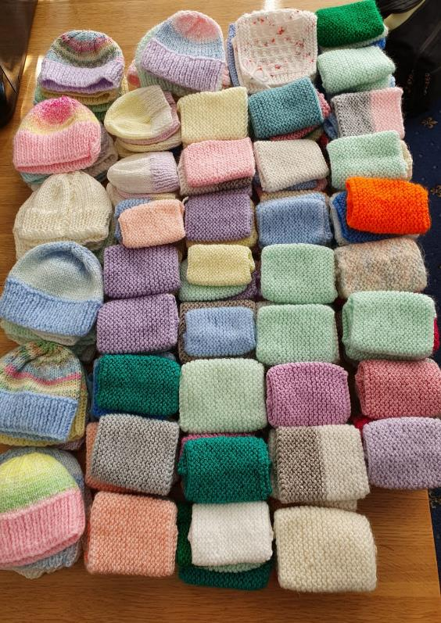
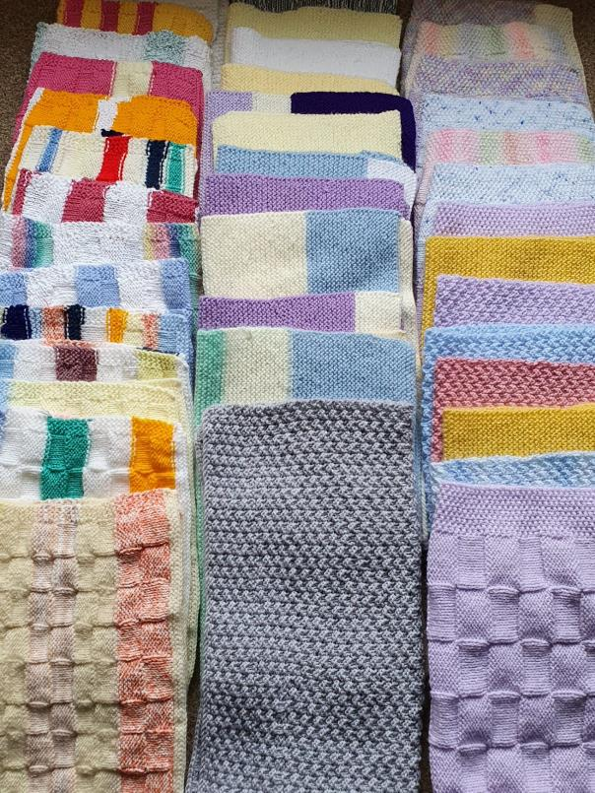
LIVING WELL AND HELPING OTHERS
ACTIVITES HAVE INCLUDED
KNITTING FOR NEO NATAL UNITS, HATS, CARDIGANS, BLANKETS AND CANNULA COVERS
KNITTING COVID HEARTS FOR THE COVID WARDS
KNTTING AND PUTTING TOGETHER BASKETS FOR NEW MUMS AND BABIES
BLANKETS FOR OTHERS IN CARE
MAKING BIRD FEEDERS FOR THE GARDEN

Slide 7
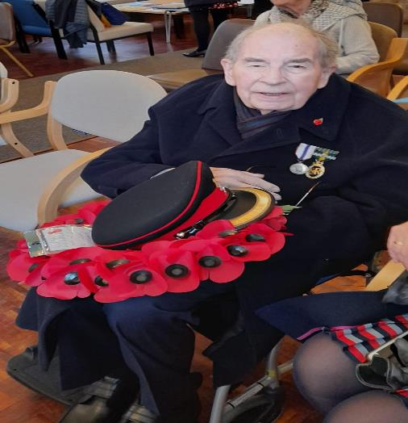
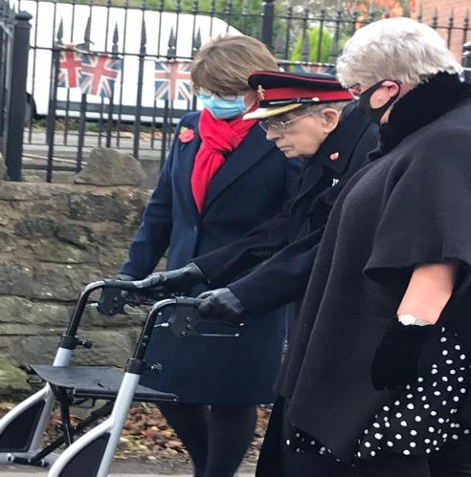
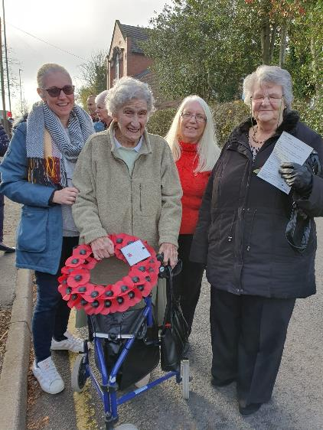
MAKING FRIENDS AND LIVING WELL
COMMUNITY INVOLVEMENT
THE LOCAL CHURCH ARE OUR FRIENDS AND VISIT REGULARY WITH A SERVICE WITHIN THE HOME MONTHLY
VILLAGE CHOIR – ACTIVE MEMBERS OF THE VILLAGE CHOIR PERFORMING AT REGULAR EVENTS AND CONCERTS
WE ATTEND COMMUNITY EVENTS FUNDAYS AND FAYRES, SPECIAL SERVICES – REMEBERANCE DAY – LAYING A WREATH AT THE CENOTAPH
PART OF THE LOCAL RESIDENTS ASSOCIATION

Slide 8
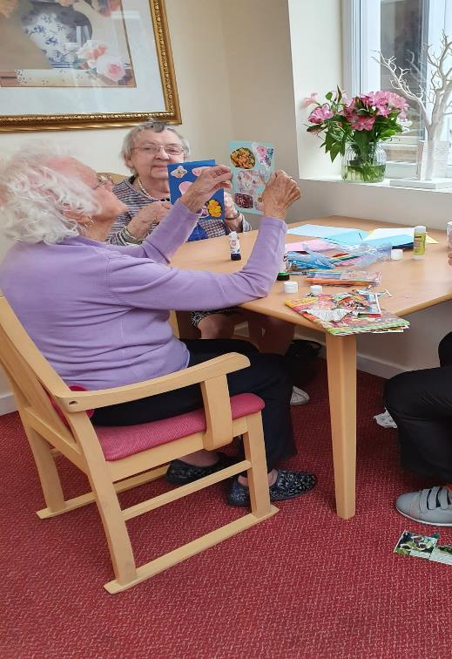
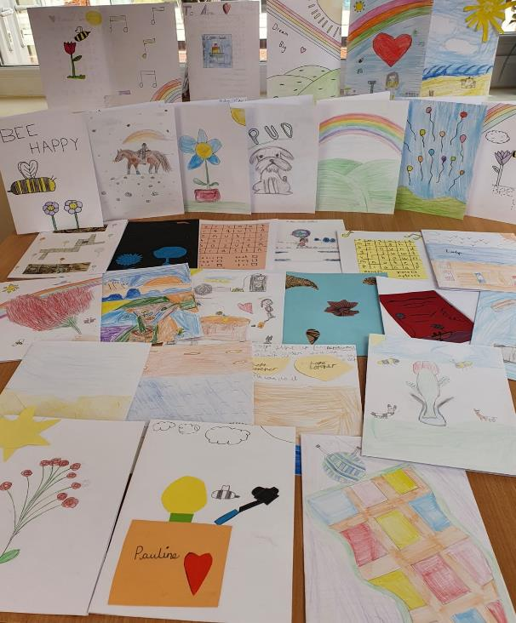
MAKING FRIENDS AND LIVING WELL
INTER GENERATIONAL – BREATH OF FRESH AIR
LINKS WITH LOCAL SCHOOLS DURING THE PANDEMIC – REGULAR CARDS FOR EACH RESIDENT – RESIDENTS WROTE BACK CREATING A LINK WHICH HAS LASTED
WLECOMED BACK THE BEAVERS TO SING AT CHRISTMAS
LOCAL SCHOOL VISITED TO SING CAROLS
WELCOMED BACK YOUNG PEOPLE ON WORK EXPERIENCE FROM LOCAL SCHOOLS
YOUNG PEOPLE ON PLACEMENT FROM LOCAL COLLEGE
YOUNG PEOPLE VOLUNTEERING WHO ARE COMPLETING DUKE OF EDINBURG AWARD

Slide 9
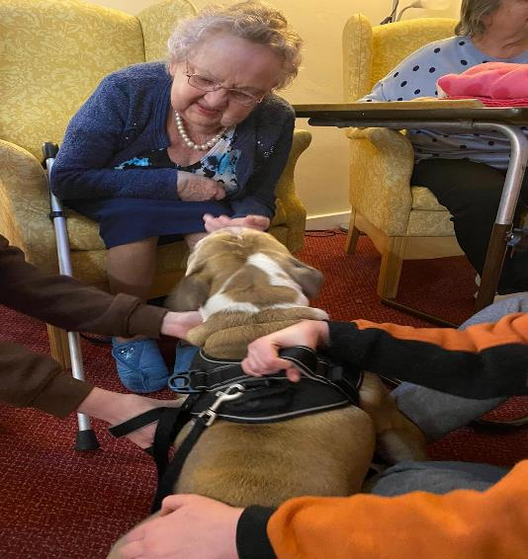
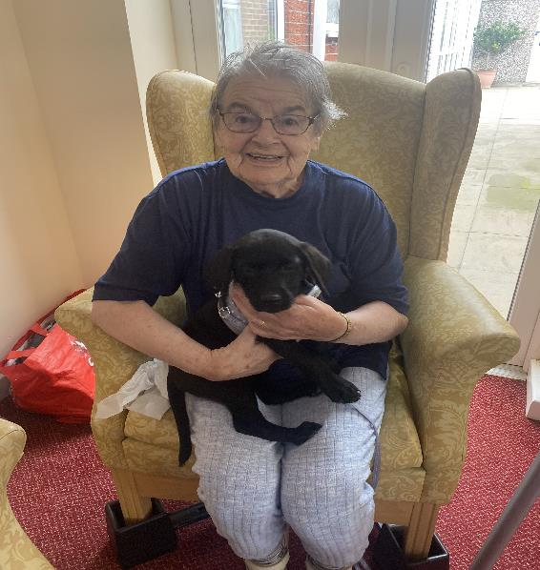
LOTS OF FURRY FRIENDS
PET THERAPY
STAFF HAVE BROUGHT IN FURRY FRIENDS
RESIDENTS HAVE LOVED THE EXPERIENCE OF THE CATS AND DOGS
PETS HAVE ENJOYED THE FUSS

Slide 10
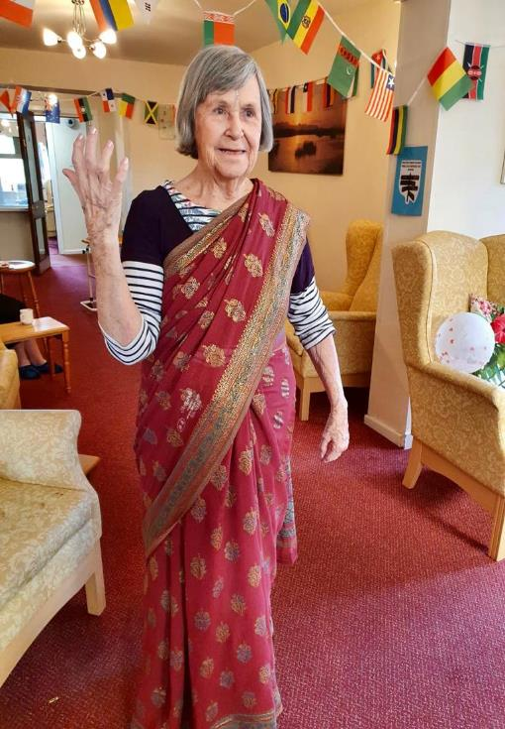
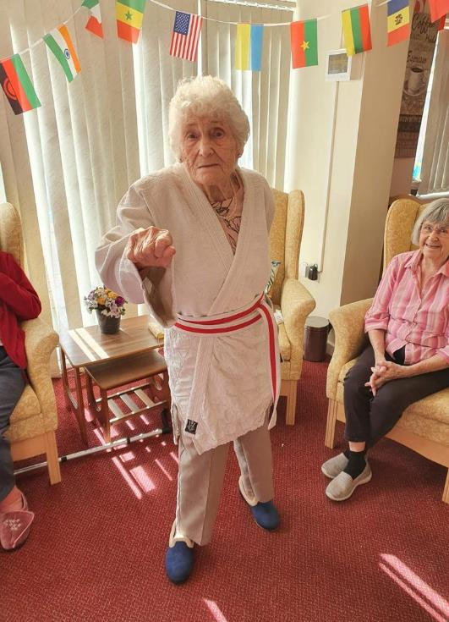
CELEBRATING CULTURE
DIGNITY CRUISE CELEBRATED DIFFERENT CULTURES, FOODS AND EXPERIENCES FROM AROUND THE WORLD
RESIDENTS ENJOYED THE EXPERIENCE OF VISITING DIFFERENT PLACES, EXPLORING CULTURE AND TASING DELICIOUS FOOD

Slide 11
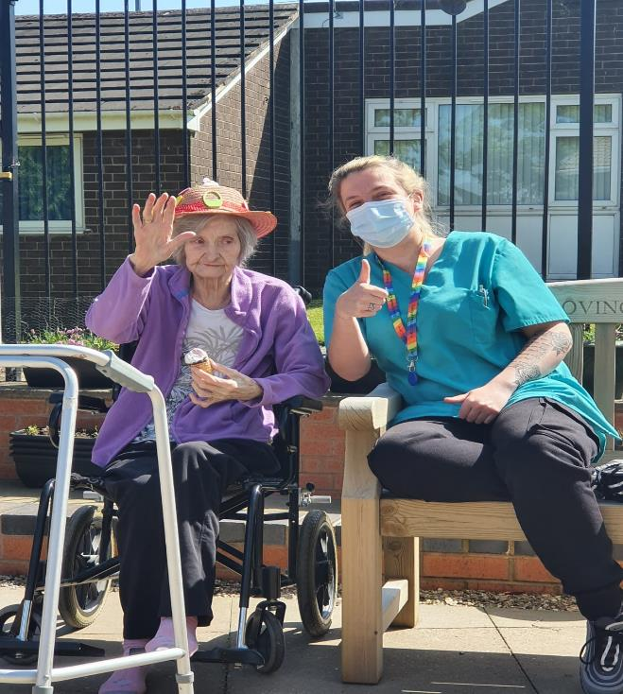
ACTIVITIES DESIGNED WITH THE RESIDENTS AT THE HEART MAKING CHOICES
ICECREAMS IN THE GARDEN – MAKES EVERYONE HAPPY
PAMPER AND SPA DAYS – MAKES EVERYONE FEEL BETTER
CRAFTS – FOR DEXTERITY EASTER BONNET- CHRISTMAS CRAFTS
HEALTHY COMPETITIONS – QUIZES WORD SEARCHES AND SPOT THE DIFFERENCE, FUNNY TONGUE TWISTERS
ASM SPORTS – KEEPING EVERYONE HEALTHY AND ACTIVE
FAVOURITE ENTERTAINERS AND PANTOMINE MAKING EACH EVENT SPECIAL

Slide 12
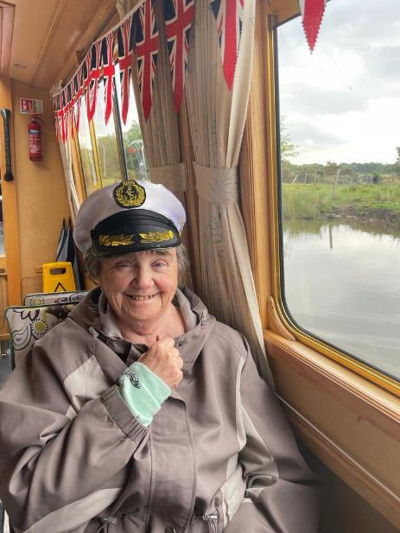
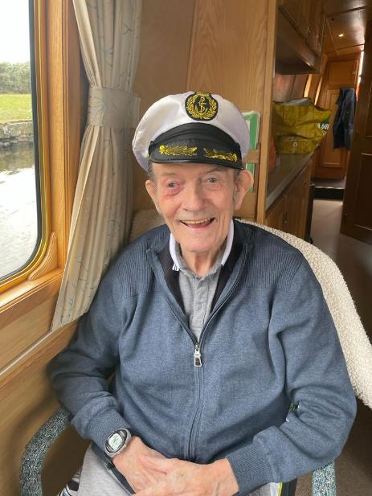
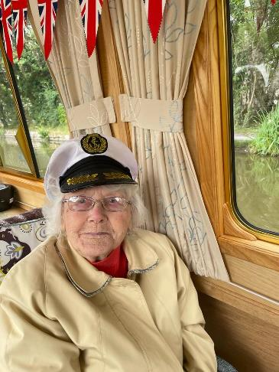
GOING OUT SAFELY
TRIPS ON THE CANAL – SCENIC DAYS OUT WITH FISH AND CHIPS FOR LUNCH
VISITS TO LOCAL BEAUTY SPOTS
DRIVE OUT FOR ICE CREAM
DRIVE THROUGH THE LOCAL COUNTRYSIDE – REMINSCING ABOUT SPECIAL PLACES

