Slide 1




Dignity Workshop Pilot Update
Vanda Carter RN Dip HE, MA,
PhD Candidate

Slide 2
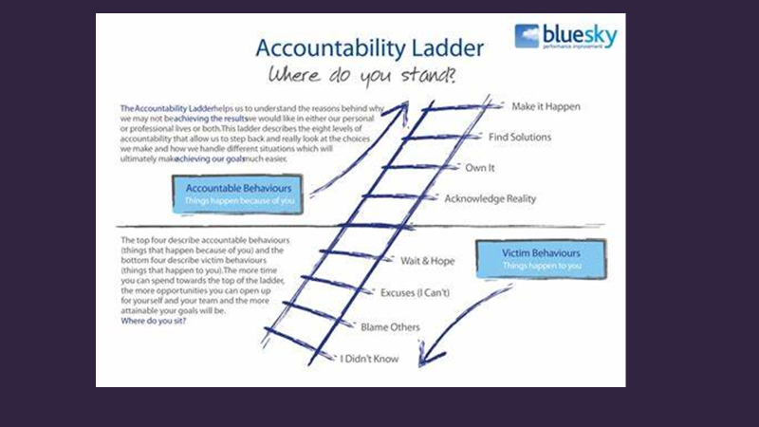

Slide 3

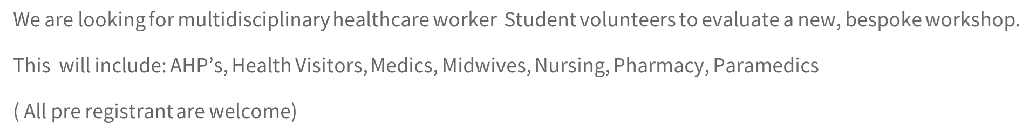

Who are the Target group for the Pilot?

Slide 4

What is Dignity?

Slide 5

What will participants be asked to do?
Learning contract - the dignity dos
10 learning activities and signposting to resources
Evaluation
Delegates will not be paid for taking part
Delegates will receive a certificate for completing, Dignity Council badge and a Dignity Champion new status

Slide 6


