Slide 1
CQC’s new assessment framework
Dave James
Head of Adult Social Care Policy, CQC

Slide 2
Our role and purpose
The Care Quality Commission is the independent regulator of health and adult social care in England.
We make sure health and social care services provide people with safe, effective, compassionate, high-quality care and we encourage care services to improve.

Slide 3
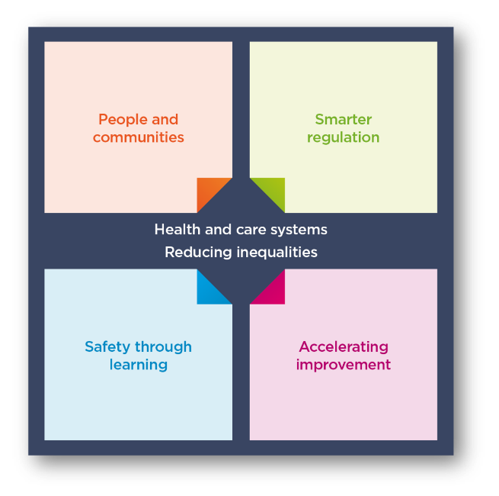
Our new strategy
Notes:
We are being ambitious.
The health and social care landscape has changed drastically since 2016, when our previous strategy was published. Changes in the health and social care sector have been accelerated by the pandemic, increasing the needs of those who access health and social care services and placing additional challenges on service providers to meet them.
Our role as the regulator of health and social care in England has also been impacted greatly by the pandemic, affecting our ability to inspect all services and provide the necessary assurance to the public of their safety.
We’re changing how we regulate to improve care for everyone.
What we’ve learned from the past five years puts us in a better position for the future. Our new strategy combines this learning and experience and we’ve developed it with valuable contributions from the public, service providers and all our partners. It means our regulation will be more relevant to the way care is now delivered, more flexible to manage risk and uncertainty, and will enable us to respond in a quicker and more proportionate way as the health and care environment continues to evolve.
This new strategy strengthens our commitment to deliver our purpose: to ensure health and care services provide people with safe, effective, compassionate, high-quality care and to encourage those services to improve. Our strategy is purposefully ambitious, and to implement it we will need to work closely with others to make it a reality. We’ll review this strategy regularly so we can adapt to changes and be prepared for what the future holds.
Our strategic themes:
We’ll continue building the underpinning systems and structures, and making changes, to enable our strategy over the next two to three years, but full realisation of the strategy will take longer as we continuously learn and evolve, responding to changes in the world around us.
the four interlinked themes that will determine the changes we will make;
People and communities - Regulation that’s driven by people’s needs and experiences, focusing on what’s important to people and communities when they access, use and move between services.
Smarter regulation - Smarter, more dynamic and flexible regulation that provides up-to-date and high-quality information and ratings, easier ways of working with us and a more proportionate response.
Safety through learning - Regulating for stronger safety cultures across health and care, prioritising learning and improvement, and collaborating to value everyone’s perspectives.
Accelerating improvement - Enabling health and care services and local systems to access support to help improve the quality of care where it’s needed most.

Slide 4
Why we are changing our framework
“A lack of coherence across local care systems has an impact on the quality of care people are likely to receive. Without a shared, agreed vision between system partners, achieving positive outcomes is significantly compromised.”
CQC “Beyond Barriers: How older people move between the health and social care system in England.”

Slide 5
Why we are changing our framework
Don’t empower people – 70+ pages!
Not clear and mix legal requirements with more aspirational material; people uncertain as to what our expectations are.
Too many KLOEs with exponential prompt growth – 335 KLOEs and prompts!
Don’t work at system level
Don’t lend themselves to more structured and granular reporting

Slide 6
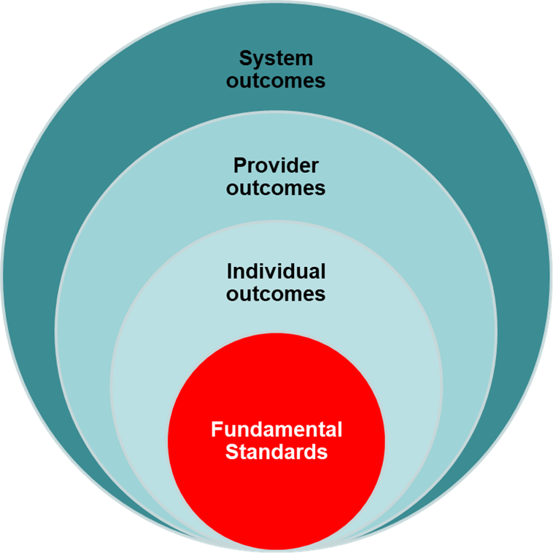
We need a definition of quality that…
Sets out what good and outstanding care looks like for people, in their terms
applies to health and social care
Is widely recognised and adopted
Provides the foundation for CQC work at system level and its ambition to have a clearer role in improvement and safety
reduced inequalities
Making It Real
Safe
Effective
Caring
Responsive
Well-Led
improved access

Slide 7
A single assessment framework
Our framework will assess providers, local authorities and integrated care systems with a consistent set of key themes, from registration through to ongoing assessment
5 Key Questions
Quality Statements
Evidence
Specific evidence and quality indicators
Aligned with “I” statements, based on what people expect and need, to bring these questions to life and as a basis for gathering structured feedback​
Expressed as “We” statements; the standards against which we hold providers, LAs and ICSs to account​
People’s experience​, feedback from staff and leaders​, feedback from partners, observation, processes, outcomes
Data and information specific to the scope of assessment, delivery model or population group
Underpinned by best practice standards and guidance​
Notes:
So what does our new assessment framework look like in a bit more detail?
Our assessment framework is built on our five key questions and well known ratings system and is what we use to set out our view of quality and make judgements.
We have drawn on work done previously by Think Local Act Personal (TLAP), National Voices and the Coalition for Collaborative Care on Making it Real. They co-produced a personalised care and support framework that can be used by people who work in adult social care, health, housing and people who use services. Importantly, this sets out what good and outstanding person-centred care looks like and what people should expect from providers, commissioners and system leaders.
We want to use ‘I statements’ as the starting point for our assessment framework, taking the important first step towards truly regulating through the eyes of the public. As the statements encapsulate the views and expectations of real people, we feel that giving them a prominent place in our single assessment framework helps to focus the whole health and social care system on people at a very human and relatable level.
We’ve already confirmed that our ratings and five key questions will stay central to our approach. But we are introducing a set of ‘quality statements’, pitched at the level of ‘good’ and linked to the regulations that will help us make our judgments about the quality of care. They will replace our current Key Lines of Enquiry (KLOEs) and prompts and be expressed as ‘we statements’ helping to make things clearer for providers about our expectations on them, while reducing the duplication that currently exists across our KLOEs.
We will use this set of statements in our assessments of all sectors and service types and at all levels, using them to register services with a provisional rating of good through to our new work looking at local authorities and integrated care systems. This will be the basis for our single assessment framework.
We want to be more consistent and transparent in our approach and how we make judgments on quality. To address this, we’re developing a way to categorise and score evidence as part of our assessments. The evidence ‘categories’ will bring more structure to our process for assessing quality. The six categories are:
Peoples experiences
Feedback from staff and leaders
Observations of care
Feedback from partners
Processes
Outcomes of care.
To enable us to be clearer with providers and the public about how we use the information we have about care in a service or local area we will set out what evidence will be required for each service type and at each level – including at registration.
In many ways this will all be data and evidence already familiar to providers and to our inspectors, but by bringing in the six categories and setting what we always need to collect and review in order to make a decision, alongside a way of scoring evidence, we are able to bring a more structured and consistent framework for assessing quality.
Our single assessment framework will act as the golden thread from initially registering a service at the level of ‘good’, through to ongoing assessments of quality.

Slide 8
‘I’ statement: When I move between services, settings or areas, there is a plan for what happens next and who will do what, and all the practical arrangements are in place.
‘We/quality’ statement: We work in partnership with others to establish and maintain safe systems of care in which people's safety is managed, monitored and assured, especially when they move between different services.
Notes:
I is the person using the service, and the we is the provider, ICS or LA - it is a commitment on their part
The following quality statements are ‘we’ statements

Slide 9
Local authority assessment

Slide 10
LA Assessment
New powers in Health and Care Act – for local authority assurance and integrated care system assessment
Same “I” statements and focus on people and communities’ experience
Single assessment framework across providers and systems
How well are local authorities delivering against their Care Act duties?

Slide 11
Quality statements: local authority assessment
Theme 1: Working with people
Assessing needs
Supporting people to live healthier lives
Theme 2: Providing support
Care provision, integration and continuity
Partnerships and communities
Theme 3: Ensuring safety
Safe systems, pathways and transitions
Safeguarding
Theme 4: Leadership and workforce
Learning, improvement and innovation
Governance, management and sustainability
Equity in experience and outcomes
Notes:
Under part 1 of the Care Act 2014, local authorities have duties to make sure that people who live in their areas:
Receive services that prevent their care needs from becoming more serious, or delay the impact of their needs
Can get the information and advice they need to make good decisions about care and support
Have a range of high quality, appropriate services to choose from
In delivering these duties, local authorities should work with their communities and other partners (such as the NHS) to make sure services are fit for what local people need now and in the future.
We will be assessing local authorities specifically on these duties.
The initial focus of our local authority assessments will be across four themes:
Working with people
Providing support
Ensuring safety
Leadership and workforce
Similarly to our ICS approach, a subset of quality statements from the single assessment framework will sit under each theme

Slide 12
Annex

Slide 13
Person-centred care: How ‘Making It Real’ applies
SAFE
I feel safe and am supported to understand and manage any risks.
I know what to do and who I can contact when I realise that things might be at risk of going wrong or my health condition may be worsening.
If my treatment, including medication, has to change, I know why and am involved in the decision.
When I move between services, settings or areas, there is a plan for what happens next and who will do what, and all the practical arrangements are in place.
I have considerate support delivered by competent people.
I can get information and advice about my health, care and support and how I can be as well as possible – physically, mentally and emotionally.
EFFECTIVE
I can get information and advice about my health, care and support and how I can be as well as possible – physically, mentally and emotionally.
I have care and support that is coordinated, and everyone works well together and with me.
I can keep in touch and meet up with people who are important to me, including family, friends and people who share my interests, identity and culture.
I have care and support that enables me to live as I want to, seeing me as a unique person with skills, strengths and goals.
I am empowered to get the care, support and treatment that I need and want.
CARING
I am treated with respect and dignity.
I have care and support that enables me to live as I want to, seeing me as a unique person with skills, strengths and personal goals.
I am supported to manage my health in a way that makes sense to me.
I am in control of planning my care and support. If I need help with this, people who know and care about me are involved.
RESPONSIVE
I have care and support that is coordinated, and everyone works well together and with me.
I can get information and advice that is accurate, up to date and provided in a way that I can understand.
I am in control of planning my care and support. If I need help with this, people who know and care about me are involved.
I am encouraged and enabled to feed back about my care in ways that work for me and I know how it was acted on.
I am supported to plan ahead for important changes in my life that I can anticipate.
Notes:
https://www.thinklocalactpersonal.org.uk/makingitreal/about/
We are working with TLAP and National Voices to co-produce I statements for well-led

Slide 14
The 5 key questions and topics
Safe
Learning culture
Safe systems, pathways and transitions
Safeguarding
Involving people to manage risks
Safe environments
Safe and effective staffing
Infection prevention and control
Medicines optimisation
Effective
Assessing needs
Delivering evidence-based care and treatment
How staff, teams and services work together
Supporting people to live healthier lives
Monitoring and improving outcomes
Consent to care and treatment
Caring
Kindness, compassion and dignity
Treating people as individuals
Independence, choice and control
Responding to people’s immediate needs
Workforce wellbeing and enablement
Responsive
Person-centred care
Care provision, Integration, and continuity
Providing information
Listening to and involving people
Equity in access
Equity in experiences and outcomes
Planning for the future
Is it safe?
Is it effective?
Is it caring?
Is it responsive?
Is it well-led?
Well-led
Shared direction and culture
Capable, compassionate and inclusive leaders
Freedom to speak up
Governance and assurance
Partnerships and communities
Learning, improvement and innovation
Environmental sustainability
Workforce equality, diversity and inclusion
Read the quality statements here:
https://www.cqc.org.uk/about-us/how-we-will-regulate/single-assessment-framework

