Slide 1
Vanda Carter RGN, Dip HE. MA , PhD Candidate Practice Education Facilitator for Research
“ Promoting Dignity The Wolves Way!”
E-mail: vanda.carter@nhs.net Twitter: @VandaCa166661543

Slide 2
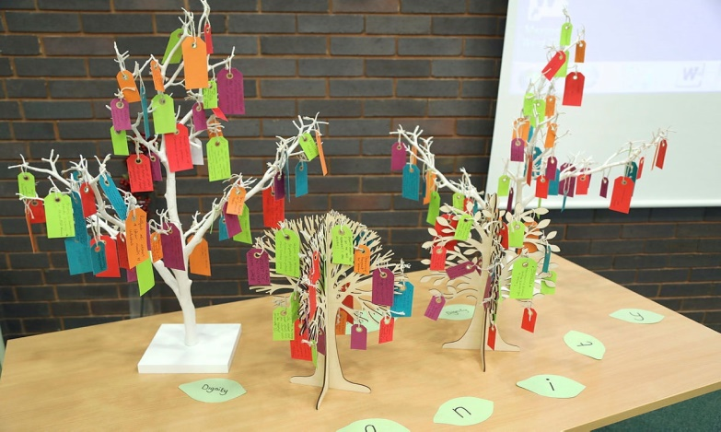
The RWT Multidisciplinary Dignity Workshop module Pilot update : Autumn 2021
Contents:
Project Team
Foreword by Jan Burns, MBE – National Dignity Council Chair
Introduction:
What is Dignity ?
Learning Objectives:
Equipment and materials
Activities 1-10
Final comments
Further reading and Tools
Dignity Commitment ( Ten Dignity Dos)
Evaluation form

Slide 3
Clinical System Framework

Slide 4
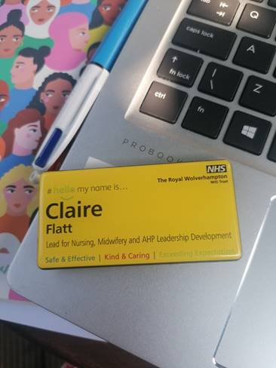
https://youtu.be/sixOl7FIhl8

Slide 5
The courage of compassion Supporting nurses and midwives to deliver high-quality care The Kings Fund
Commissioned by The RCN Foundation
Nurse and midwives have three core work needs that must be met to ensure wellbeing and motivation at work, and to minimise workplace stress:
autonomy – the need to have control over their work lives, and to be able to act consistently with their values.
belonging – the need to be connected to, cared for, and caring of others around them at work, and to feel valued, respected and supported.
contribution– the need to experience effectiveness in what they do and deliver valued outcomes.
Michael West Suzie Bailey Ethan Williams September 2020

Slide 6
Did you know? Incivility can be defined as rude or unsociable speech or behaviour, displaying a lack of regard for others (UKPHR 2019). The price of incivility is high, in a survey conducted by Porath and Pearson (2013) of 800 managers and employees in 17 professions, it was revealed that 80% of people on the receiving end lose time worrying about the rudeness and 38% reduce the quality of their work. Incivility affects more than just the recipient; it affects everyone. The survey also showed that witnesses of incivility experience a 20% decrease in performance and 50% experience a decrease in willingness to help others (UKPHR 2019).
(UK Public Health Register UKPHR (2020) The Impact of Workplace Incivility Available from https://ukphr.org/the-impact-of-workplace-incivility/)
(Porath, C & Pearson, C 2013, ‘The Price of Incivility’, Harvard Business Review, January – February, https://hbr.org/2013/01/the-price-of-incivility)

