Slide 1
Annual Conference
1st February 2016
Delivering Dignity –
Opportunity Not Challenge
Baroness Sally Greengross OBE
Member of the House of Lords and Chief Executive ILC –UK
1

Slide 2

Today 1st Feb. is National Dignity Day

Slide 3
The Dignity Council
I fully support the vision of the National Dignity Council where an environment is created where dignity and compassion are the norm.
I also fully endorse the aspirations of the Dignity Council as they seek to re-stimulate and refocus the Dignity in Care campaign.
Better training and recognition for those who work in care is essential to delivering better care and support.
.

Slide 4
The Dignity in Care Network
Incidents of people in receipt of health and social care services not being treated with dignity is an unacceptable breach of human rights.
Therefore I fully endorse the Dignity in Care campaign's core values about having dignity in our hearts minds and actions.

Slide 5
Related Dignity Campaigns
Other stakeholders have developed their own campaigns and materials that support dignity principles and dignity in care –
These Include:
Age UK
BAPEN
The Dignity in Care Commission
British Geriatrics Society
British Institute of Human Rights
Campaign to End Loneliness
Older People's Advocacy Alliance
Dementia Friends
The Malnutrition Task Force
The National Care Forum
The Relatives & Residents Assn
Royal College of Nursing
Skills for Care
WRVS
Beth Johnson Foundation

Slide 6
Inter-Generational Approach
I share the view of your Dignity Ambassador - Baroness Joan Bakewell who said :
“We need to be especially careful to instil ways of
thinking and behaving that make late years rewarding rather than punishing…….
This instinct can start young, with all generations realising that the one ahead of them deserves special consideration. After all, they will be there themselves soon…”

Slide 7
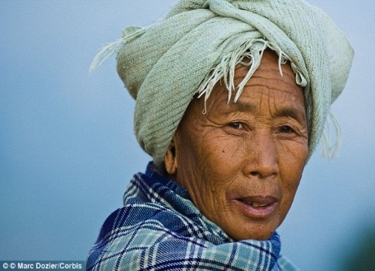
Global Ageing
  There are presently 740 million in the world aged 60 years or over.
  Within 3 years the number of 65 year olds will outnumber those under the age of 5 for the first time.
  Across the world, the number of people aged 80 plus has increased from 15 million (1950) to 110 million (2011).
  In 2014 there were 3.1m people aged 80 in Europe. In 2012, 5 million people in Africa were aged 80 or over.
Source. 'Populations Projections by the United Nations by John Wilmoth, 2015
ILC-UK Factpack 2015. 80 at Eighty

Slide 8
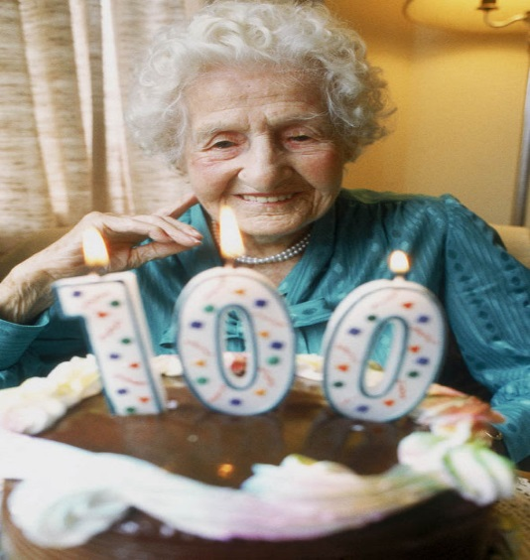
The Ageing UK Population
  Within 20 years 25% of UK Population will be aged over 65.
  The number of over 80s have risen by 800,000 in the last decade.
  The number over 100 has quadrupled over the last 30 years.
  People now spend 7 years longer in retirement than in the 1970s.
Source ONS & ILC-UK
:

Slide 9
Key facts on Social Care
Older people's social care has been cut by £2Bn in the last 10 years.
The number of people who don’t get any help at all, paid or unpaid, has increased from 800,000 in 2010 to over a million in 2015.
NHS funding has not kept pace with demographic change and growing needs. A £20 billion shortfall by 2020 is expected.
The number of emergency admissions and readmissions in hospitals is increasing.
The number of times an older person visits a GP practice has increased from seven to 13 on average in just 13 years.
Source Age UK evidence review Nov. 2015

Slide 10
The Care Issue
1.86 million people over the age of 50 in England have unmet care needs.
The numbers accessing care services have fallen by half a million since 2008/9 (a drop of 30%) despite a growing ageing population.
There are already around 1.5 million people providing over 50 hours per week of unpaid care.
The UK does not have the required infrastructure to move to a model of care that relies so heavily on family support.
Without extra investment greater unpaid caring could risk an erosion in dignity and the quality of care provided.
Source ‘The End of Formal Adult Social Care?’ ILC_UK Dec. 2015

Slide 11
The CSR and Dignity – Winners & Losers!
Damaging cuts to funding for care at home mean that many older people are sacrificing their dignity because they can’t get the support they need.
A fresh look is needed at the phasing of this investment in social care, with more in years one and two, to reduce the risk of a crisis in social care supply in 2016 and 2017.
Local authorities need to be funded sufficiently for them to rebuild preventive services for older people and offer a lot more social care support.‎

Slide 12
The CSR and Dignity – Winners & Losers!
I welcome the Government’s confirmation that the ‘triple lock’ will continue protecting the value of the State Pension.
The doubling of the Disabled Facilities Grant by the end of the CSR period to £500m, can help older people to sustain their dignity for longer - Unless they have health issues!
The 2% council tax precept to fund social care and £1.5bn extra for the Better Care Fund will not fill the existing gap in social care.
Data from 326 local authorities shows that the councils with the highest concentration of older people and unpaid carers will be the ones that will bring in the least amount of money from the 2% ctp.
– The Result may be a post code lottery of health inequality

Slide 13
Ageism - Defining the problem
In 1968 Robert Butler defined ageism as a combination of three connected elements:-
Including prejudicial attitudes towards older people, old age, and the ageing process;
Discriminatory practices against older people;
And institutional practices and policies that perpetuate stereotypes about older people.

Slide 14
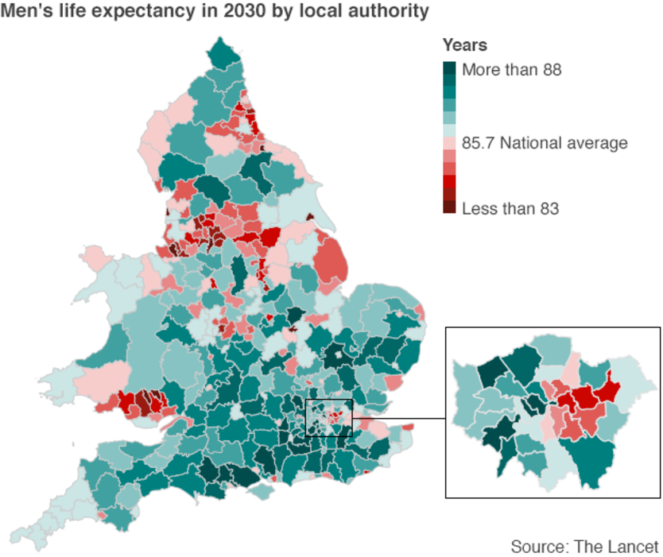
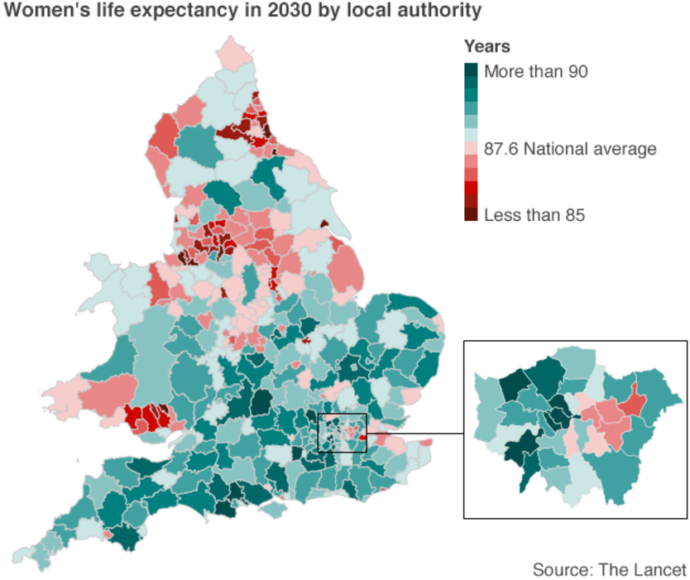
England and Wales Life Expectancy by Gender
Men are narrowing the gap on women when it comes to life expectancy.
By 2030 men will be living 85.7 years on average - just two fewer than women. In 1981 men lagged behind women by six years.
Though life expectancy is improving for both sexes, it comes at the cost of widening inequalities between deprived and affluent areas.
Sources The Lancet April 2015 and ILC-UK

Slide 15
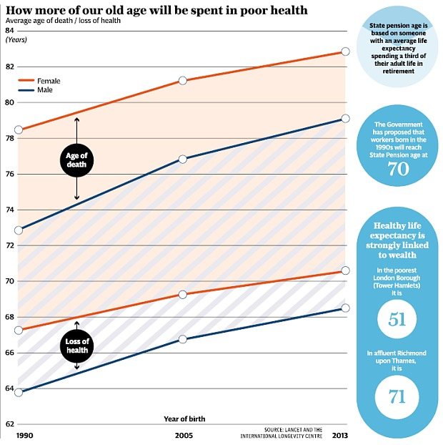
Health Inequality
Source - ILC –UK and Telegraph Money 2015

Slide 16
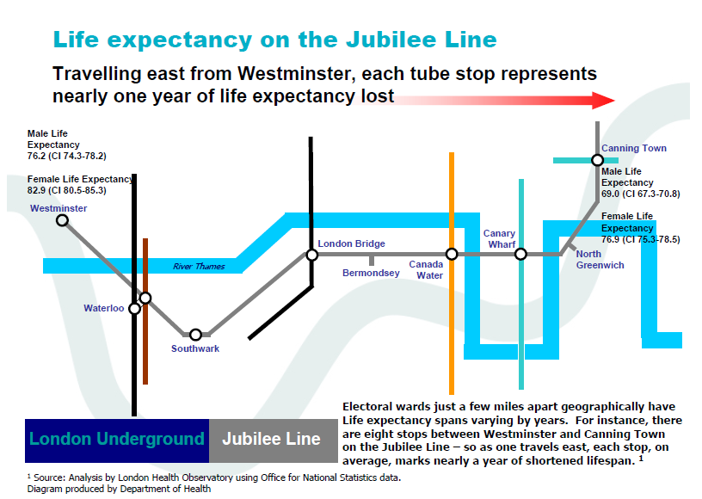
Ageism in Health Care in the UK

Slide 17
Key areas
  are :
    Health
    Wellbeing
    Empowerment/ Social Contribution
    Independence & Dignity

Slide 18
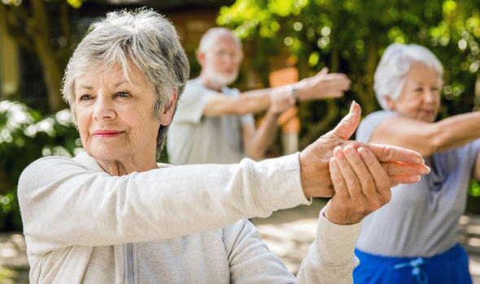
The Path Forward –
  Wellbeing,
  Empowerment,
  Education
  and Social Engagement

Slide 19
Today 1st Feb. is National Dignity Day
Human right to dignified treatment
Healthy = Dignified
Elderly or Older?
Culture specific
Personal Preference – Mrs Smith, Doris, Duck, My love!

Slide 20
DIGNITY DO’S
1. Have a zero tolerance of all forms of abuse.
2. Support people with the same respect you would expect.
3. Treat each person as an individual.
4. Enable people to maintain independence, choice and control.
5. Listen and support people to express their needs and wants.
6. Respect people’s right to privacy.
7. Ensure people feel able to complain without fear of retribution.
8. Engage with family members and carers as care partners.
9. Assist people to maintain confidence and self-esteem.
10. Act to alleviate people’s loneliness and isolation

Slide 21
Where next?
I really hope this conference will give us the opportunity to both underpin the Campaigns actions to raise awareness, inspire, share good practice, transform services and reward and recognise those people who make a difference and serve to ensure and build connectivity, so that the Dignity Champions feel empowered, resourced and are able to be utilised as a real force for change.
          Thank You

