Slide 1
THINK DELIRIUM!
Dr Lucy Hicken and Dr Emma Ryland

Slide 2
Aims
To inform you about delirium
To help you DETECT delirium
To help you MANAGE delirium
To help you PREVENT delirium

Slide 3
What is Delirium?
https://vimeo.com/31892402?lite=1
up to 04.23

Slide 4
What is Delirium?
A disturbance of consciousness and a change in cognition
Reduced ability to focus, sustain or shift attention
Short period of time – acute
Tendency to fluctuate
Hypoactive form – withdrawn, sleepy, not interacting
Hyperactive – restless, agitated, hyperactive
Mixed
Sleep disturbance
Emotional disturbance - FEAR
‘They seem more confused than usual today doctor’

Slide 5
Isn’t delirium like dementia?
Feature | Delirium | Dementia | Depression
Onset | Sudden | Insidious | Gradual
Fluctuations | Yes – over hrs | Not usually | Situational
Duration | Hours – 1 month | Months - years | Weeks - years
Cause | Acute illness - reversible | Chronic degeneration | Reactive / biochemical
Conscious level | Abnormal | Normal | Normal
Memory | Impaired | Impaired | May refuse to answer
Conversation | Often slow, inappropriate | Word finding difficulties | Sparse
Orientation | Varies | Impaired | Normal
Hallucinations | Often present | Rarely present | Rarely present
Night-time | Worse | Can be worse | No effect
Notes:
Delirium is not dementia or depression. Dementia is progressive and (currently) incurable. Depression causes people to not want to answer questions, rather than not know the answers, and comes on gradually.
Delirium has a definite cause, or more frequently multiple causes, which can usually be treated, and it is therefore potentially reversible. It also comes on more quickly and affects the conscious level of a person, which dementia does not.
Delirium is caused by many things. The list of what can cause delirium is never-ending. But there is always a cause underlying it, and the key to treating delirium is finding the cause and treating it.
The most important way to differentiate them is the speed of onset, but one would also expect the scores on cognitive tests performed once a week to stay relatively stable with dementia and depression, but alter with delirium.

Slide 6
Delirium – why it’s important
COMMON!! – affects around 10% of all hospitalised patients
40% of elderly inpatients
80% ICU admissions
Poorly recognised – 50% cases go undetected
Delirium is a MEDICAL EMERGENCY!
Doubled in-hospital mortality rate in >65s
Increased rate of hospital acquired infection
Increased length of stay
Increased risk of admission to institutional care
Can last up to 6 months

Slide 7
Why do we need Delirium Guidelines?
Evidence that we can prevent delirium in at least one third of high risk patients
Evidence that effective management reduces the severity and length of an episode of delirium and therefore reduces distress for patient, family, staff and reduces length of stay

Slide 8
Why do we need Delirium Guidelines?
NICE guidance on delirium issued July 2010
  Assess all new patients for risk of delirium
  Within 24 hours of admission initiate an individualised prevention intervention for those at risk of delirium
  Identify and diagnose delirium at admission
  Follow management guidelines including effective communication, reorientation and non-pharmacological management of distress

Slide 9
Preventing Delirium

Slide 10
Risk factors for developing delirium
Age
Pre-existing cognitive impairment
Previous episode of delirium
Current hip fracture
Current severe physical illness
Sensory impairment: hearing or visual
Please complete Delirium Care Pathway for patient with ANY ONE OF: | Tick
Age 65 years or older
Dementia or AMT score <8/10
Current hip fracture
Severe illness (a clinical condition that is deteriorating or is at risk of deterioration)
Delirium present

Slide 11
Interaction of Risk Factors and Precipitants
More risk factors = more vulnerable
Possess more risk factors
Only need minor precipitant to initiate episode of delirium

Slide 12
Prevent delirium by managing delirium risk factors
Unchangeable risk factors | Manageable risk factors
Older age | Drugs /medications
Dementia | Dehydration
Pre-hospital fracture | Pain
 | Disorientation
 | Reduced mobility
 | Constipation
 | Visual & hearing impairment
Notes:
Delirium can be prevented by management of the risk factors for delirium.
Some risk factors can obviously not be altered – age, dementia, fracture
This leaves shorter list of risk factors to focus on
The research evidence suggests that it is necessary to act on these risk factors several times a day in order to prevent delirium, rather than just once on admission. This is probably because delirium can come on quickly, over hours, and risk factors, such as dehydration, can come on after admission
Ask the audience to suggest some ways in which these risk factors could be modified.
Suggested answers are:
monitoring the oral fluid intake of each patient, at least for the first week of their admission
Make sure we offer & walk the patient to the toilet every couple of hours so that they aren’t afraid of drinking
Giving relatives a simple chart so that they can write down what the patient has drunk whilst they have been thereAsk relatives to encourage patients to drink
Check spectacles and hearing aids are there and working
Regular re-orientation to surroundings, people and events helps to reduce disorientationStimulation of the mind will also help patients keep a grip on reality
Needs to be several times a day to be effective
Think about how to bring about stimulating interaction between patients, patients and staff and patients and visitors e.g. sitting non-infected, non-sleepy patients close together, reading to them, playing simple games with them, discussing the news with them
Regularly ask about pain, bowels and need for toilet
Review medications on admission to ward, when something new is prescribed and regularly thereafter for potential delirium triggers

Slide 13
Prevent delirium by improving sensory environment
Spectacles – available and clean
Hearing aids – available and working
Cognitive stimulation
Regular reorientation
several times a day
Tell patients clearly what is happening and why before you touch them, speak slowly, use eye contact
Encourage sleep – quiet as possible, no medications at night, mobilise during day
Encourage family to bring in familiar objects and visit
Avoid bed / ward moves
} talk to patients
Notes:
See Appendix 1 in guidelines
Hospitals are very strange and busy places to patients, who are not used to them.
Increasing the amount of sensory information patients can take in in order to keep their grip on reality (which they lose in delirium) is also necessary to prevent delirium. You can help them with this. It will be especially helpful to patients who already have dementia.
Spectacles – available and clean
Hearing aids – available and working
Cognitive stimulation
Regular reorientation
several times a day
Tell patients clearly what is happening and why before you touch them, speak slowly, use eye contact
Encourage sleep – quiet as possible, no medications at night, mobilise during day
Encourage family to bring in familiar objects and visit
Avoid moving patients between wards or beds if possible

Slide 14
Prevent Delirium by using Delirium Care Pathway
Available now!
Start using it NOW!
On Intranet: Departments – Elderly Medicine – Delirium
This talk is your training

Slide 15
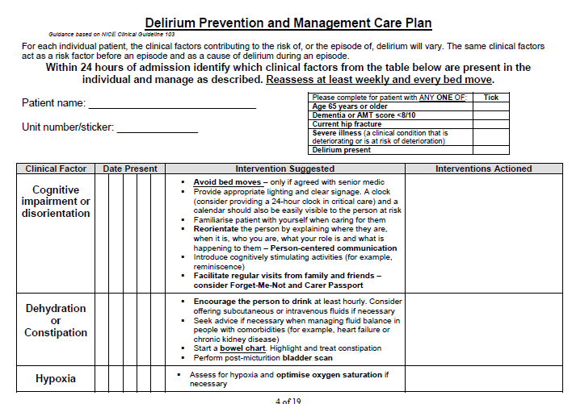
Daily Care Plan

Slide 16
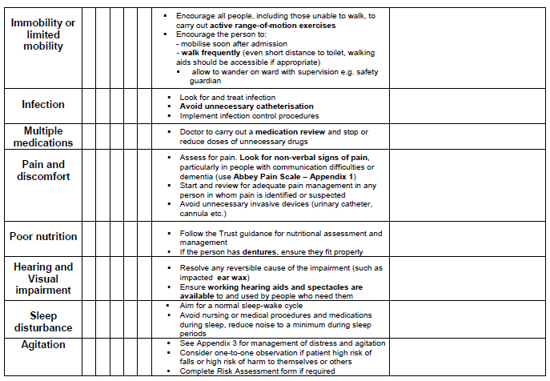
Daily Care Plan page 2

Slide 17
Diagnosing Delirium
THINK DELIRIUM!

Slide 18
Recognising Delirium
SQiD:
‘Do you think [patient] has been more confused lately?’ put to friend or family member
Perform or ask ward doctor for formal diagnosis of delirium using CAM
Complete Delirium Care Pathway
SQiD = single question in delirium

Slide 19
Recognising Delirium
Perform AMTS on all new admissions >64 years of age and all positive SQiD
If score <8/10 consider delirium or dementia
If patient “confused” “vague” “agitated” “poor historian” assume it is new = THINK DELIRIUM!
To confirm whether this is delirium:
Speak to family/carers about usual cognitive state – USE THE TELEPHONE!
Monitor cognitive state & behaviour to identify a change – SPEAK TO THE PATIENT!

Slide 20
Diagnosing Delirium
https://www.youtube.com/watch?v=M4wsPTtGeIc
https://www.youtube.com/watch?v=9QURzexhWP4 to 30 secs

Slide 21
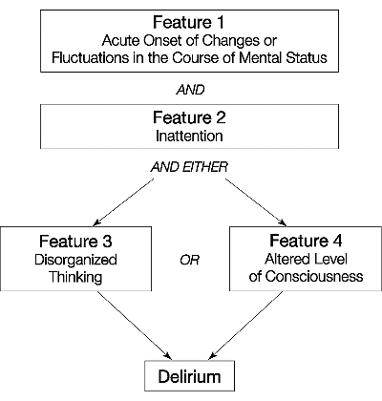
CAM Confusion Assessment Method
CAM most common delirium diagnosis tool
Sensitivity 94-100% Specificity 90-95% High inter-rater reliability
THINK DELIRIUM! Screen all patients aged 65 or over, or <65 with history of cognitive impairment, using the Confusion Assessment Method (CAM) tool below:
Feature 1: Acute onset of mental status change and/or fluctuating course (e.g. more confused than usual)
Feature 2: Inattention (difficulty concentrating, easily distracted)
Feature 3: Disorganised thinking (rambling speech, odd flow of ideas) | OR | Feature 4: Altered level of consciousness
1 + 2 + (3 AND/OR 4) = Delirium
Delirium screen positive? No Yes If Yes, complete Delirium Care Pathway

Slide 22
Frequently Asked Questions
How recent is recent?
Within the last month, but usually more recent than that.
How do I detect fluctuation?
Changes in confusion (presence/absence or severity of symptoms) over the past 24 hours have been detected by yourself or family.
Or a different state to the one you are observing has been documented by colleagues within the past 24 hours.

Slide 23
Frequently Asked Questions
What is inattention?
Examples:
- Questions must be frequently repeated because attention wanders, NOT because of decreased hearing.
- Unable to gain patient’s attention or to make any prolonged eye contact.
- Patient’s focus seems to be darting about room.
- Patient keeps repeating answer to previous question (perseveration).
- Patient is dazedly staring. When you ask a question, he looks at you momentarily but does not answer. He then continues to stare.

Slide 24
Frequently Asked Questions
What is disorganised thinking?
Rambling or irrelevant conversation – not related to the question you asked them.
Illogical flow of ideas and unpredictable switching from subject to subject during their conversation.
Incoherent speech – you are unable to make any sense of what they are saying, and they do not have a known speech disorder
N.B. Patient must be able to speak or write (e.g., not comatose) to assess this item. If they are unconscious, score them as 0.
This is NOT just disorientation to time/person/place.

Slide 25
Frequently Asked Questions
What is hypervigilance?
This is a form of abnormal conscious level, the opposite to drowsiness.
The patient startles easily to any sound or touch. Their eyes are wide open.

Slide 26
Delirium Associated Features
Sleep-wake cycle disturbance
Psychomotor disturbance
Hypoactive
Hyperactive
Emotional disturbance - FEAR
EEG abnormalities
Notes:
Delirium is often associated with a disturbance in the sleep-wake cycle, e.g. daytime sleepiness & nighttime agitation and difficulty falling asleep or excessive sleepiness throughout the day, or wakefulness through the night.
Delirium is frequently accompanied by disturbed psychomotor behaviour. Many individuals with delirium are restless or hyperactive. Manifestations of increased psychomotor activity may include attempting to get out of bed when it is unsafe, sudden movements, or groping or picking at the bedclothes (Carphology- cotton- picking at fabric & floccillation – wool- picking at the air)
The individual may show decreased psychomotor activity – hypoactive - with sluggishness and lethargy that approach stupor. They will be slow to make a movement, and slow to respond to questions, so appearing deaf, depressed, or with cognitive impairment. Hypoactive delirium has been found to carry a higher mortality rate than hyperactive, probably because the diagnosis is missed, and the patient not investigated and treated.
Psychomotor activity often shifts from one extreme to the other over the course of a day.
Comparable levels of cognitive impairment have been observed with both the hyper- and hypo-active states.
Hallucinations, delusions and agitation are somewhat more likely to occur in the hyperactive state.
The individual may exhibit emotional disturbances such as anxiety, fear, depression, irritability, anger, euphoria and apathy.
The disturbed emotional state may be evident from attacking carers, injuries from trying to escape, calling out, screaming, cursing, moaning or other sounds. These behaviours are especially prevalent at night and under conditions in which environmental cues are lacking.
In addition to laboratory findings the EEG is typically abnormal, showing generalized slowing.

Slide 27
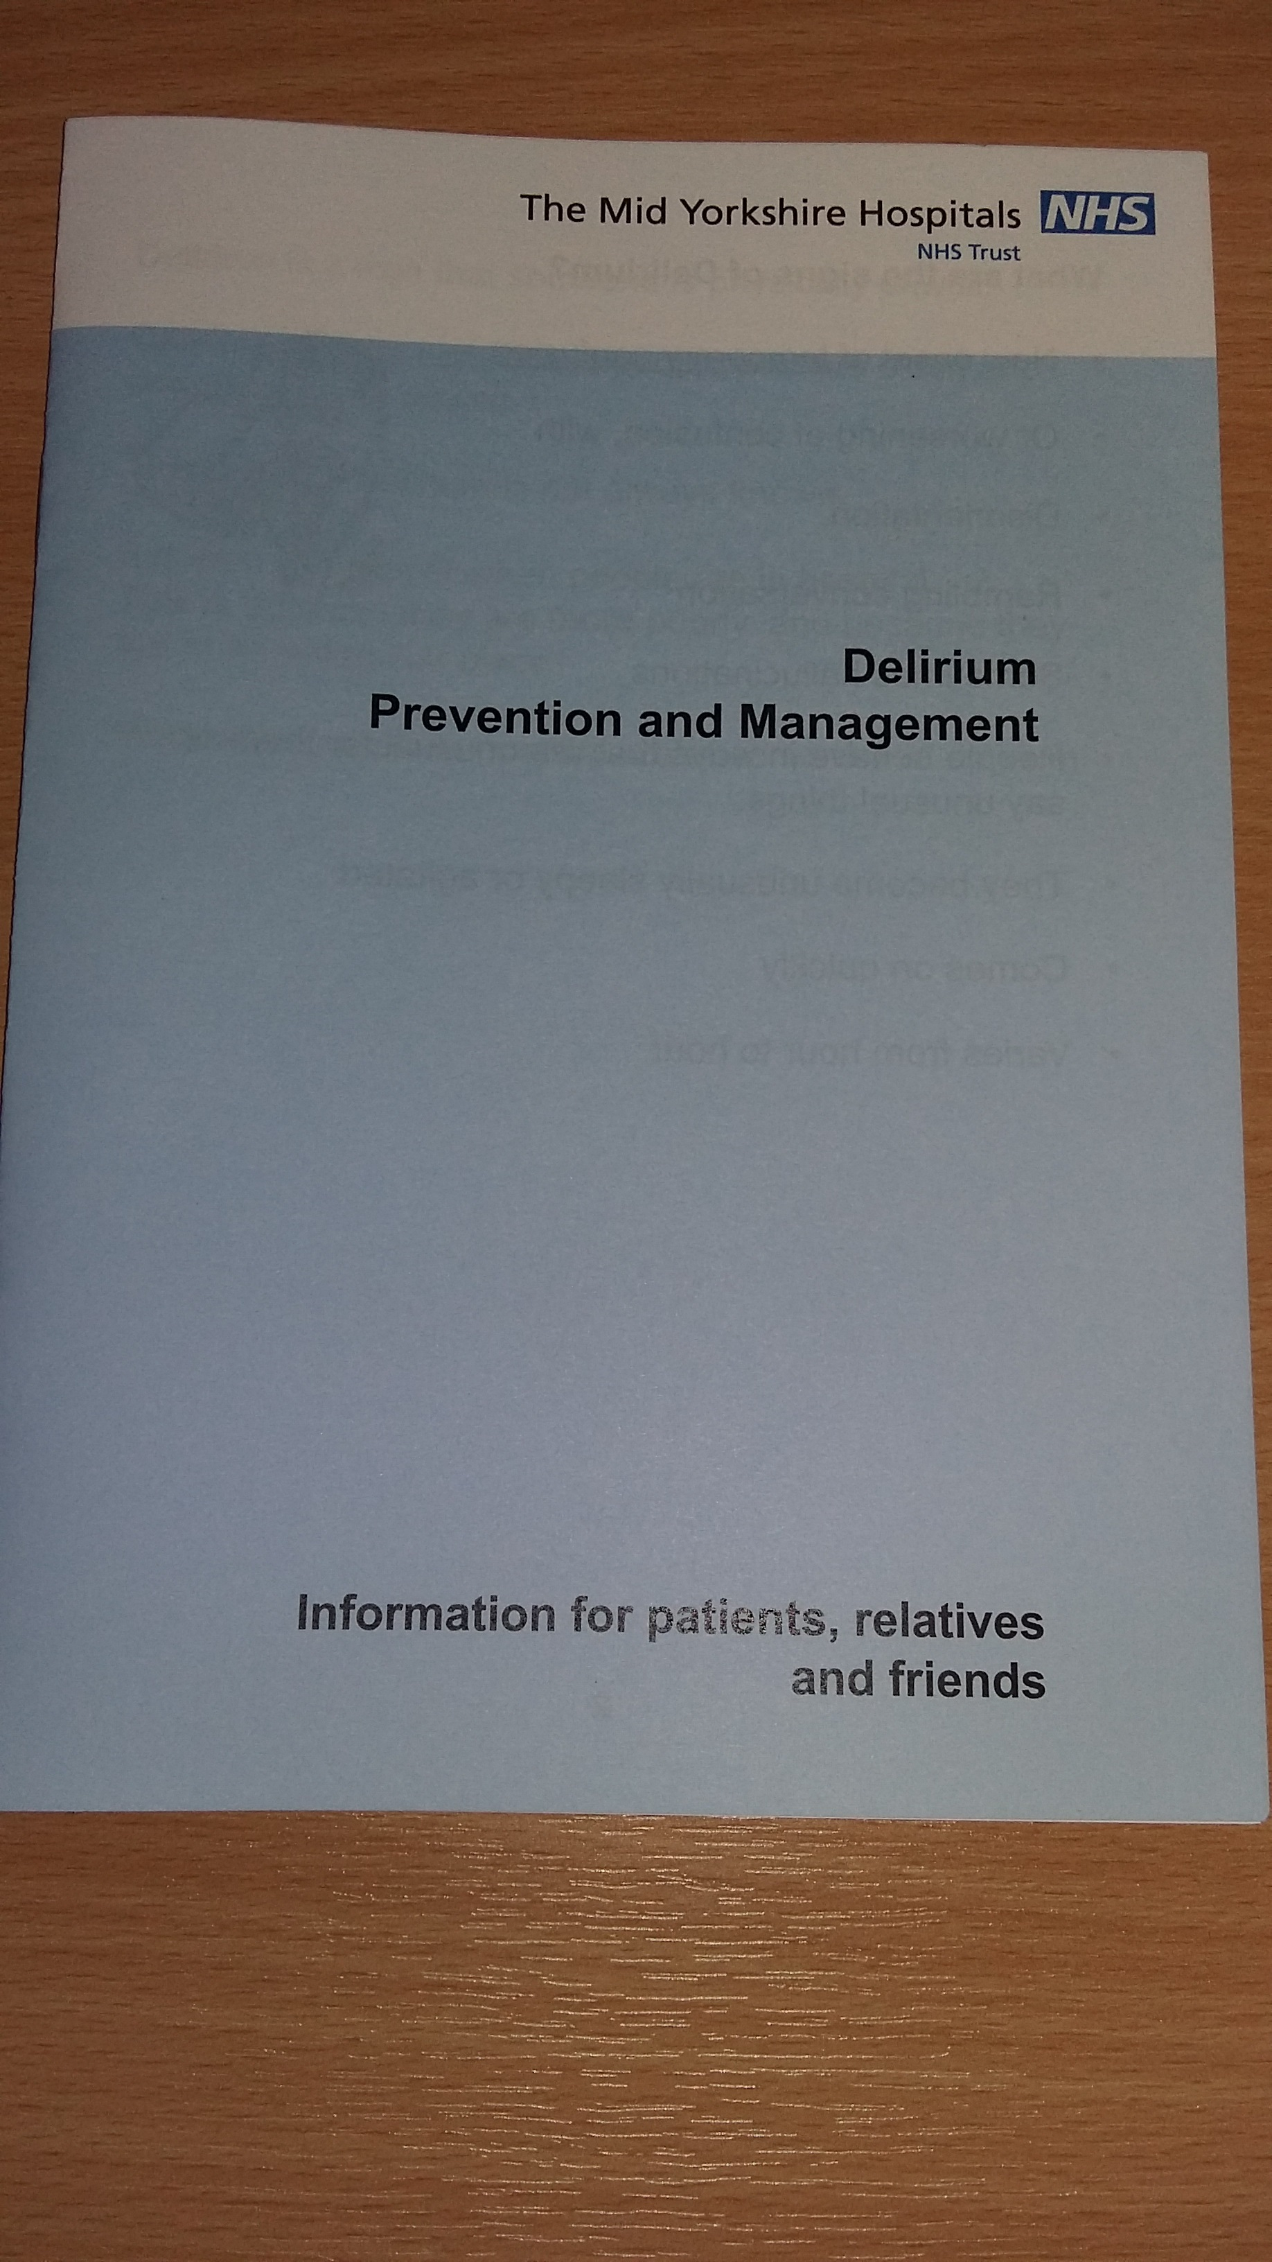
Diagnosing Delirium – What Next?
Record diagnosis in medical notes
Inform colleagues
Commence Delirium Care
Pathway
Inform patient and family (leaflet)
Investigate - Treat - Reassure

Slide 28
Investigating Delirium

Slide 29
Why is it important to identify delirium?
DELIRIUM IS A MEDICAL EMERGENCY!
IF delirium identified early & all causes treated, it frequently resolves, patients have better outcomes
Notes:
Why is it important to detect delirium ASAP?
Because:
DELIRIUM IS A MEDICAL EMERGENCY!

Slide 30
Identifying Underlying Causes of Delirium
Delirium is due to an underlying general medical condition but this is not always immediately apparent
Usually more than one cause of delirium in older patients
Risk factors become additional causes once delirium present – need to manage the risk factors as well
Notes:
“Delirium is due to an underlying general medical condition but this is not always immediately apparent” from Dr Kesavan’s guidelines on delirium
One of the reasons delirium is managed poorly is that the underlying cause can be difficult to identify. Illnesses present atypically in the elderly, and sometimes the only thing you have to go on is the presence of delirium itself.
This is why a systematic approach is necessary, with basic screening initially, and any and all abnormalities followed up with further assessment and investigation.
Remember that risk factors can become causes and that you will usually need to treat several problems at once

Slide 31
Causes of Delirium
PINCH’S ME
P pain
I infection
N nutrition
C constipation
H hydration (+urine retention)
S sleep
M medication
E electrolytes

Slide 32
Identifying underlying causes of delirium
Perform basic observations
Perform basic assessments (for urine retention, constipation, pain, distress)
History and examination (inc. neurological)
Basic investigations: ECG / Blood glucose / MSU / FBC / CRP / Blood cultures / U&E / Calcium / CXR
Medication review
Notes:
1. History
- Collateral - from family, friends, carers, other health professionals - usual cognitive function, alcohol or drug intake, possession of spectacles and hearing aids, course of episode, symptoms of underlying causes, previous episodes of delirium
- Patient - symptoms, fears, ask about hallucinations and delusions
2. Examination
- Full clinical examination
- Must include neurological examination and rectal examination for constipation and assessment for possible urine retention
- Assess cognition (AMTS / 6CIT)
- Assess nutrition and hydration
3. Essential Investigations
- Blood tests - U&E FBC LFT Calcium CRP Glucose
- Oxygen saturations
- Urine dipstick - N.B. in elderly patients it is common for uninfected urine samples to test positive for protein, blood and leucocytes - do not treat on the basis of this alone - ensure a sample is sent to the microbiology laboratory
- CXR
- ECG
4. Additional investigations - if cause not apparent or delirium not improving with treatment
- Blood cultures
- Abdominal Xray and other imaging
- CT head
- Thyroid function, vitamin B12 and folate levels
- Lumbar puncture for encephalitis or other CNS infection
- Toxicology / drug levels
EEG for non-convulsive status epilepticus or recurrent seizures, and for delirium diagnosis
This is a plan for the systematic searching for causes of delirium & all staff can contribute to it. It should be performed quickly once the diagnosis is made, as the earlier the correct treatment is started, the shorter and less severe the episode of delirium will be.
Blood glucose is a basic investigation, CT head is not – unless there are new focal neurological signs or a history of head injury
Talk about how to do a medication review

Slide 33
Managing Delirium

Slide 34
Daily Care Plan
Use same care plan to treat as for preventing delirium
On Intranet: Departments – Elderly Medicine – Delirium

Slide 35
Daily Care Plan

Slide 36
Daily Care Plan page 2

Slide 37
Managing Delirium without Medications
Communicate sensitively
- make eye contact
- respect personal space
- explain who you are and what you are about to do before you touch them
- speak slowly and clearly using simple language
- acknowledge the feelings expressed – ignore the content, change the subject
Encourage mobility and hydration
Avoid restraint

Slide 38
Managing agitated delirium
Non-pharmacological management of agitation
  nurse near nurses station OR side room
  bed moves are avoided unless absolutely necessary
  ask family to come in
  ensure lighting adequate and area quiet
  allow to wander under supervision
Consider short-term (≤ 1 week) use of haloperidol or Olanzapine to reduce severity of delirium
DON’T use to manage behaviour that challenges
Haloperidol (0.5mg PO/IM usually bd, with maximum dosing frequency every 30 minutes and maximum dose in 24 hours 2mg)
ECG should be checked for QTc immediately prior to and at least once during use as prolongation of QTc is a relative contraindication to use of Haloperidol.
Olanzapine 2.5 or 5mg (PO orodispersible Velotab once daily maximum) as a last resort.
Lorazepam 0.5mg PO /IM (if available)/sublingual where antipsychotics contraindicated - e.g. Lewy body dementia, Parkinson's disease, prolonged QTc on ECG, bradycardia and phaeochromocytoma. Titrate doses cautiously according to symptoms.
Notes:
If the patient is rambling, delusional or hallucinating tactfully disagree (if the topic is not sensitive), acknowledge the feelings expressed – ignore the content, change the subject
Avoid sedation
– increases complications (falls, fractures, pressure sores, incontinence, increased severity of delirium) – only use if absolutely essential for treatment after non-pharmacological methods have been tried

Slide 39
Resolving delirium
Monitor for improvement or deterioration
Use serial AMTS / CAM
Plus monitor features of delirium
Continue Delirium care Pathway to prevent further episodes
Notes:
Monitor for improvement or deterioration using serial CAM scores or serial assessments of the features of delirium and serial cognitive scores
Re-investigate if deteriorating

Slide 40
Ongoing delirium
Re-investigate from beginning if deteriorating
Consider opinion from liaison psychiatry 51746 (esp. if uncertain of diagnosis)or Dementia and Delirium Support nurses – 51658, 51739
At discharge:
Document episode of delirium on TTO/inform GP
Document any planned follow up from mental health team, memory clinic etc
If decision made to continue antipsychotic meds, clearly state why and follow up plan for this

Slide 41
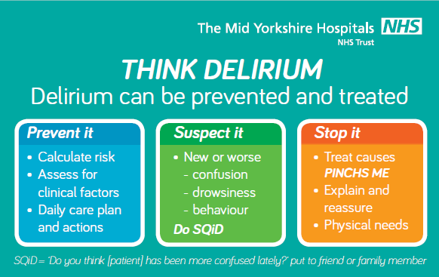
THINK DELIRIUM!

Slide 42
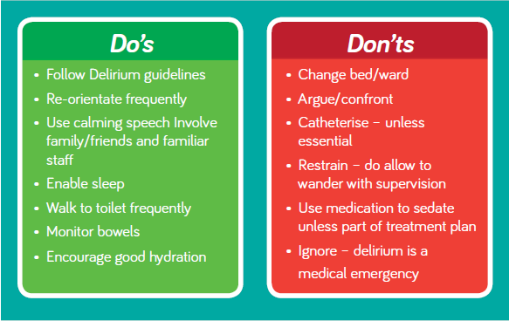
Do’s and Don’ts in Delirium

