Slide 1

National Dignity Council
Annual Conference 2014
Dignity the spice of life?

Slide 2
Jan Burns
Chair of the National Dignity Council

Slide 3
Paul Burstow MP
Member of Parliament for Sutton, Cheam and Worcester Park

Slide 4
Workshops (session 1)
Group 1 Premier Suite Dignity Do’s 8&10
Group 2 Bracebridge Suite Dignity Do’s 1&7
Group 3 Bracebridge Suite Dignity Do’s 2&9
Group 4 Bracebridge Suite Dignity Do’s 3&5

Slide 5
DIGNITY DO’s
Have a zero tolerance of all forms of abuse
Support people with the same respect you would want for yourself or a member of your family
Treat each person as an individual by offering a personalised service
Enable people to maintain the maximum possible level of independence, choice and control
Listen and support people to express their needs and wants
Respect people’s right to privacy
Ensure people feel able to complain without fear of retribution
Engage with family members and carers as care partners
Assist people to maintain confidence and a positive self-esteem
Act to alleviate people’s loneliness and isolation

Slide 6
David Pearson
President of ADASS

Slide 7
National Dignity Council Conference
Creating a system that delivers dignity
David Pearson
President of the Association of the Directors of Adult Social Services
Corporate Director, Adult Social Care, Health and Public Protection
Nottinghamshire County Council

Slide 8
About Adult Social Care
1.3 million people
1.5 million staff
2% of public expenditure and going down
£17.2 billion - £14 billion after income deducted
152 local authorities responsible for commissioning over half of care and support
A very large number of organisations providing care and support

Slide 9
Some challenges across health and care
Examples of very poor quality care
People find it fragmented and difficult to navigate
Low paid staff
Low investment in training
Concerns about the commissioning of services and whether they are properly funding
Whilst health spend has remained static social care has had to save 26%

Slide 10
Social care funding
Savings of 12% in cash and 14% due to increasing need, gone from 30% to 35% of local authority expenditure
Directors are worried that:
People who may need services will not be able to access them
Providers will get into financial difficulty
There will be more legal challenges
It will be difficult to support the NHS with the pressures
Concern that the quality of care and the quality of life may be worse

Slide 11
The national audit office – 2014 the state of social care in England
“People are living longer and have some long term and complex health conditions that require managing through care. Need for care is rising while public spending is falling, and there is unmet need. Departments do not know if we are approaching the limits of the capacity of the system to continue to absorb these pressures.”

Slide 12
Deprivation of Liberty Safeguards
People who lack capacity and are in need of continual supervision
Best Interest Assessors leading to authorisation by local authority
For people outside hospital or care home process goes to the Court of Protection
10 fold increase since Supreme Court judgement in March 2014
Dignity involves having needs assessed in timely manner
In discussion with the Government about resources to meet increased need and changed in the law.
Value of lasting power of attorney
Some better news…

Slide 13
The Care Act sets a template for future care
Promoting health and wellbeing
Giving people choice and control through person-centred, co-ordinated care and support integrated, joined up approaches between health care and other services
Integrating health and care and other public services

Slide 15
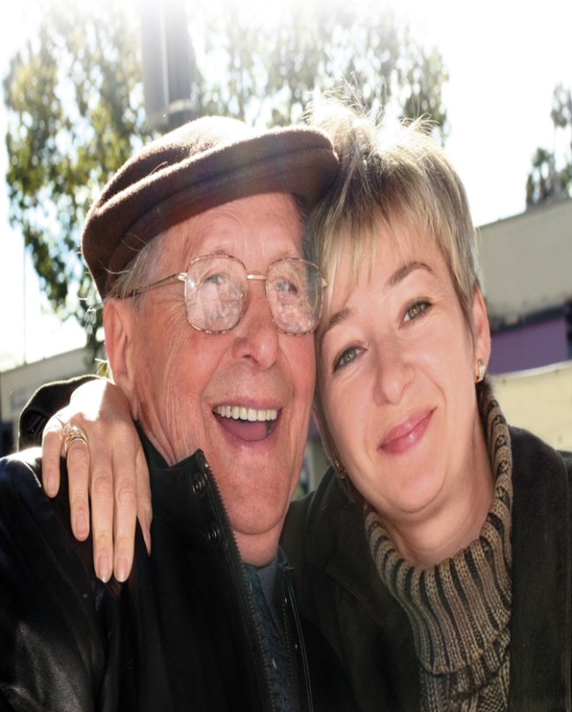
The Care Act
Changes 2015/16
Prevention and early intervention
Advice and information
Assessment and eligibility
Carers services
Deferred payments
Personal budgets
Safeguarding
Social care in prisons
Responsible for a sustainable, improving market and one in which the terms and conditions of staff are consistent with high quality care

Slide 16
The Care Act
Changes 2016/17
Change the financial threshold for means tested care from £23,250 to £118,000
Cap on care costs of £72,000, although there will be some costs, accommodation will remain
A policy that extends the arm of the state, but spreads the reducing funding even more thinly, is not a dignity policy
Care and support in this country is malnourished
We need to decide as a nation whether we really believe in dignity because this is partly represented in the level if investment

Slide 17
What is the approach?
Good advice and information
Prevention, early intervention and helping people in crisis
Assessment of needs, indicative budgets for people and support planning
Providing a personal budget, through a "managed budget" or a Direct Payment
Building community capacity through social action, supporting informal carers, neighbourhood and community action and support

Slide 18
Some of the answers
New regime for Care Quality Commission
Joining up care to meet best outcomes
Make Care a career choice
Invest in training
Link the level of investment in care to that of health
Help people to explore and manage the risks
Combat discrimination including disability hate crime
National awareness campaigns
Create a bigger social movement
Dignity in care from 55,000 to 550,000
Every Britain counts

Slide 19
Personalise services
This means from being person-centred to giving people the money to manage care if they wish
2001 – Mandatory for local authorities to offer a direct payment
2008 – Putting people first
2009 – People who lack capacity entitled to direct payments

Slide 20
Joint announcement of NHS, ADASS, Local Government Association and Think, Local, Act Personal (a partnership of over 40 national organisations promoting personalisation of services) for integrated personal health and care budgets.
“North of 5 million”
  “We need to stop treating people as a collection of health problems and treatments. We need to treat them as individuals whose needs and preferences should be seen in the round and whose choices shape services, not the other way round”
  Simon Stevens, July 2014

Slide 21
What the impact can be
Mrs K is 84 years old, has been diagnosed with dementia and has a range of other health problems. Following a fall she was admitted to hospital and from there to a step up bed in a care home and was at risk of remaining in long term residential care.
With input from Short Term Assessment and Reablement Team brokerage, her husband chose one of three agencies that expressed an ability to offer home based support to Mrs K on her discharge. Mrs. K was discharged home with a direct payment with her husband acting as her Suitable Person. The care agency Mr K chose provides daily support mornings and evenings. Total cost of direct payment £147 per week.
Joint project between Nottinghamshire County Council and Alzheimer’s Society to promote use of Personal Budgets for people with dementia. This showed that:
  Personal Budgets for people with dementia can be very cost effective. Case studies evidence that people with dementia and other health conditions can live in the community with the right support, at comparable or less cost than in residential care
  Factors that make community and home based support effective in maintaining people with dementia at home - reliability, continuity of carers, trust and consistency

Slide 22
What the impact can be (cont’d)
Mr D. has Lewy Body dementia and gets anxious and agitated when his routine changes. His mobility is also very slow. He has recently been discharged home after 26 weeks in hospital after being admitted with a severe leg infection causing him to hallucinate and not recognise his family.
He was keen to remain independent at home for as long as possible, but is aware he has memory difficulties.
A direct payment was put in place with his daughter acting as a Suitable Person. She is using a prepayment card to manage the direct payment finances. Following input from START brokerage a support agency was identified that could provide practical support and personal care and could work around his need for consistency and reliability of carers. Total cost of Direct Payment £175 per week.
  Personal budgets can help people to remain at home who previously would have been in a care home
  START brokerage helps to source the support of choice
  The prepayment card is a way of making the direct payment more manageable and reduces transaction costs

Slide 23
So … to culture
Starts with leaders – the single biggest factor is the quality of the manager
Training and development including awareness through the lens of the service user
Dealing with different behaviour
Leadership is about setting an example and challenging poor practice – but this is everyone’s job
Supervision involves considering emotional impact and not just tasks

Slide 24
Some thoughts …
Dignity is not just about care but how we, as a nation, treat all with respect and make every citizen count
Public services need to work with citizens and communities to add quality to life not just years to life
Dignity is about being treated with compassion and respect but more than this – helping to maintain independence, choice and control
It is about the sensitivity of services across public services, in families, neighbourhoods and communities

Slide 25


Slide 26

ADASS Business Unit
Local Government House
Smith Square
London SW1P 3HZ
Tel: 020 7072 7433
Fax: 020 7863 9133
EMAIL: team@adass.org.uk WEB: www.adass.org.uk

Slide 27
Gillian Moncaster
Dignity Council Member

Slide 28

Winston Churchill Fellowship
South Africa 2014
Gillian Moncaster
Dignity Lead
Manchester City Council

Slide 29
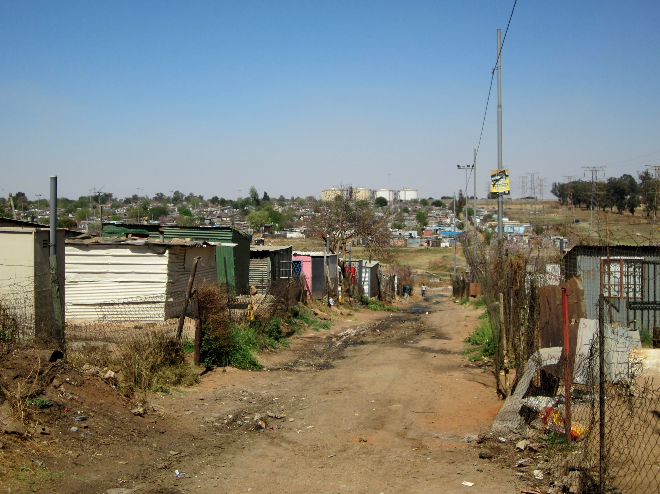


Slide 30
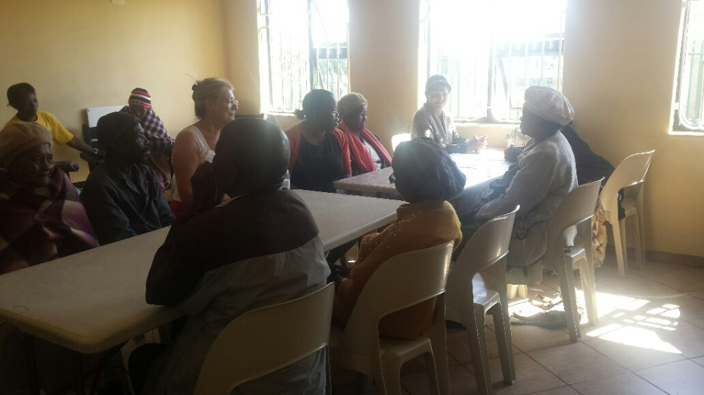
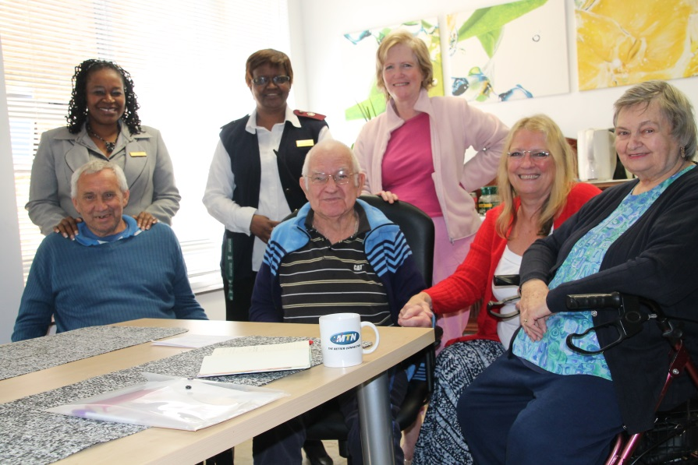
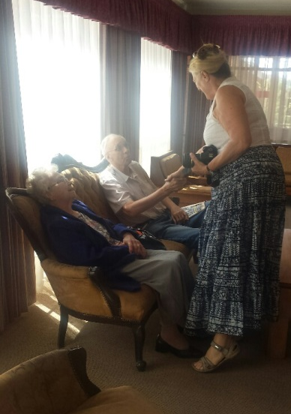
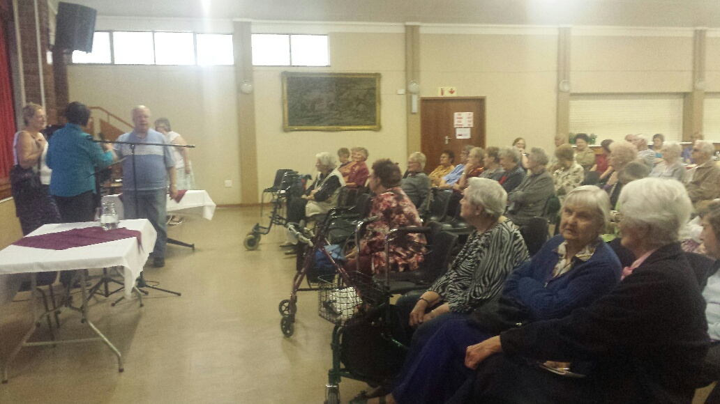
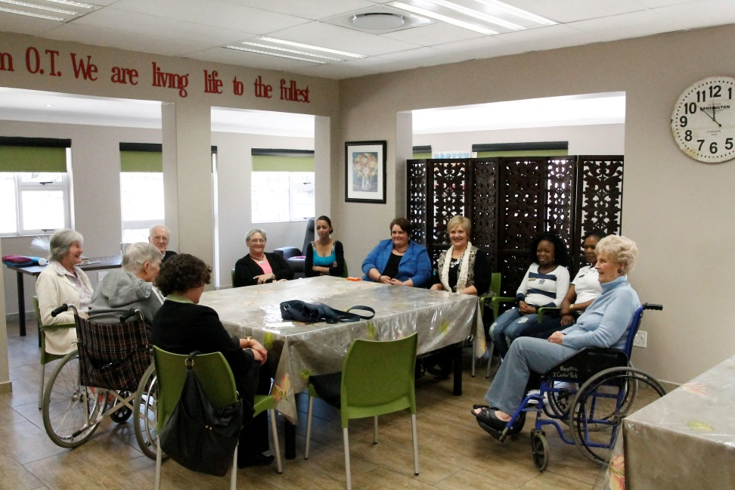
Talking to the residents

Slide 31

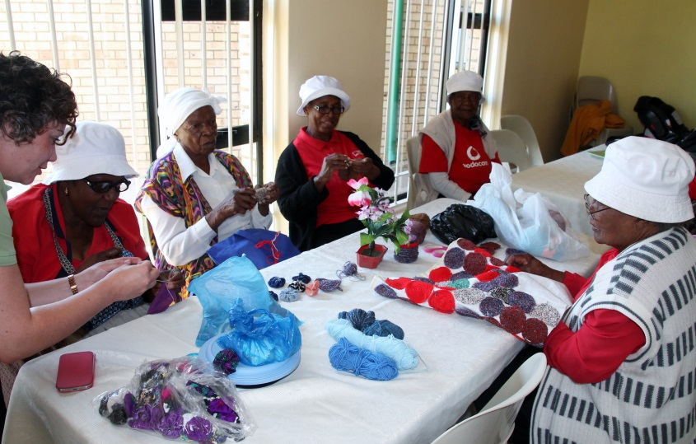

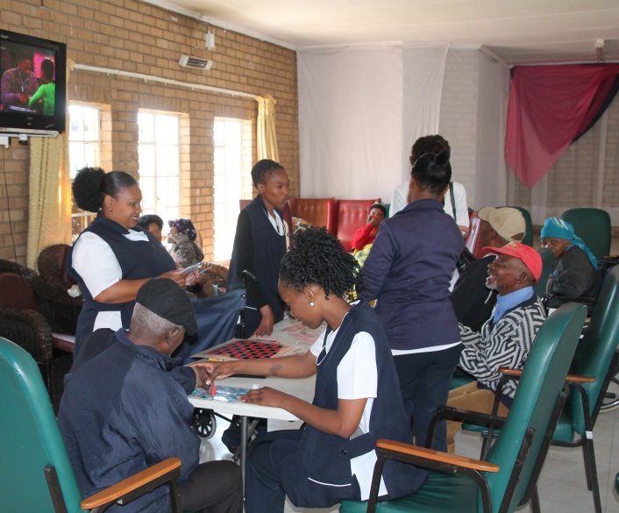

Contrasting outlooks - but…

Slide 32
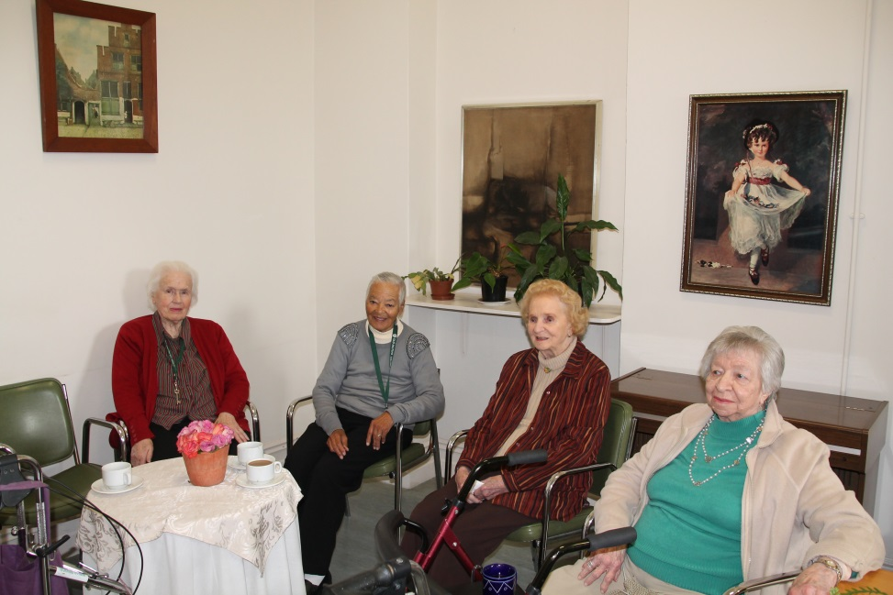
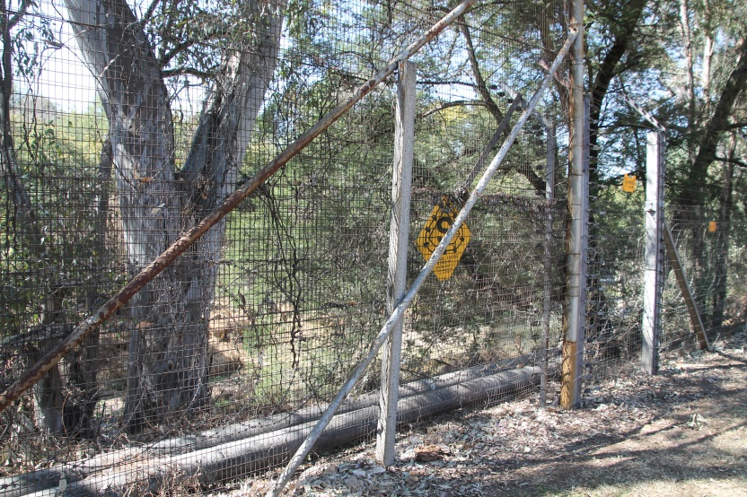

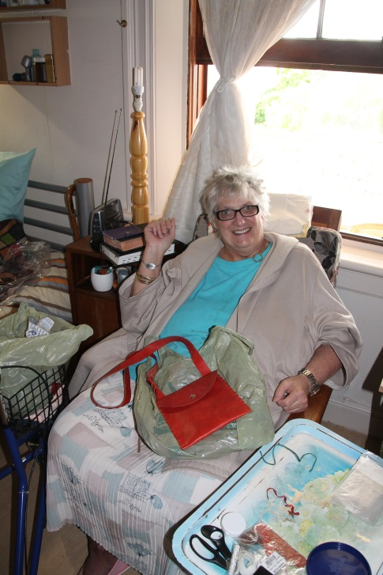
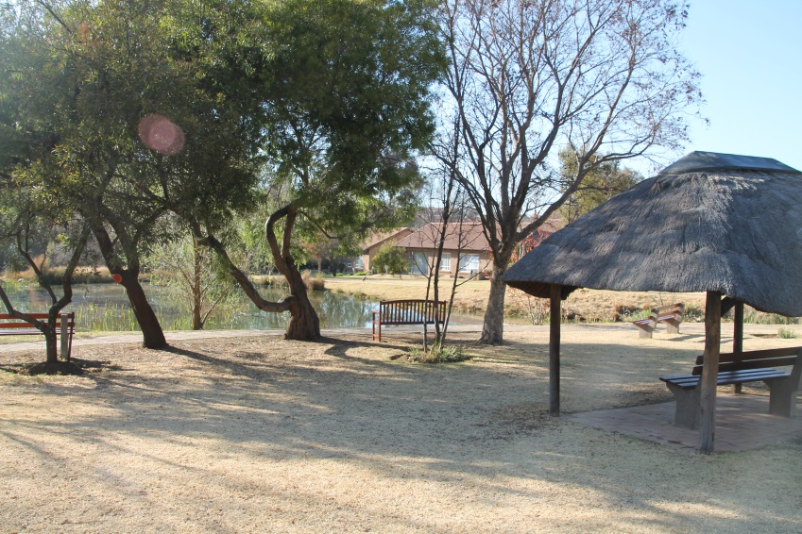
Contrasting outlooks - but…

Slide 33
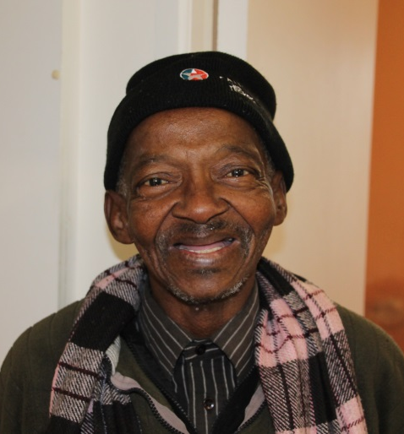
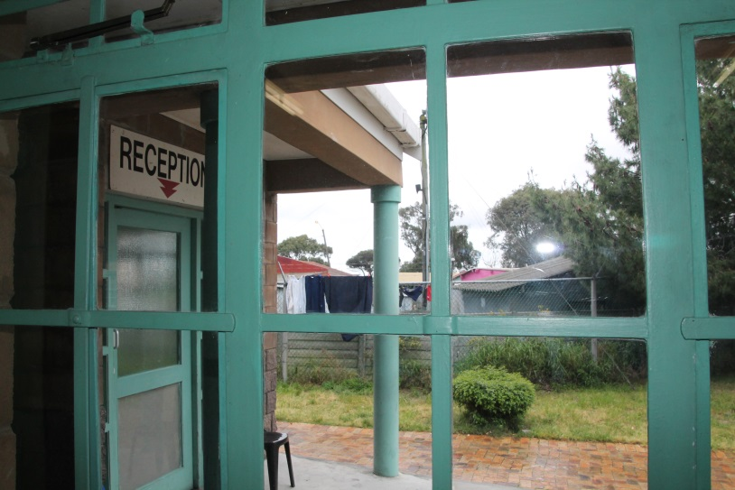
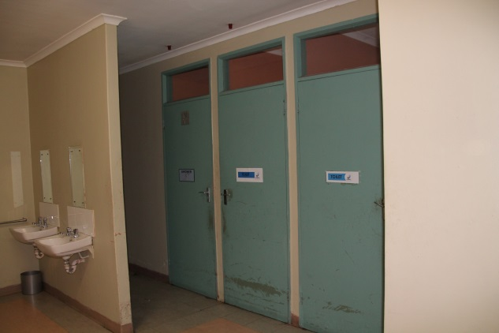
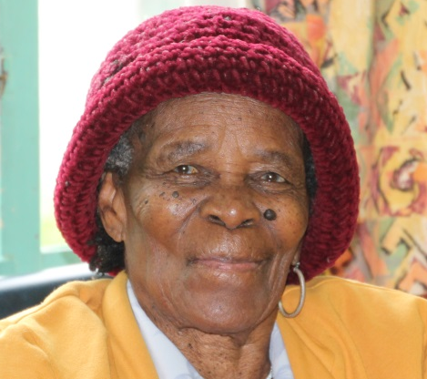
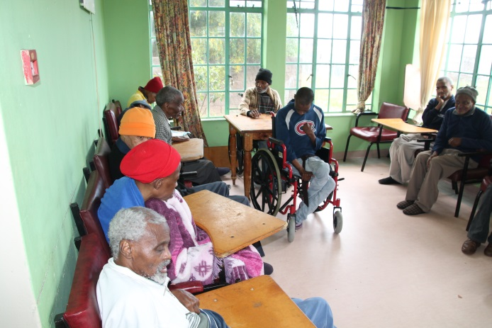
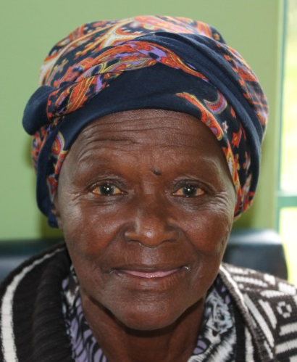
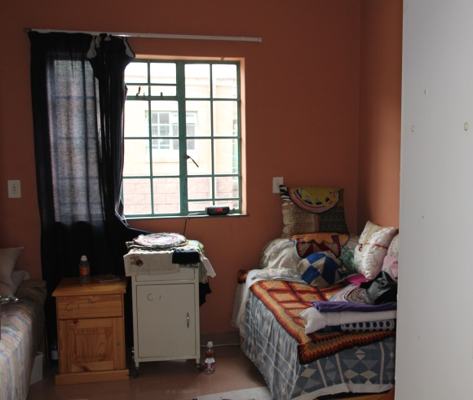
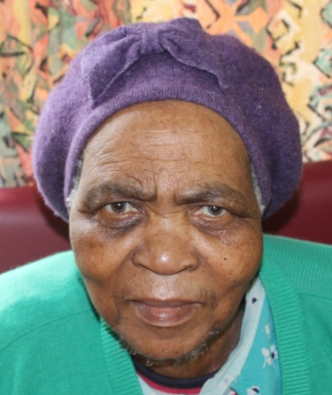
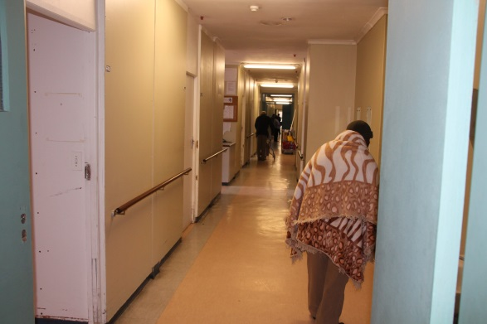
Work in Progress….

Slide 34
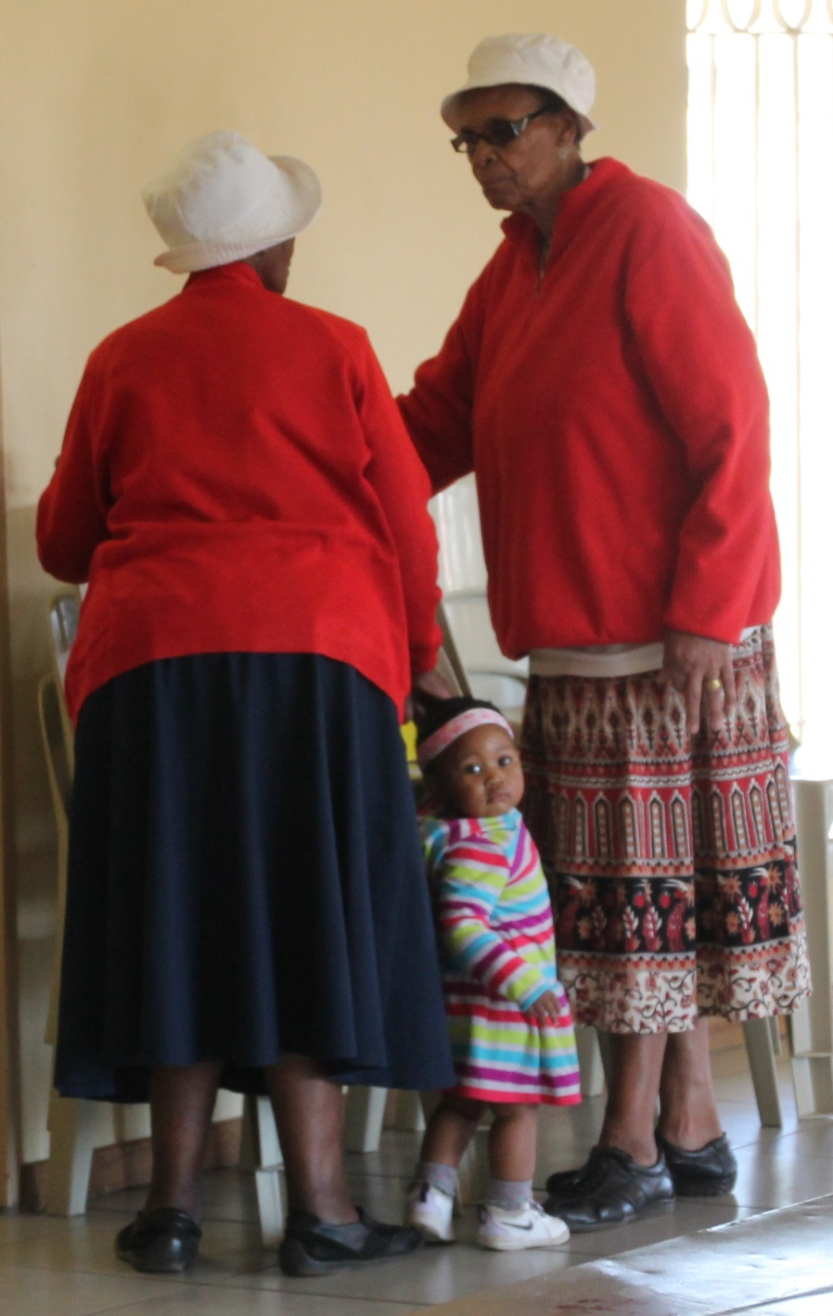
The Missing Generation

Slide 35
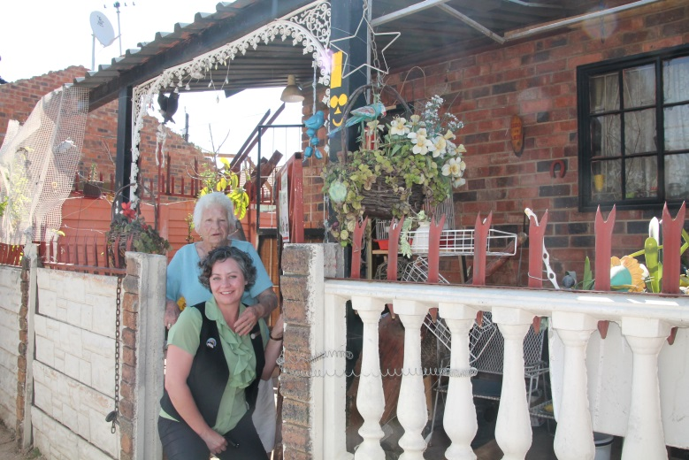
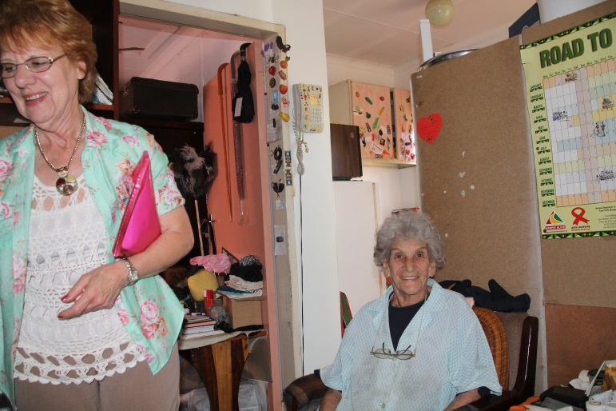
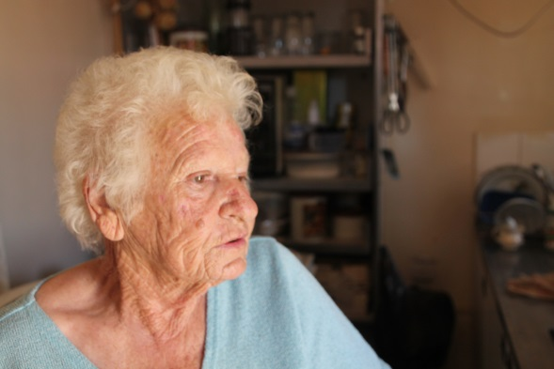
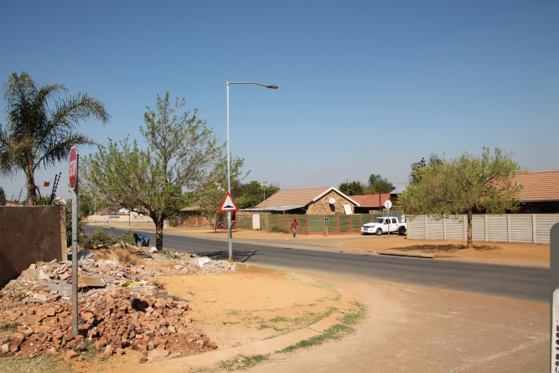
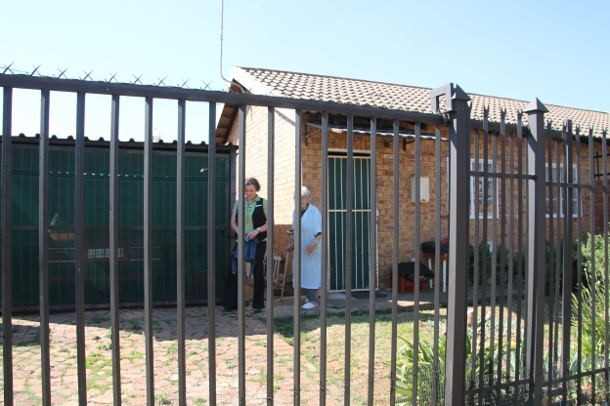
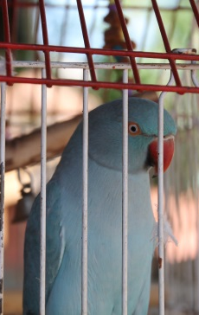
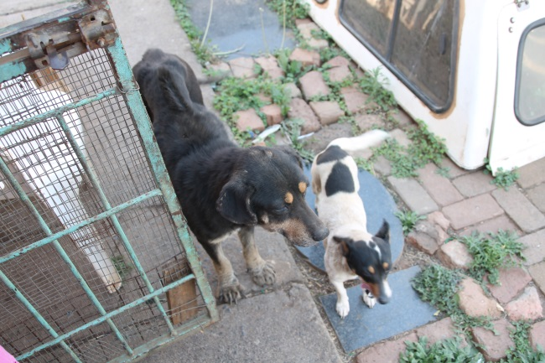
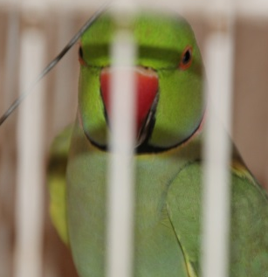
Support at Home?

Slide 36
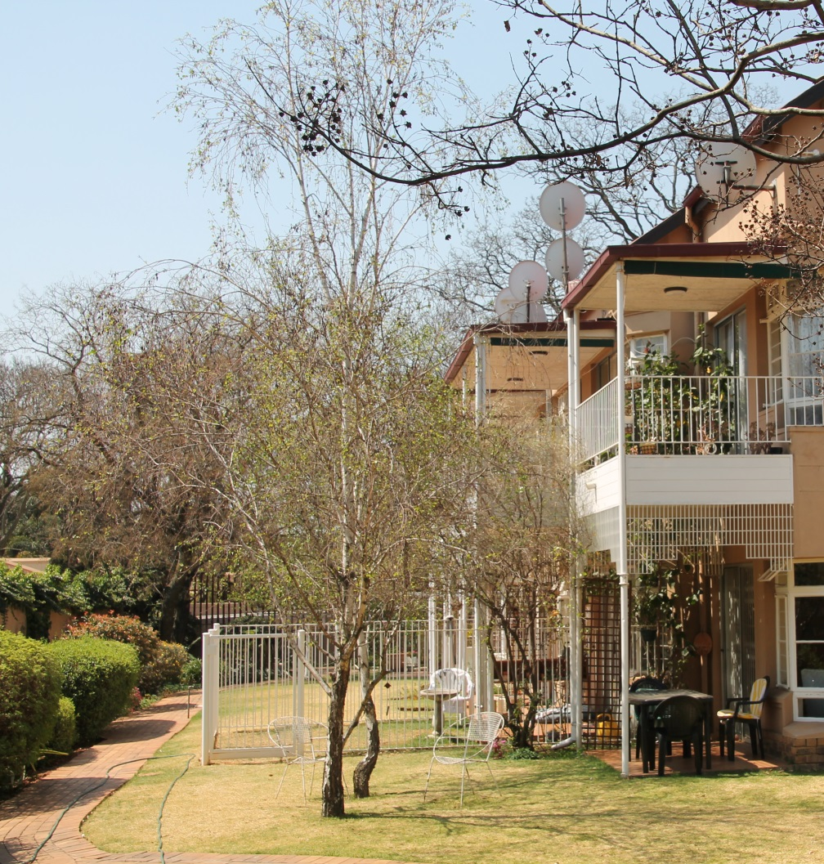
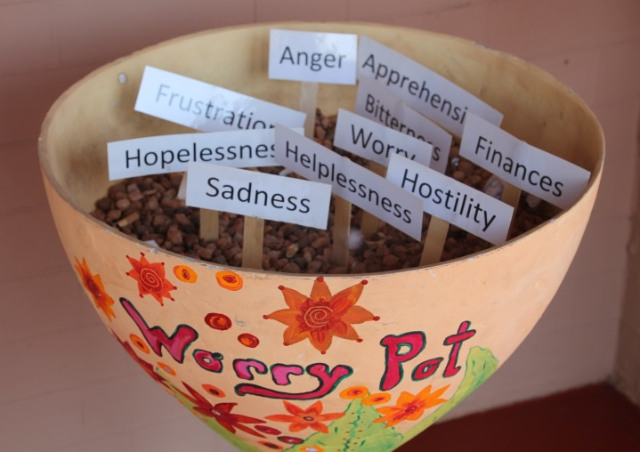
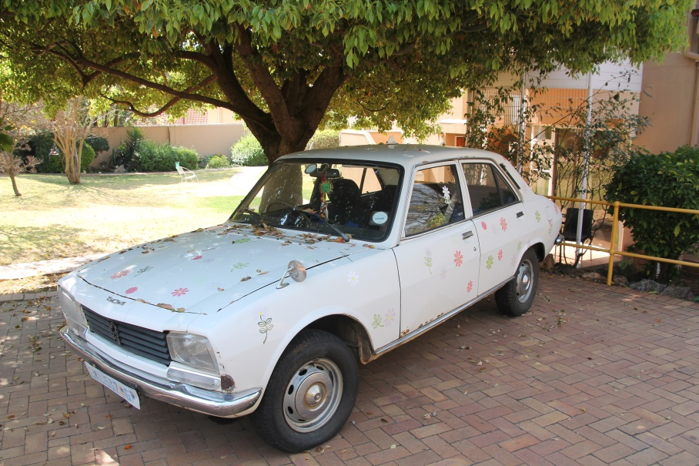
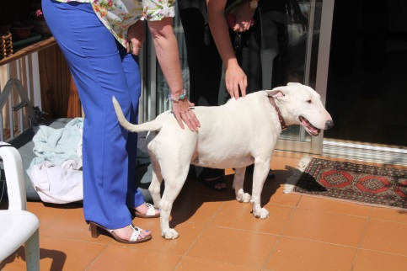
Dementia Homes

Slide 37
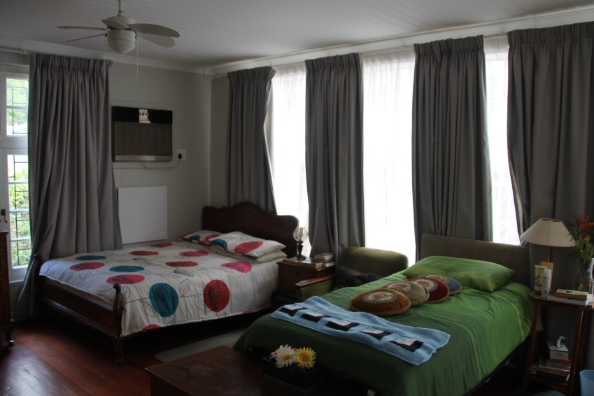
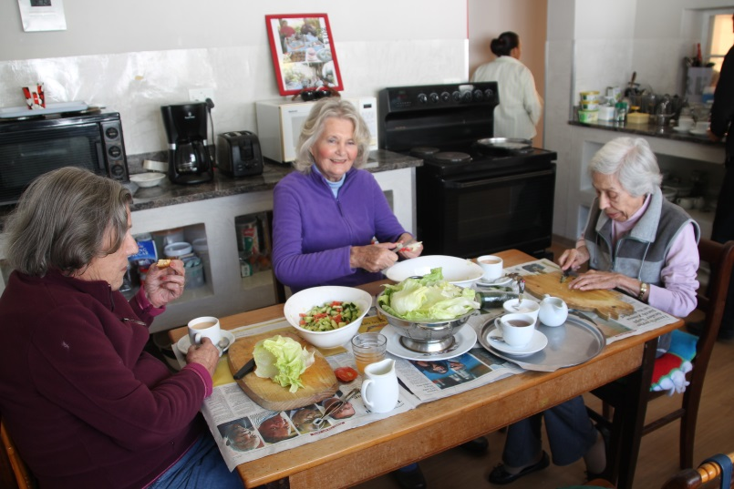
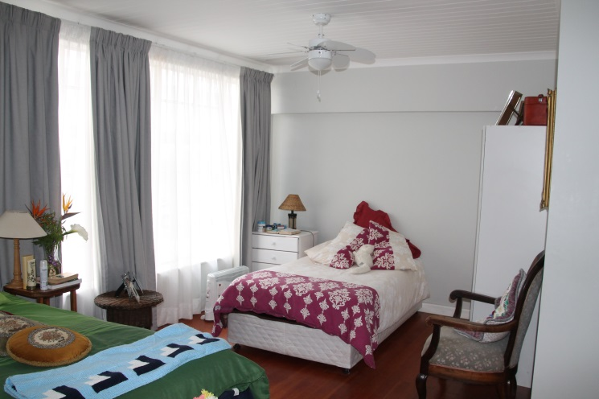

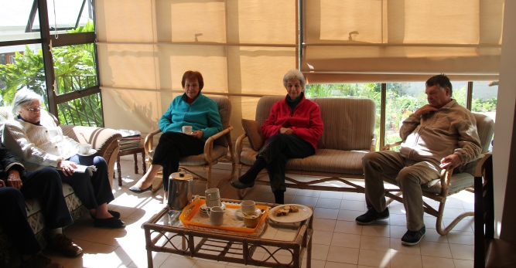
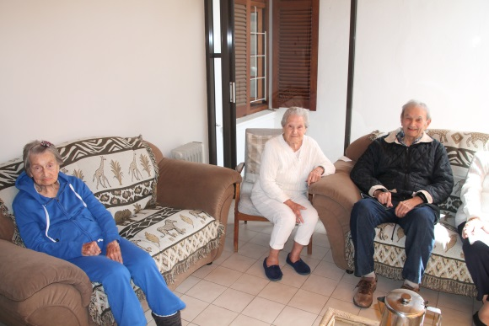
Dementia Homes

Slide 38

The end….. and the beginning!
We can
ALL
make a difference

Slide 39
Sue Howard
Interim Deputy Chief Inspector
Of Adult Social Care
Care Quality Commission

Slide 40

National Dignity Conference
CQC new approach
Sue Howard
14 October 2014
40
Notes:
40

Slide 41


Our purpose and role
Our purpose
We make sure health and social care services provide people with safe, effective, compassionate, high-quality care and we encourage care services to improve
Our role
We monitor, inspect and regulate services to make sure they meet fundamental standards of quality and safety and we publish what we find, including performance ratings to help people choose care
41

Slide 42
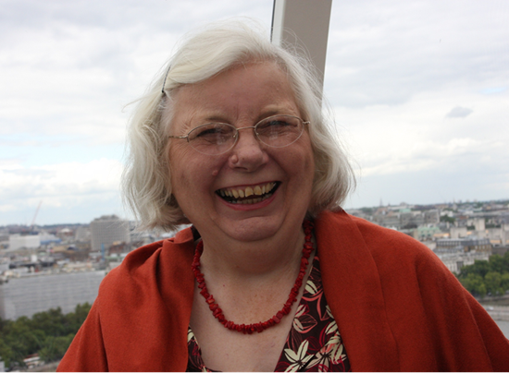
The Mum Test
Is it responsive to people’s needs?
Is it good enough for my Mum?
Is it
effective?
Is it safe?
Is it
well-led?
Is it caring?
My Dad? My Nan? My brother? My friend? Me?
Andrea’s Mum!

Slide 43
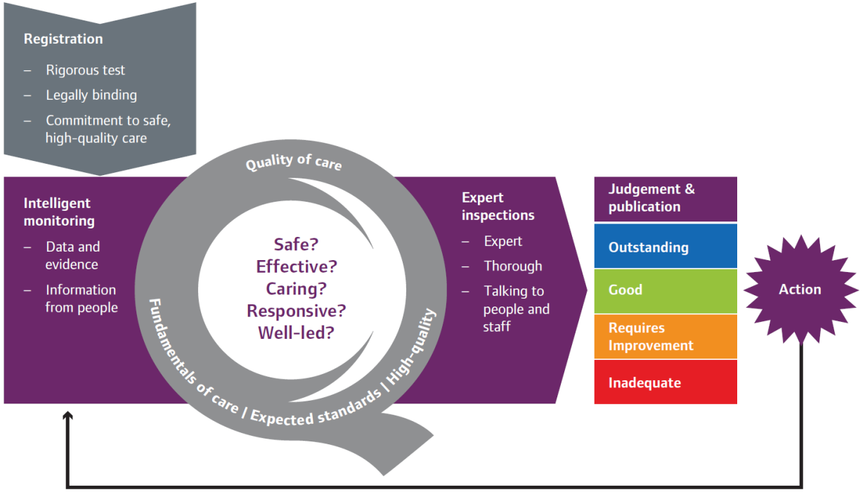
CQC operating model

Slide 44
What will be different
Now | Future
Outcomes | 5 key questions – Safe, Effective, Well led, Responsive & Caring?
Guidance about compliance | KLOEs (21 in total, 16 mandatory) and characteristics of ratings
Focus on compliance | What good looks like – quality, improvement and ratings
Reporting non-compliance | Report answers 5 questions and mum’s test
Annual inspection | Frequency determined by ratings 6 months to 2 years
Ongoing monitoring | Improved by better information

Slide 45
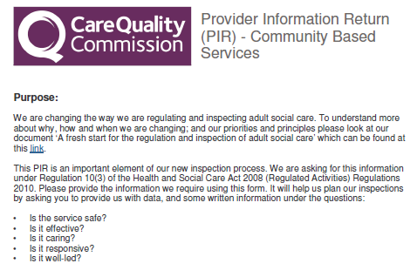
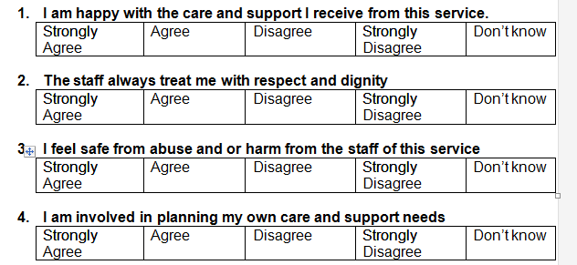

What will be different:
The PIR and questionnaires
Provider information return:
  Provider
Questionnaires:
  People who use the service
  Family and friends
  Staff
  Community professionals
Aligned to the 5 key questions

Slide 46
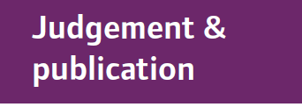
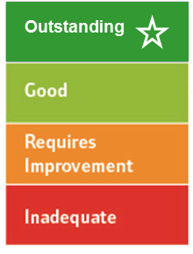
Four point scale
High level characteristics of each rating level
Innovative, creative, constantly striving to improve, open and transparent
Consistent level of service people have a right to expect, robust arrangements in place for when things do go wrong
May have elements of good practice but inconsistent, potential or actual risk, inconsistent responses when things go wrong
Severe harm has or is likely to occur, shortfalls in practice, ineffective or no action taken to put things right or improve
46
Notes:
Following each inspection, we will judge whether services are outstanding, good, requires improvement or are inadequate.
We have developed characteristics to describe what each of these ratings looks like (

Slide 47
Caring KLOE - How is people’s privacy and dignity respected and promoted?
Caring KLOE – Residential Services (C3)
How are people assured that information about them is treated confidentially and respected by staff?
Do people have the privacy they need?
Are people treated with dignity and respect at all times?
Can people can be as independent as they want to be?
What arrangements are there for making sure that the body of a person who has died is cared for in a culturally sensitive and dignified way?

Slide 48
Caring KLOE – Residential Services (C3)
Do staff understand and promote respectful and compassionate behaviour within the staff team?
Are people’s relatives and friends able to visit without being unnecessarily restricted?
How does the service make sure that staff understand how to respect people’s privacy, dignity and human rights?

Slide 49
Timetable
Oct 2013 – March 2014
Co-production and development to shape consultation proposals
April 2014
Consultation on regulatory approach, ratings and guidance
April –
May 2014
Wave 1 pilot inspections
June 2014
Evaluation; guidance and standards refined.
July – Sept 2014
Provider guidance consultation. Wave 2 pilot inspections, initial ratings of services
Oct 2014
New approach fully implemented and indicative ratings confirmed
March 2016
Every adult social care service rated

Slide 50

  Why does this matter?
People are at the heart of it
50

Slide 51


Get involved
enquiries@cqc.org.uk
@CareQualityComm
www.cqc.org.uk

Slide 52
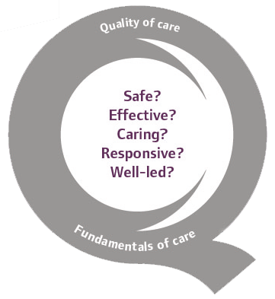
  Thank you
www.cqc.org.uk
Sue Howard
Interim Deputy Chief Inspector of Adult Social Care
52

Slide 53
Workshops (session 2)
Group 1 Premier Suite Dignity Do’s 1&7
Group 2 Bracebridge Suite Dignity Do’s 2&9
Group 3 Bracebridge Suite Dignity Do’s 3&5
Group 4 Bracebridge Suite Dignity Do’s 4&6

Slide 54
DIGNITY DO’s
Have a zero tolerance of all forms of abuse
Support people with the same respect you would want for yourself or a member of your family
Treat each person as an individual by offering a personalised service
Enable people to maintain the maximum possible level of independence, choice and control
Listen and support people to express their needs and wants
Respect people’s right to privacy
Ensure people feel able to complain without fear of retribution
Engage with family members and carers as care partners
Assist people to maintain confidence and a positive self-esteem
Act to alleviate people’s loneliness and isolation

Slide 55
The Way Forward – Getting Connected

Slide 56
Plenary: Panel of Council Members

Slide 57
Thank you for attending the National Dignity Council Annual Conference
Have a safe journey home and hope to see you again next year

